Slide 1
Accessibility Testing with Wave
Kara Harkins
July, 2019
#DrupalGovCon @kara_h

Slide 2
Getting a bit meta …
Background and Installing WAVE
Using WAVE
WAVE Examples
Other Accessibility Issues
Q&A sections are after each section
Note that examples are for web but can help with general accessibility (like alt text).
I am always finding things to tweak on my own pages. Accessibility is never done.

Slide 3
Background and installing WAVE

Slide 4
BACKGROUND
WCAG 2.0 (3 levels)
  Level A → Good!
  Level AA →Yay!!
  Level AAA → WOW!!!
ADA
Section 508
  Current version is basically a copy/paste of WCAG 2.0
  Required for government and some others

Slide 5
Main disability Issues
Hearing
Vision
Color Blindness
Physical Ability
Cognition (Often hardest accessibility issues for reengineering sites)
Neurodiversity (can include autism, ADHD, etc)
Learning Disabilities
Yes, temporary disabilities are included

Slide 6
Why care?
Access for all is A Good Thing
Promotes good coding
See getting buy-in

Slide 7
How to Convince Others (getting buy-in)
A must if government (and some others)
What if your main user were temporarily disabled?
What if a new user is disabled?
What if a developer becomes disabled?
More users that can access site

Slide 8



CMS (Content Management systems)
Big help with accessibility as they already handle many things so you can focus on accessibility of content
Drupal of course (8 is great)
Wordpress
Joomla!
Various PHP/MySQL based systems
Commonspot, etc ….

Slide 9
Testing
Can you navigate without a mouse?
Is your HTML correct?
Run WAVE or another tool.
BEST test: tests by people with various disabilities

Slide 10
WAVE Installer
Extensions available for:
Chrome
Firefox
Some Chromium based browsers like brave (edge will be chromium based eventually)
https://wave.webaim.org/extensions for more details
If none of these apply use https://wave.webaim.org
These URLs will also be on the next slide.

Slide 11
Questions so Far? Install WAVE or Use Form
https://wave.webaim.org/extensions or https://wave.webaim.org
Start playing with it.
#DrupalGovCon
@kara_h

Slide 12
Using WAVE

Slide 13

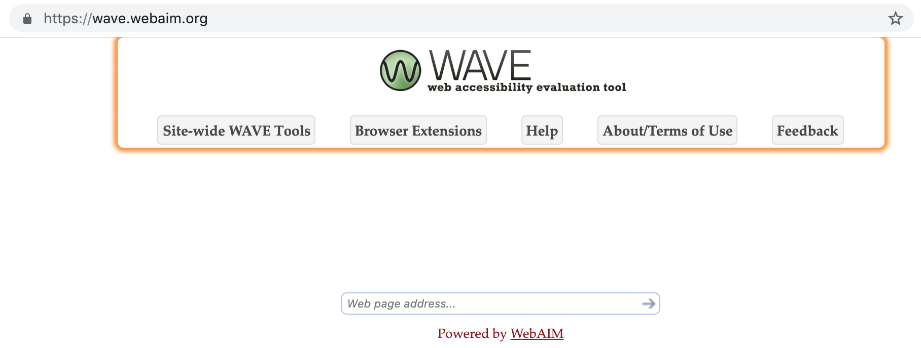
WAVE interface
In a browser click this:
OR
If no extension go to https://wave.webaim.org and use this:

Slide 14
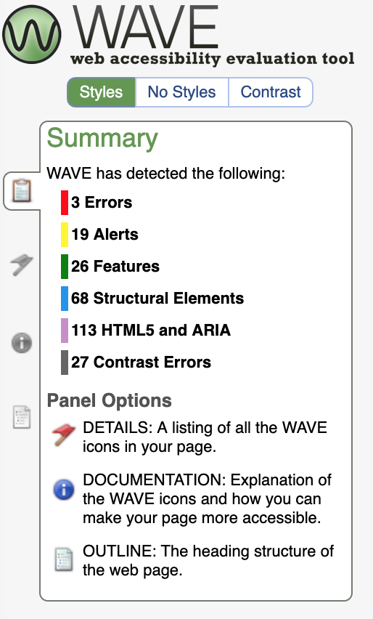
You Will Now See This on the Left
This is the summary panel and is shown by default.
No styles is your page without styles loaded.
Contrast is for looking up color contrasts.

Slide 15
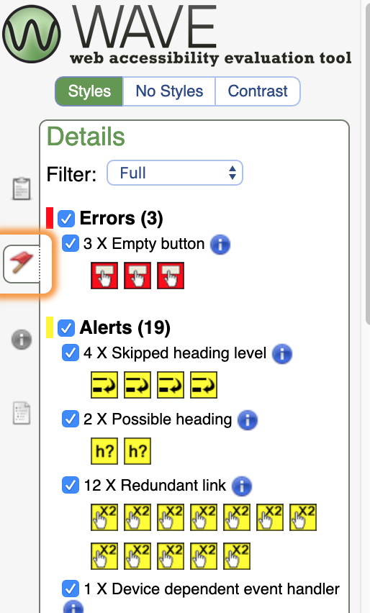

Details Tab
This keeps going on, click on the symbols for
more information. Note that not everything
here is an issue but things to be aware of.

Slide 16
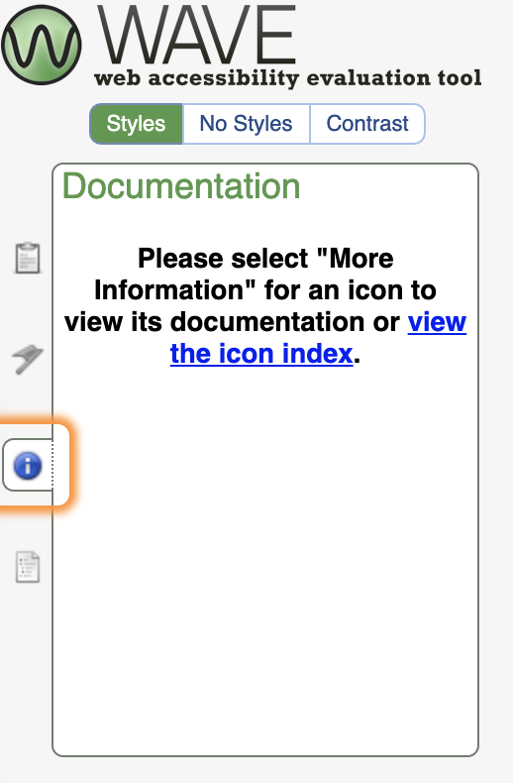
Documentation Tab
Initially:
The next slide will show what you will see here
And the right side will have a tooltip

Slide 17
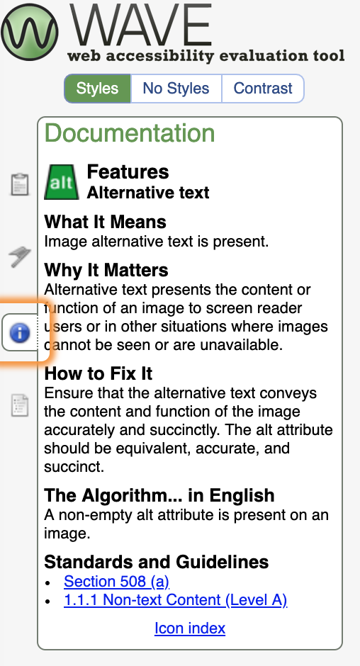
Documentation Tab, Clicked Icon on Right

Slide 18
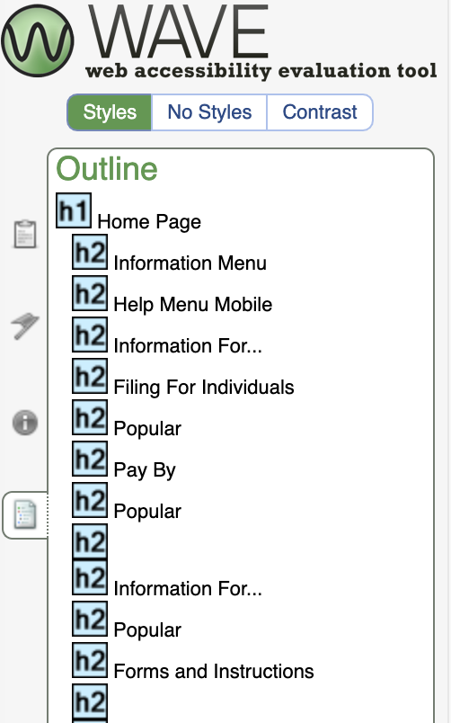
Outline Tab
This goes on and on and is a good way of seeing the structure. Note that the h2 tags are indented from the h1, which is what you would expect.

Slide 19
Questions?
#DrupalGovCon
@kara_h

Slide 20
WAVE examples

Slide 21
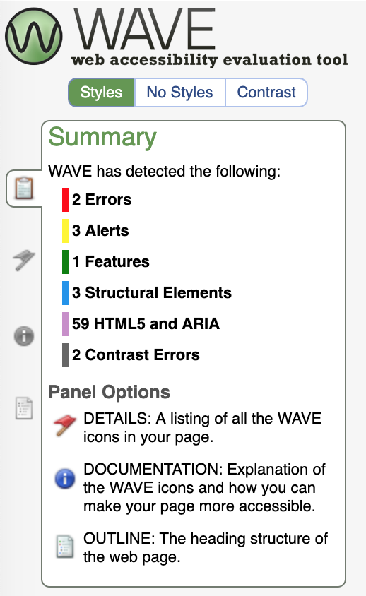
WAVE: www.google.com
Yes, even google shows errors so need to analyze what it reports.

Slide 22
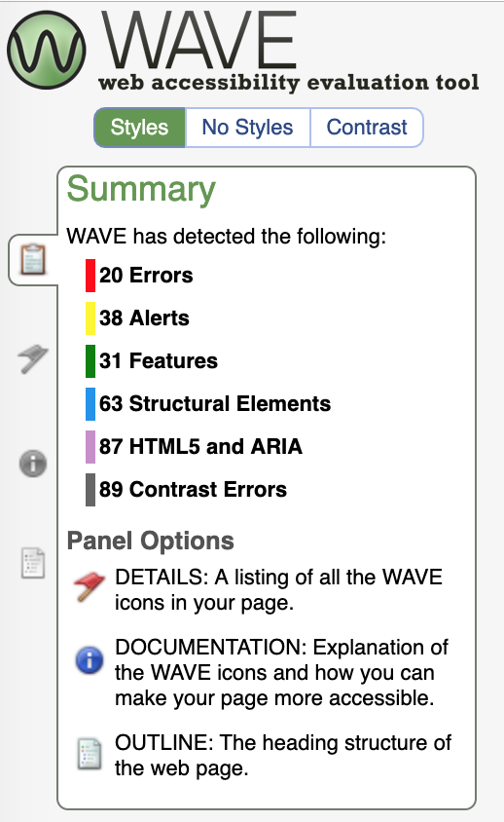
WAVE: www.yahoo.com
More possible errors than google.

Slide 23
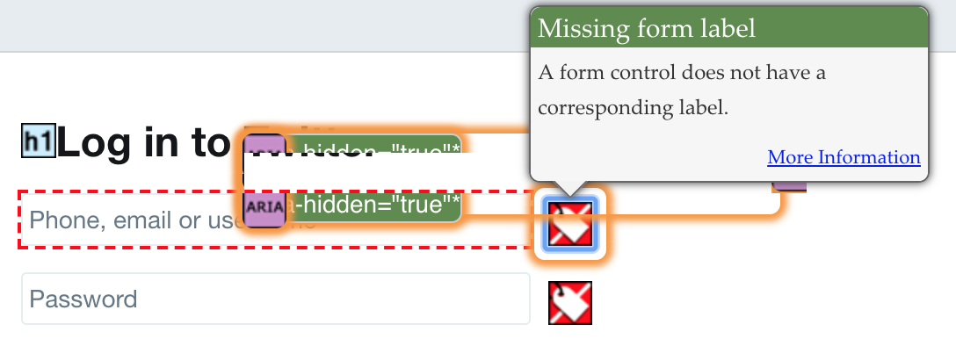
WAVE: www.twitter.com/login (not logged in)
Note the username and password fields are bad.

Slide 24
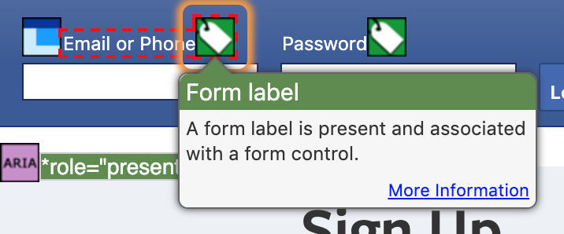
WAVE: www.facebook.com (not logged in)
A good use of labels.

Slide 25
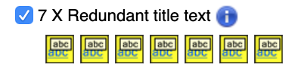
WAVE: www.irs.gov
Remember possible errors are not always errors, you have to investigate them to get more information.

Slide 26

WAVE: www.unh.edu
A good use of modern things but they should look at their colors.

Slide 27
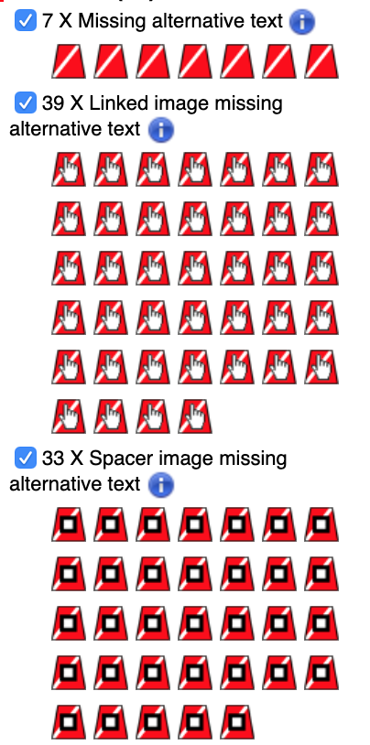
WAVE: www.washingtonpost.com
Errors with alt text, pretty common:

Slide 28
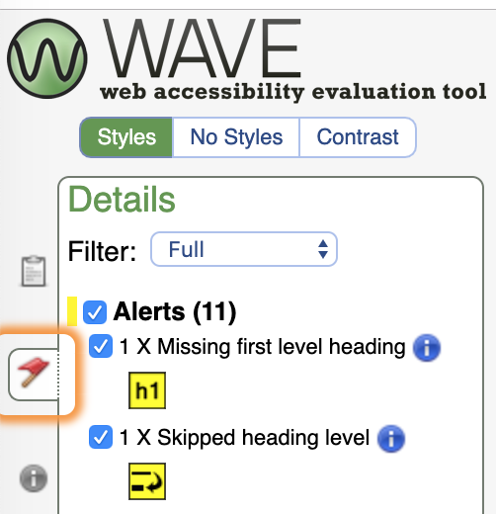
WAVE: www.section508.gov
No errors but they did not avoid some pretty common alerts.

Slide 29
Questions? Other sites?
#DrupalGovCon
@kara_h

Slide 30
Other Accessibility Issues

Slide 31
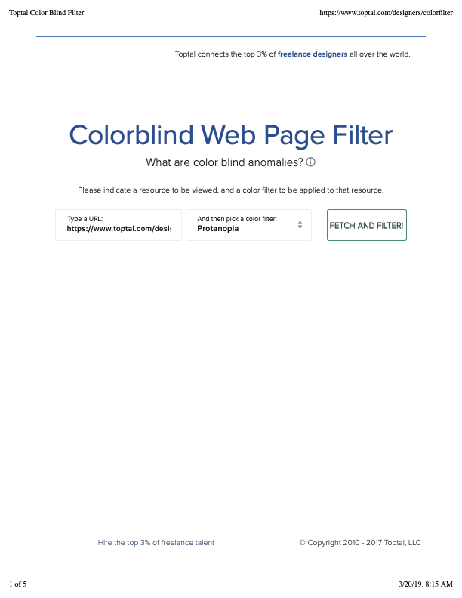
Colorblindness
Test for different conditions:
  https://www.toptal.com/designers/colorfilter

Slide 32
Contrast
Check any proposed colors:
https://webaim.org/resources/contrastchecker/

Slide 33
Why CSS stylesheets?
Allows overriding by users
Trend for things like <font> tags is to go away
Allows display code to be future proofed
The more text the better for accessibility technologies
Separating content and display is good design
Use relative sizing rather than pixel sizing (general tip)

Slide 34

<img> examples
NO
  <img src=‘dog-2280748_960_720.jpg’>
  <img src=‘dog-2280748_960_720.jpg’ alt=‘an animal’>
  <img src=‘line.gif’ alt=‘a pretty line’>
YES
  <img src=‘dog-2280748_960_720.jpg’ alt=‘brown puppy with tan spots sitting on a tan couch’>

Slide 35
LINK Example
NO
  Hardcoding a <STYLE></STYLE> section
  Using style=“…..” in an element
  Leaving out any attribute in the example below
YES
  In <head> section -> <LINK rel=“stylesheet” type=“text/css” href=“default.css”>

Slide 36
Form element example
NO
  <p>University <input type=‘text’ id=‘universityname’></p>
YES
  <p><label for=‘universityname’>University</label>
  <input type=‘text’ id=‘universityname’></p>

Slide 37
<html> examples
NO
  <html>
  <html class=’pageclass’>
YES
  <html lang=‘en’>
  <html lang=‘jp’>
  <html lang=‘en’ class=‘pageclass’>

Slide 38
Other Notes
Only use tables for data (use divs for positioning)
H1, H2, H3, H4 …
Aria (for low vision) is simply tags, but beyond scope of this course
Links should be descriptive, not ‘click here’

Slide 39
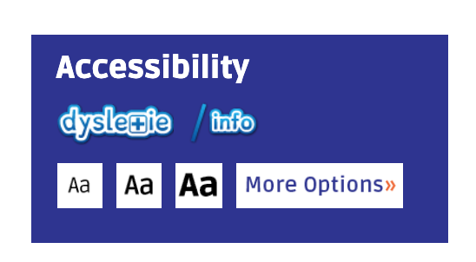
www.autisticadvocacy.org
Not wave but I always admire this control on their page, including that there are options beyond them. Showing a commitment to accessibility like this really drives traffic to your site as people will use the tools and appreciate them being there.

Slide 40
Final Questions?
#DrupalGovCon
@kara_h

