Slide 1

Global Drupal Training Day
Booz Allen Hamilton External
Build-a-Module
Helen Li – Alex Screven – CONNOR HOEHN
January 2018

Slide 2


Instructors
    _{Helen LI}
Job Title
Software Engineer
Project Work
I work on the Drupal 7/8 Benefits.gov project.
Hobby
Painting, salsa dancing, taking care of my pet fish
Favorite Drupal 8 part
I like the Object-Oriented programming (OOP) features included in Drupal 8.
https://www.linkedin.com/in/helen-li-92131229

Slide 3
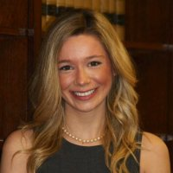
Instructors
    _{Alex Screven}
Job Title
Software Engineer
Project Work
I work on Disaster Assistance.gov
Hobby
I love my dog
Favorite Drupal 8 part
I’ve been working with D7 and D8 for 2 years
https://www.linkedin.com/in/akscreven/

Slide 4
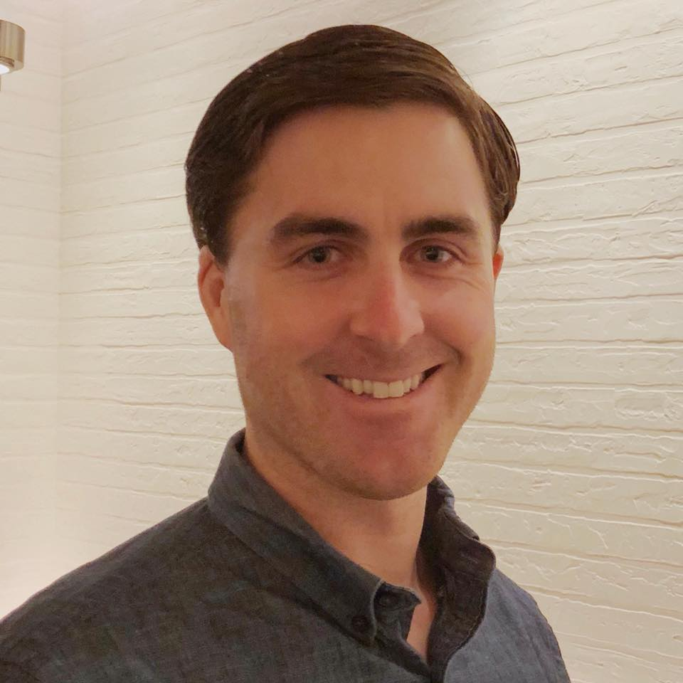
Instructors
    _{Connor Hoehn}
Job Title
Software Engineer
Project Work
My client is the Department of Labor. I work on the HIRE Vets project supporting Veteran employment.
Hobby
I enjoy walking the trails with my canine friend and making great food.
Favorite Drupal 8 part
The plugin system is great.
https://www.linkedin.com/in/connorhoehn/

Slide 5
Overview
    I: Introductions (3 min)
    II: Overview (5 min)
    III: Project Setup (5 min)
    Enterprise Tools
    Installation
    File System
    III: D7 -> D8 (5 min)
    Symphony2 Overview
    YAML
    Routing
    Controllers
    V: HELLO_WORLD (10 min)
    VI: Workshop pt.1 (30 min)
    VII: Break (15 min)
    VII: Workshop Pt.2 (40 min)
    VIII: CONCLUSION (5 min)
    Resources
    Contact

Slide 6


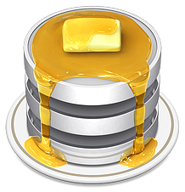
Project Setup: Enterprise tools
    Docksal
    PHPSTORM
    Sequel Pro
    Tools
    Docksal – virtualized development environment available for Window and OSX.
    PhpStorm – enterprise-level code editor with Drupal support.
    Sequel Pro/MySQLWorkbench – database GUI

Slide 7

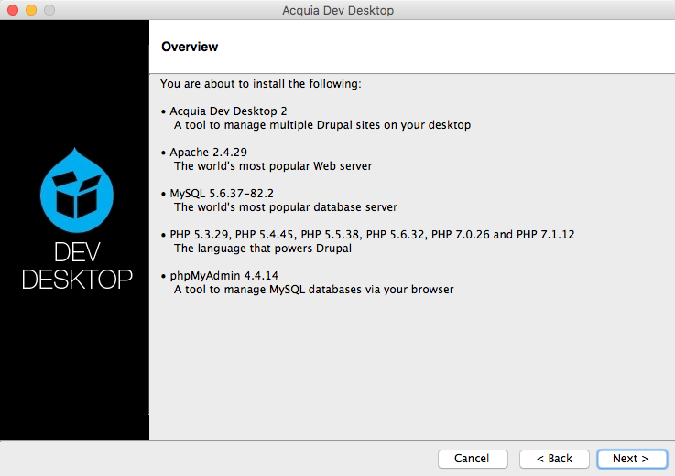
Project Setup: Acquia Dev Stack
    Why Acquia Dev Stack
    An enhanced MAMP stack comes with all the required PHP packages to run a Drupal 8 website. It manages both a MySQL and Apache server through a graphical interface.
    Download it here: https://dev.acquia.com/downloads

Slide 8
Project Setup: Composer
    What is Composer
    Composer is a tool for dependency management in PHP. It allows you declare the libraries your project depends on and it will manage (install/update) them for you. With Composer we can be assured that our projects dependencies will be consistent in a local context or in a remote deployed environment.
    Drupal 7 vs Drupal 8
    The community didn’t utilize composer in Drupal 7. The preferred method was using the Drush CLI tool to install a contributed module. Composer has been used in other PHP projects for many years and is a significant enhancement.
    Here is a link that we use to start a Composer-based Drupal project: https://github.com/drupal-composer/drupal-project

Slide 9
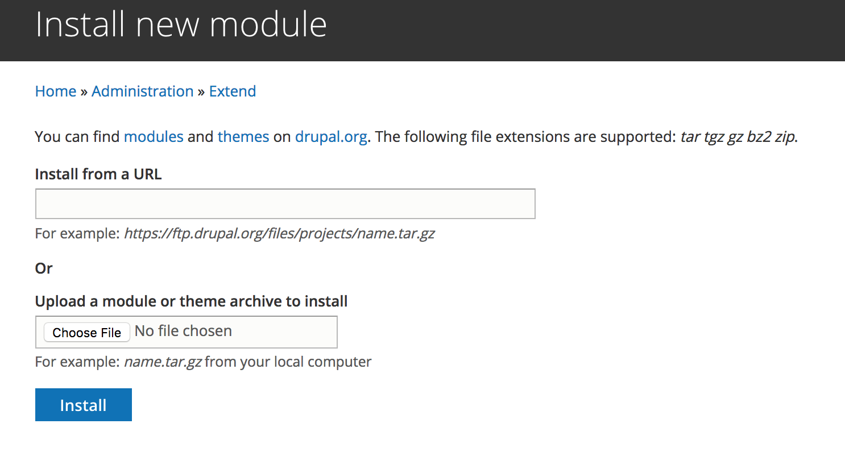
Project Setup: Installation
    Module Administration
    Modules can be installed from a remote or local source
    Drupal Page: your-project.com/admin/modules/install
    Drupal UI Capabilities:
    Enable
    Install
    Uninstall (disable)
      Drupal UI
        Figure 1. Modules can be enabled and uninstalled through the Extend admin page.

Slide 10
Project Setup: drush & drupal console
    drush
    Drush 6.X only works with Drupal 6 & 7. Drush 7.X works with Drupal 8.
    Suggestion: install with Composer
    Slightly different commands to Drush 6.X
    Download: github.com/drush-ops/drush
    Drupal console
    Another Drupal CLI
    Good for generating boilerplate code
    Can have both Drupal Console and Drush running
    Download: drupalconsole.com

Slide 11
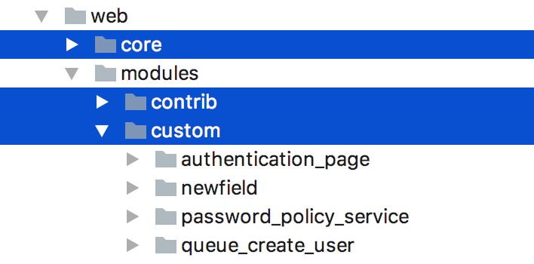
Project Setup: File System
        Figure 2. A snapshot of a Drupal 8 composer installation
    Module Placement
    Core – Drupal’s core modules are bundled with the project within the core directory.
    Contributed – Community maintained modules should be placed within the contrib directory.
    Custom – Project specific modules should be placed within the custom directory.

Slide 12
D7 -> D8: What is SYMFONY2
    Symfony2
    Enterprise full-stack web application framework composed of numerous CMS-friendly libraries – A true MVP implementation with a model, view, and presentation layer. Built using OOP paradigms to promote extendibility and portability when extending components.
    YAML
    file format that can be easily converted into PHP arrays
    used for storing configuration data
    used for defining module settings
    ROUTING
    replaces usage of hook_menu()
    used to route requests to controllers
    declared in yaml format
    CONTROLLER
    replaces page callbacks
    used to build a render response

Slide 13
D7 -> D8: services, Plugins
    Symfony2
    Enterprise full-stack web application framework composed of numerous CMS-friendly libraries – A true MVP implementation with a model, view, and presentation layer. Built using OOP paradigms to promote extendibility and portability when extending components.
    YAML
    file format that can be easily converted into PHP arrays
    used for storing configuration data
    used for defining module settings
    ROUTING
    replaces usage of hook_menu()
    used to route requests to controllers
    declared in yaml format
    CONTROLLER
    replaces page callbacks
    used to build a render response

Slide 14
D7 -> D8: services, Plugins, blocks
    Services
    Services are decoupled reusable classes that are easy to plug in your code. It’s a better way of handling dependencies. D8 is built on top of services.
    Plugins
    Classes that implement different behaviors via a common interface. Example: image transformations. Limited in scope; does one thing and does it well. The evolution of hook_info()
    Blocks
    Blocks are plugins in D8.

Slide 15
D7 -> D8: Namespaces, Annotations, yaml
    Namespaces
    Like virtual folders. How Drupal autoloader finds your code. Must be in Vendor\Namespace\Classname format and have the right directory structure
    Annotations
    Metadata inside a docblock
    yaml
    YAML Ain’t Markup Language

Slide 16
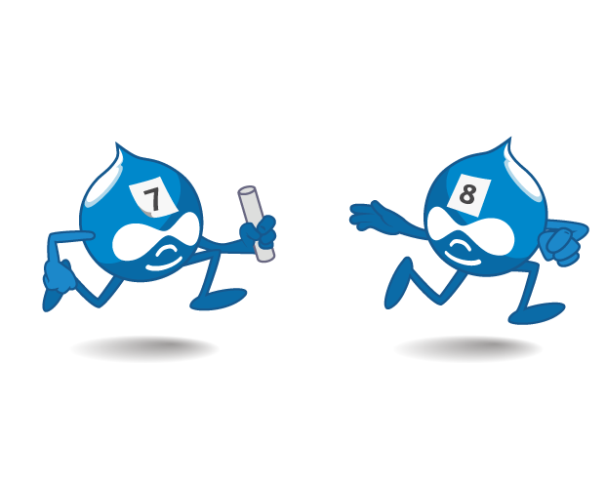
Hello world
Module Development: Helen Li

Slide 17
Hello world module
    Let’s build a module
    We’ll create a page at /hello
    We’ll print “Hello World” on that page
    We’ll create a link in the admin reports page that links to /hello

Slide 18
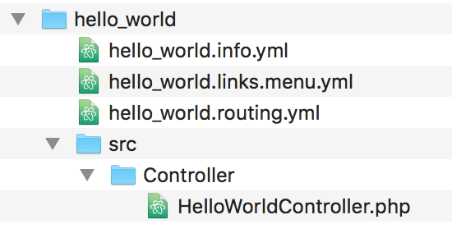
Set up
    Make these folders
    Inside your custom modules folder, make a hello_world folder
    This will be the setup:

Slide 19
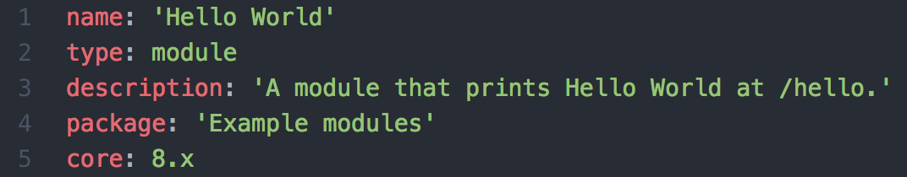
Info.yml
    Hello_world.info.yml
This goes in the root of our module folder
    Name, description & package
These show up in the modules page
    type
The type of extension
    Core
Which Drupal core version your module is compatible with
Notes:
Drupal 7 needed a .info file and a .module file to let Drupal know about your module
Drupal 8 just needs a .info.yml file

Slide 20
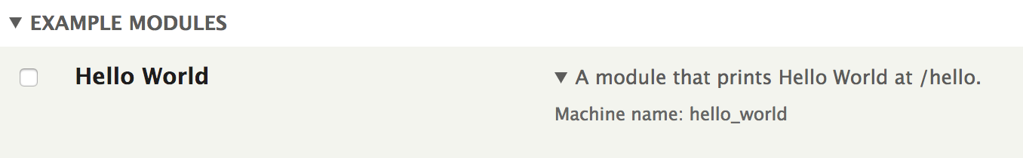
Enable your module
    Through the ui
Go to /admin/modules, check the checkbox next to our module and hit Save to enable it
    Or Through drush
(fin) drush en hello_world

Slide 21
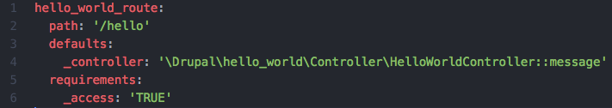
router
    Hello_world.routing.yml
Links your paths to your controllers and functions
Make sure you give yourself access
This routing system replaces the routing parts of hook_menu() in Drupal 7

Slide 22
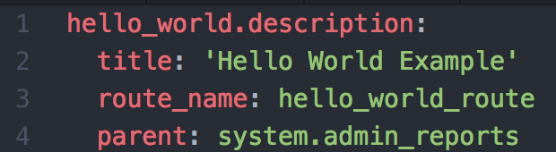
Menu.yml
    Hello_world.links.menu.yml
This also goes in your root folder
This places a link to our hello world page in /admin/reports
    First line
Needs to include our machine name
    Route name
Refers back to our router
    Parent
Includes the machine name of the admin menu we’re targeting

Slide 23
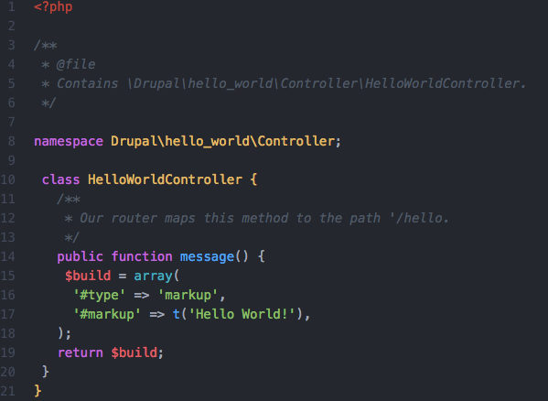
controller
    Hellocontroller.php
This goes in src/Controller
This is where we’re putting
our module’s logic
    annotations
Annotation contains metadata about the function
    namespace
Like virtual folders
Automatically gets mapped to /src folder

Slide 24
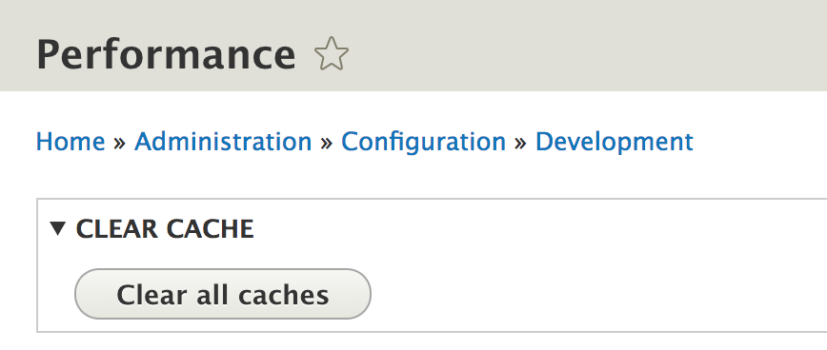
Clear cache
    Through the gui
In /admin/config/development/performance
Clear all caches
    Or With drush
(fin) drush cr

Slide 25
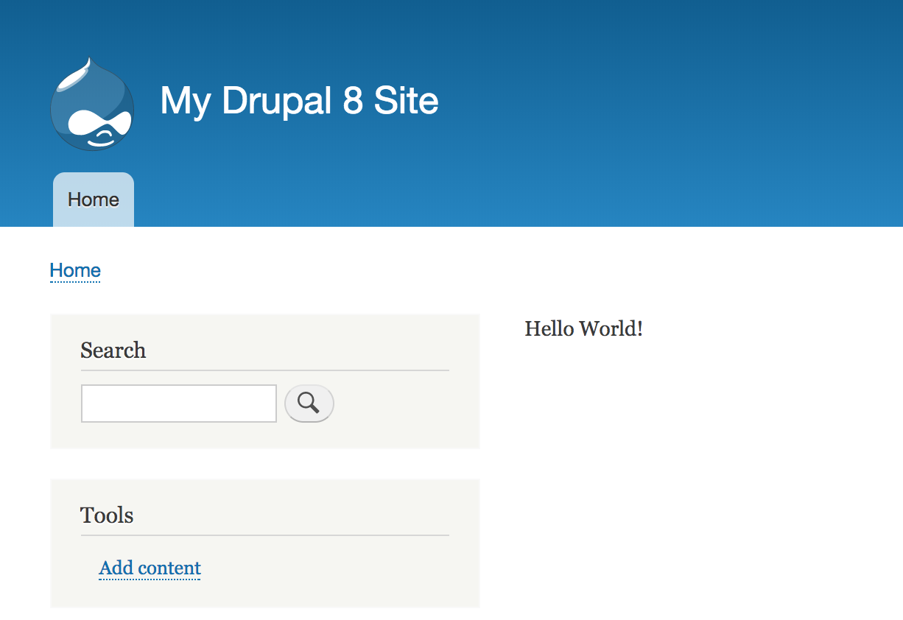
Success!

Slide 26
Workshop
Workshop: Alex Screven

Slide 27
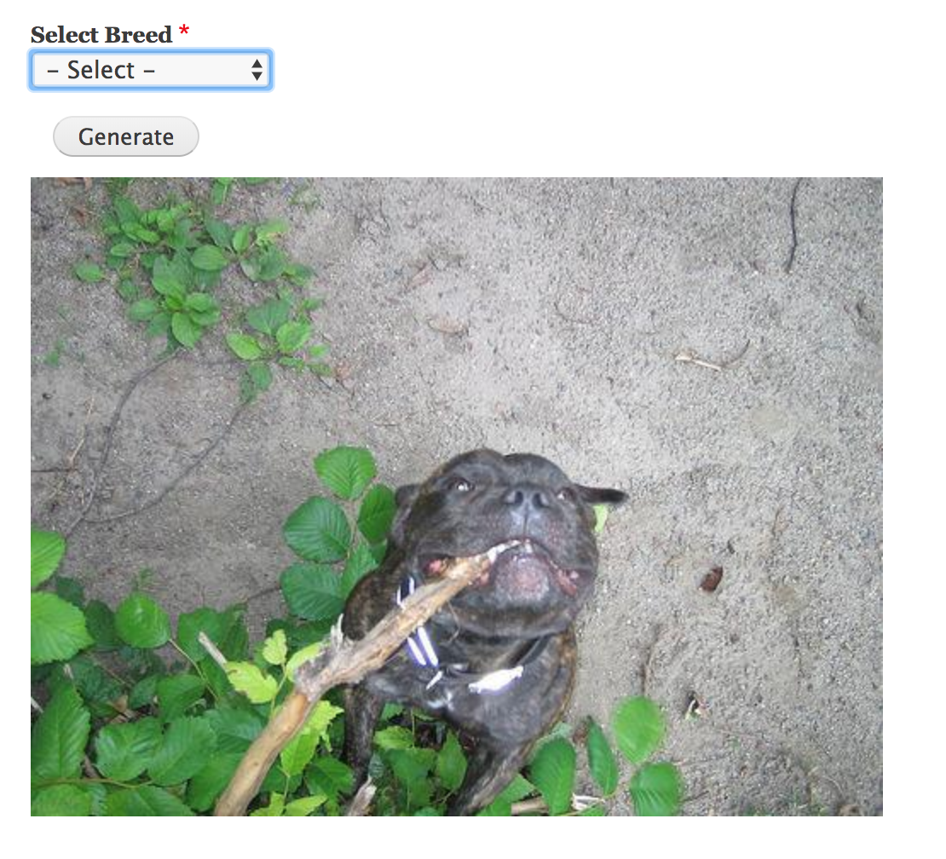
Workshop Code
    Code
    https://github.com/ascreven/dogs
    Part 1 Goals
    Create and enable module with info.yml file
    Part 2 goals
    Block and form allowing user to select breed
    Part 3 goals
    Router and controller for breed pictures

Slide 28
Conclusion
    Resources
    https://docksal.readthedocs.io/en/master/
    https://www.jetbrains.com/phpstorm/
    https://getcomposer.org/
    https://symfony.com/
    Code Repository
    https://github.com/ascreven/dogs

Slide 29
Contact US
    Helen
    li_heting@bah.com
    Alex
    screven_alexandra@bah.com
    Connor
    hoehn_connor@bah.com
    Booz Allen’s Drupal.org Profile:
    https://www.drupal.org/booz-allen-hamilton
    Please contact Booz Allen’s Strategic Innovation Group for more information on our Drupal practice:
    Farazdaghi_Arash@bah.com
    Robbins_Eric@bah.com​
    Warsaw_Craig@bah.com

