Slide 1

PHPStan: static code analysis
Drupal GovCon, July 25 or 26, 2019
Dear organizers: I’ll be on GovCon Thursday and Friday only. These slides are a first draft only.
Notes:
https://glamanate.com/blog/writing-better-drupal-code-static-analysis-using-phpstan

Slide 2
What is PHPStan?
“PHP Static Analysis Tool –
discover bugs in your code without running it”

Slide 3
Who is creating PHPStan?
Ondřej Mirtes: PHP in general
Matt Glaman: Drupal integration

Slide 4
Structure of the presentation
For a public contrib module: Drupal 7 first, then Drupal 8
For your drupal-composer/drupal-project
GitLab integration

Slide 5
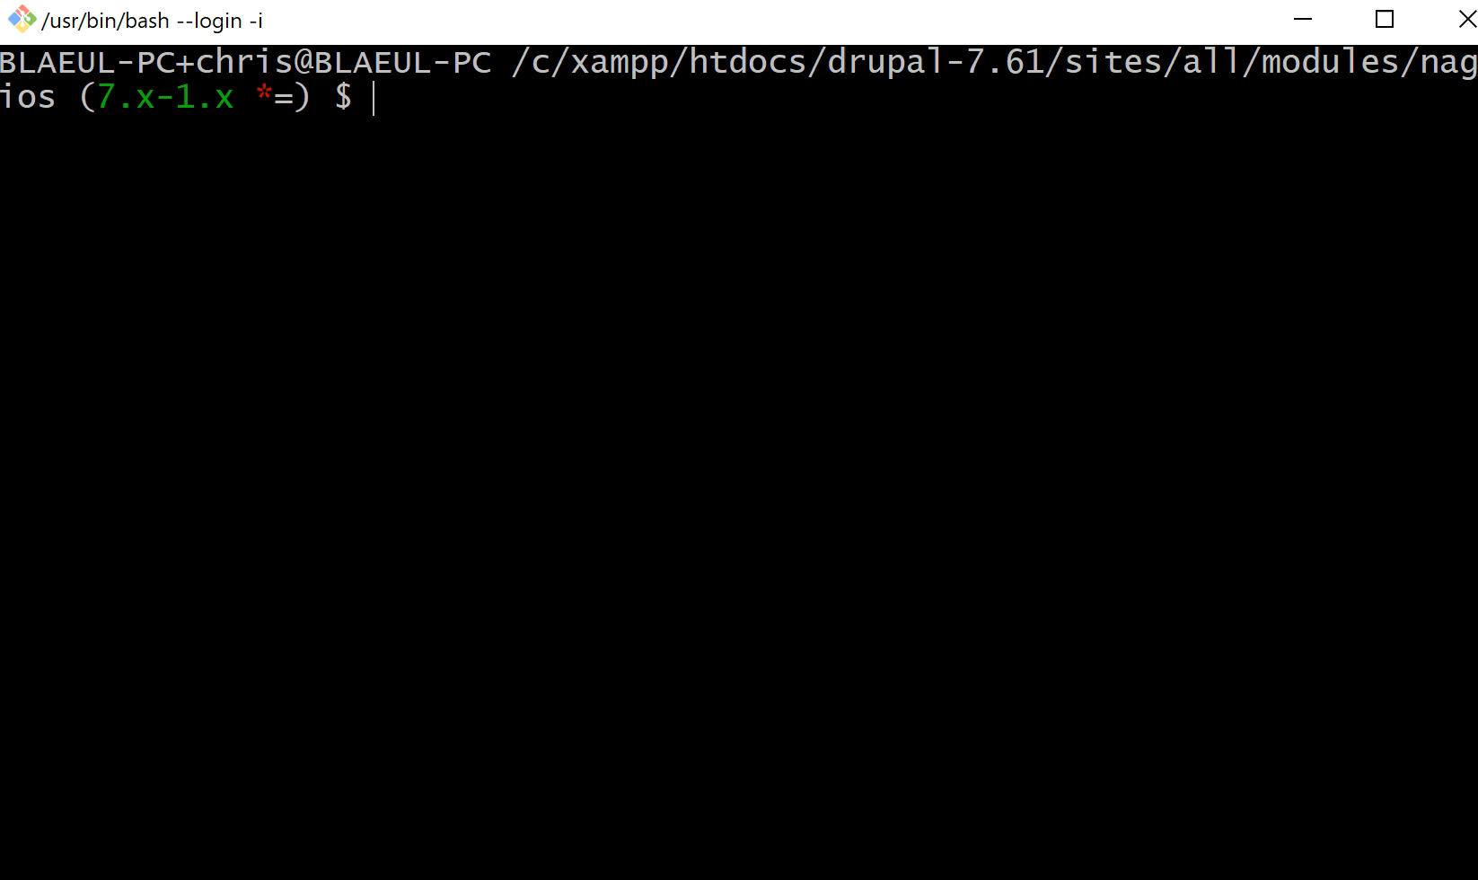
First install

Slide 6
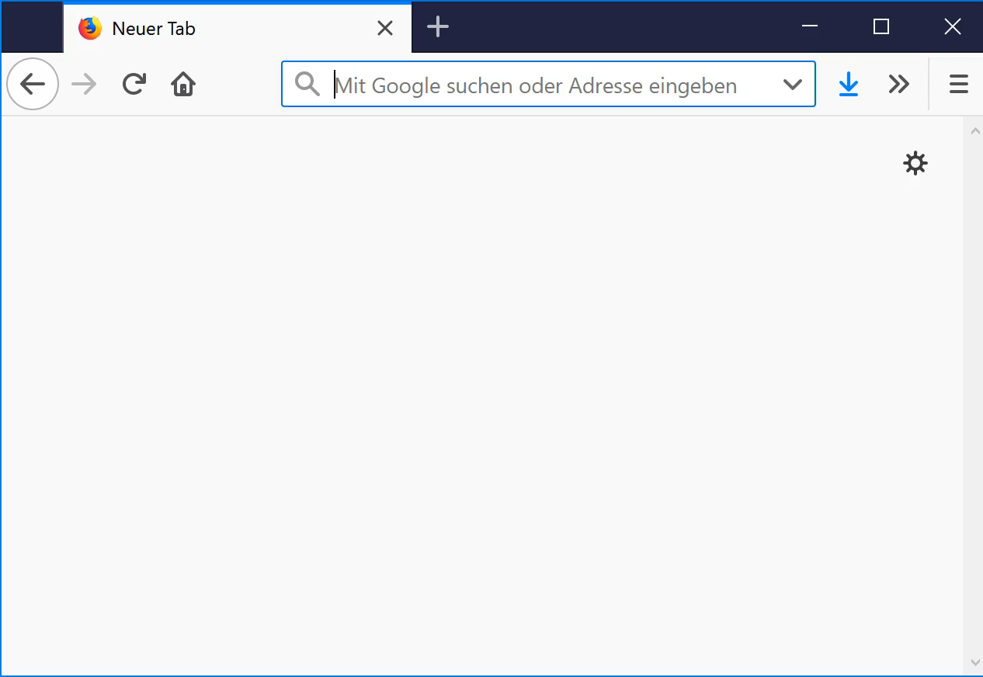
First install
Source is in the Nagios module

Slide 7
phpstan.neon
The configuration file
# How to run PHPStan
# 1. $ cd your_Drupal_7_root
# 2. $ composer require phpstan/phpstan drush/drush:^8.0 --dev
# 3. $ cd sites/all/modules/nagios
# 4. $ ../../../../vendor/bin/phpstan analyze --level 4 .
parameters:
autoload_files:
- %rootDir%/../../../includes/bootstrap.inc
...
- %rootDir%/../../../vendor/drush/drush/includes/output.inc
- tests/phpstan-bootstrap.php
- nagios.drush.inc
- nagios.install
- nagios.module
fileExtensions:
- php
- module
- inc
- install
excludes_analyse:
- *.api.php

Slide 8
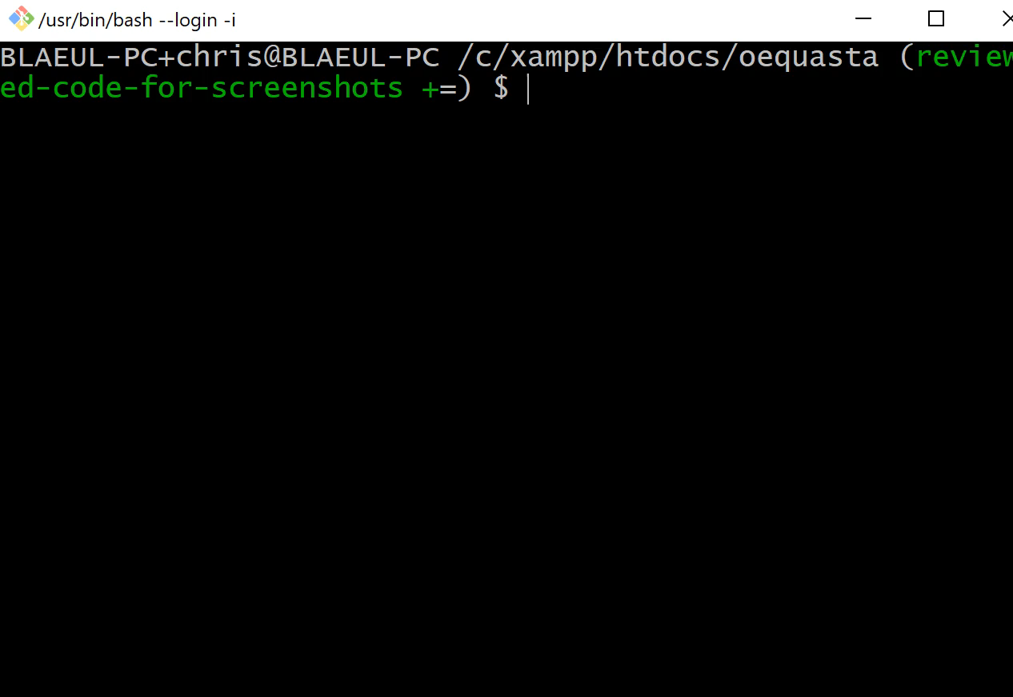
Now Drupal 8 contrib
Source is in the Nagios module

Slide 9
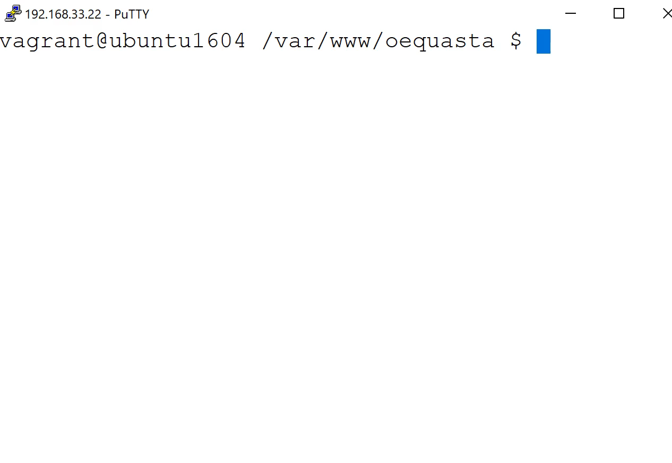
For your drupal-composer/drupal-project
Running on Ubuntu

Slide 10
.gitlab.yml
Runs on every push

Slide 11
phpstan.neon
Runs on every push

Slide 12
How to reach me
I’m @Gogowitsch on Drupal.org and Twitter
Mail: Blaeul@quodata.de
Also: Don’t be shy with questions, anytime!

