Slide 1
MEASURING WHAT MATTERS
Using Analytics to Inform Content Strategy
July 2019
Notes:
In this session, we will explore:
How to identify metrics that matter to your organization, stakeholder by stakeholder
How to gain insight into the effectiveness of your marketing and outreach efforts
How and when to report metrics to your leadership

Slide 2
Jason Hamrick
Senior Strategist
Phase2
jhamrick@phase2technology.com

Slide 3
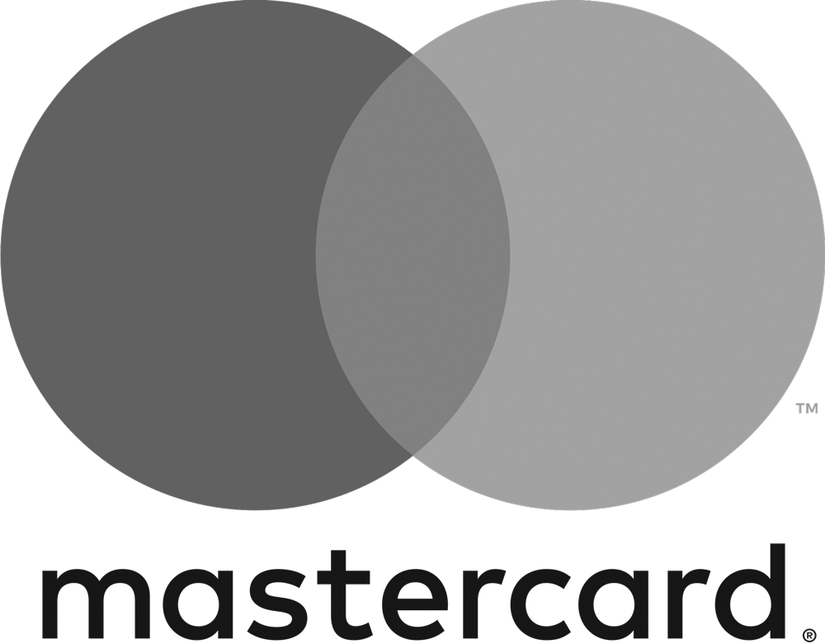
WHO TRUSTS US.
Notes:
We are a digital engagement agency based in Arlington, VA
Our ideas and work are unlocking the potential for anyone, anywhere to engage with the world's most impactful organizations at any time.

Slide 4
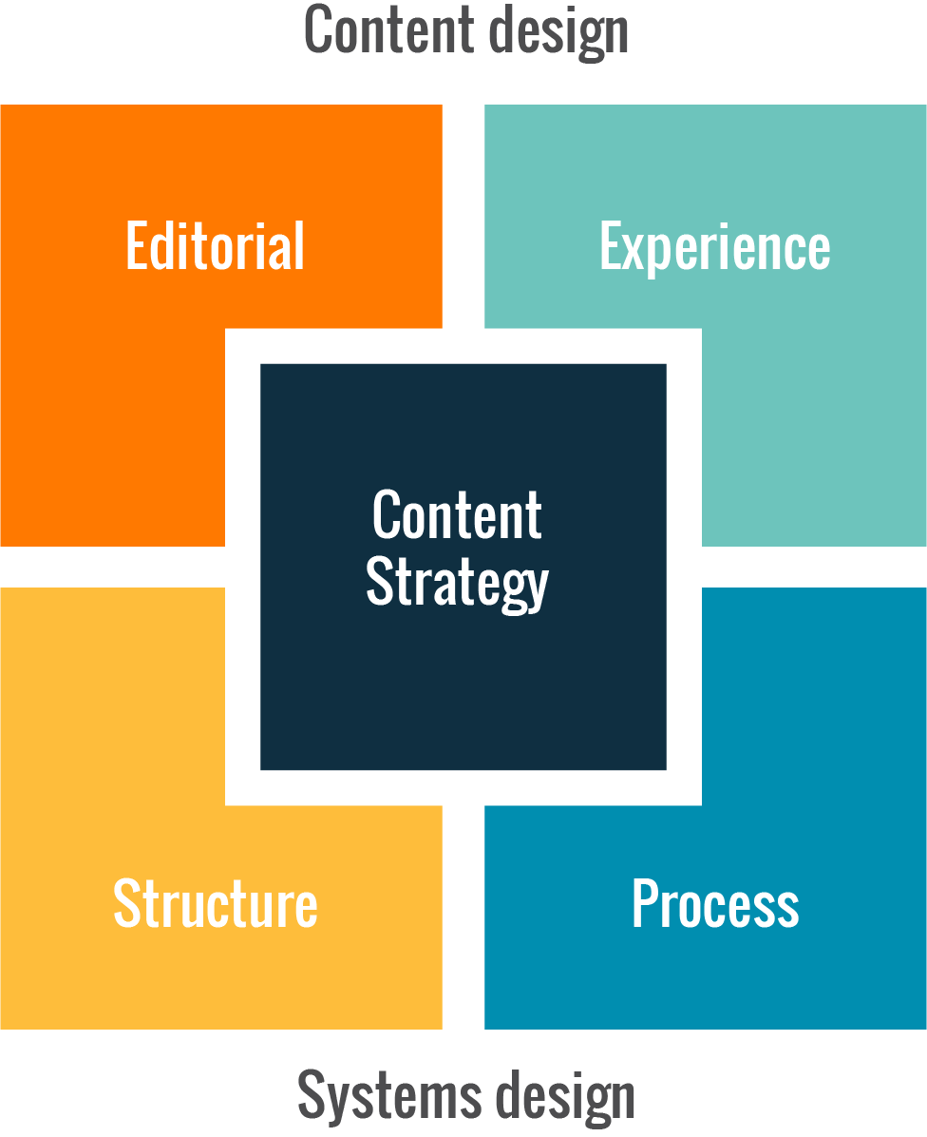
Source: ⓒ Brain Traffic 2018
Notes:
Many of you are familiar with Kristen Halverson and her work defining content strategy and the Content Strategy Quad

Slide 5
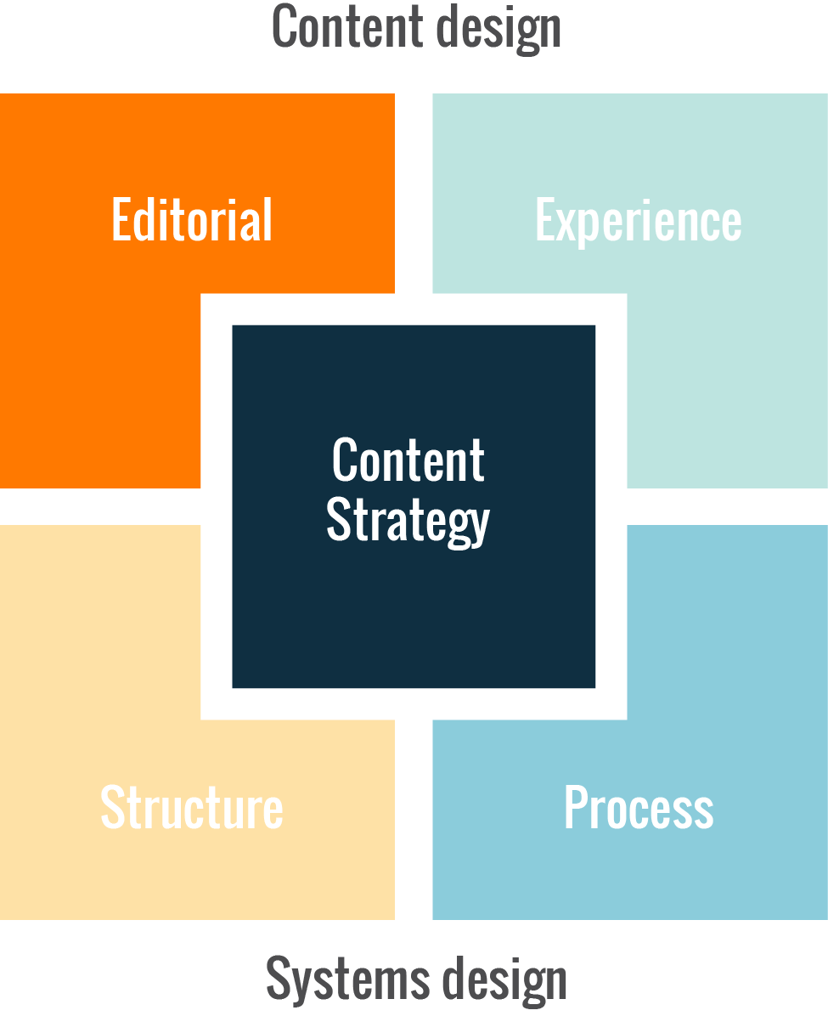
Source: ⓒ Brain Traffic 2018
Notes:
People focus on the Editorial Strategy part of the equation, which answers these questions

Slide 6
Editorial Questions
What is our editorial mission?
Who are our target audiences?
What is our point of view?
What is our voice and tone?
What brand and language standards do we need to comply with?
Notes:
What is our editorial mission?
Who are our target audiences?
What is our point of view?
What is our voice and tone?
What brand and language standards do we need to comply with?

Slide 7
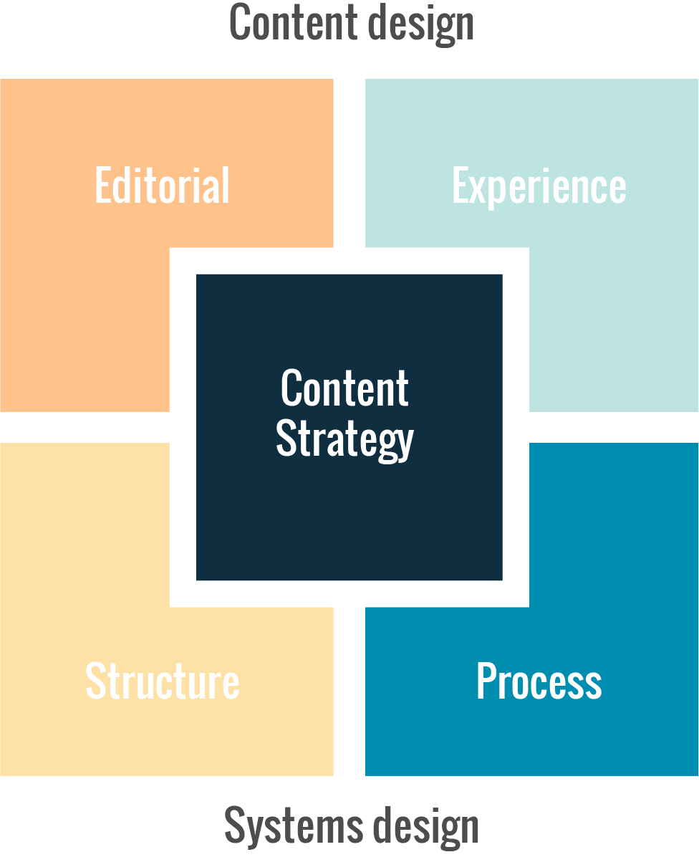
Source: ⓒ Brain Traffic 2018
Notes:
But there is another part of the quad that gets less press - Process Design

Slide 8
Process Questions
How will content move through its lifecycle?
What tools will we use to create, deliver, and maintain content?
How and when do we care for our existing content?
Who gets to say “no”?
What standards and metrics will we use to measure our content quality and performance?
Notes:
How will content move through its lifecycle?
What tools will we use to create, deliver, and maintain content?
How and when do we care for our existing content?
Who gets to say “no”?
What standards and metrics will we use to measure our content quality and performance?
Another way of asking that last question is:

Slide 9
Is my content strategy working?
Notes:
… Is my content strategy working?
This is what I would like to present today… a way to answer this question

Slide 10
Digital Measurement Model
Notes:
It’s called the Digital Measurement Model. It’s an idea that’s be floating around the internet for years, mostly codified by Avinash Kaushik and his blog “Occam’s Razor”

Slide 11
FUNCTIONAL OBJECTIVE
ENGAGEMENT
STRATEGY
KPI
KPI
TARGET
SEGMENT
REFINE STRATEGY
Notes:
The core of this model is:
Identify a client’s Business Functional Objectives, what we are trying to achieve for the business, inside of a functional area (Sales, HR, Operations, Marketing, etc)
For each objective, capture the Implementation Strategy employed to accomplish the objective.
Decide on one or more Key Performance Indicator (KPI), a number (metric) that helps us understand how we are doing against the objective.
If possible, uncover the KPI Baseline, the current value of the KPI.
Decide on a KPI Target, a numerical value we’ve pre-determined as an indicator of success or failure of that Implementation Strategy.
Identify an Audience Segment, the group of people or onsite behaviors that can move that KPI.
Over time, we can track the progress of these KPIs and Refine our Strategy
We can invest more resources in the strategies that are working, and for those that are not working, we can recommend alternative approaches using A/B testing and related enhancements to move faltering KPIs in the right direction.

Slide 12
Measuring What Matters
Functional Objective
What we are trying to achieve for the organization, inside an area
Engagement Strategy
Specific strategy employed to accomplish the objective
Key Performance Indicator (KPI)
Number that helps us understand how we are doing against the objective
Uncover a baseline, benchmark, and set a realistic target
Audience Segment
A group of people or a behavior that can move that KPI
Notes:
Let me explain the framework… then I’ll walk you through examples….
----------
Functional strategy is the strategy adopted by each functional business area (like marketing, HR, or customer service) in order to help achieve business or corporate goals.
It’s super important to use functional strategy (vs. overall business/corporate strategy) to inform your content strategy. If you try to work with overall business goals, you might get stuck with statements like, “Increase profit margin by x%” or “Reduce facilities expenses by x%.” How are you supposed to directly align content strategy with those goals? You can’t.
But if you use the goals driving your functional strategy, you can draft statements like:
Increase sales by x%
Build brand awareness among target audience by x%
Launch x new products or services in 12 months
Decrease content management costs by x%
Based on those specific goals, we can then identify multiple Engagement Strategies to accomplish that objective, and then a number of KPIs for each of those strategies.
We can segment our data by personas or behaviors

Slide 13
Serve Patients and Caregivers
Functional Objective
Get patients and caregivers the right information and resources in ways they can understand.
Engagement Strategy
Create engaging content in a wide variety of content types that demonstrate the institute’s knowledge
Key Performance Indicator (KPI)
Percentage of multi-pageview sessions inside Health Information section
Audience Segment
Separate patient persona and caregiver persona
Notes:
For Example…

Slide 14
A Funding Resource for Researchers
Functional Objective
Be the nation’s leading funder of basic and translational research for scientists and laboratories at universities and hospitals nationwide.
Engagement Strategy
Provide researchers with comprehensive information about available funding opportunities.
Key Performance Indicator (KPI)
Number of external clicks to grants.gov
Audience Segment
Segment by lag between FOA posting and first external clicks
Notes:
For Example…

Slide 15
A Community of Care
Functional Objective
Rally a community of support around patients and caregivers through community outreach
Engagement Strategy
Provide a community engagement toolkit
Key Performance Indicator (KPI)
Percent of visitors who download the engagement toolkit
Audience Segment
Segment by number of interactions before download
Notes:
For Example…
The beauty of this model is that it can work for both online and offline metrics.
You can have multiple Strategies per Objective
Multiple KPIs per Strategy

Slide 16
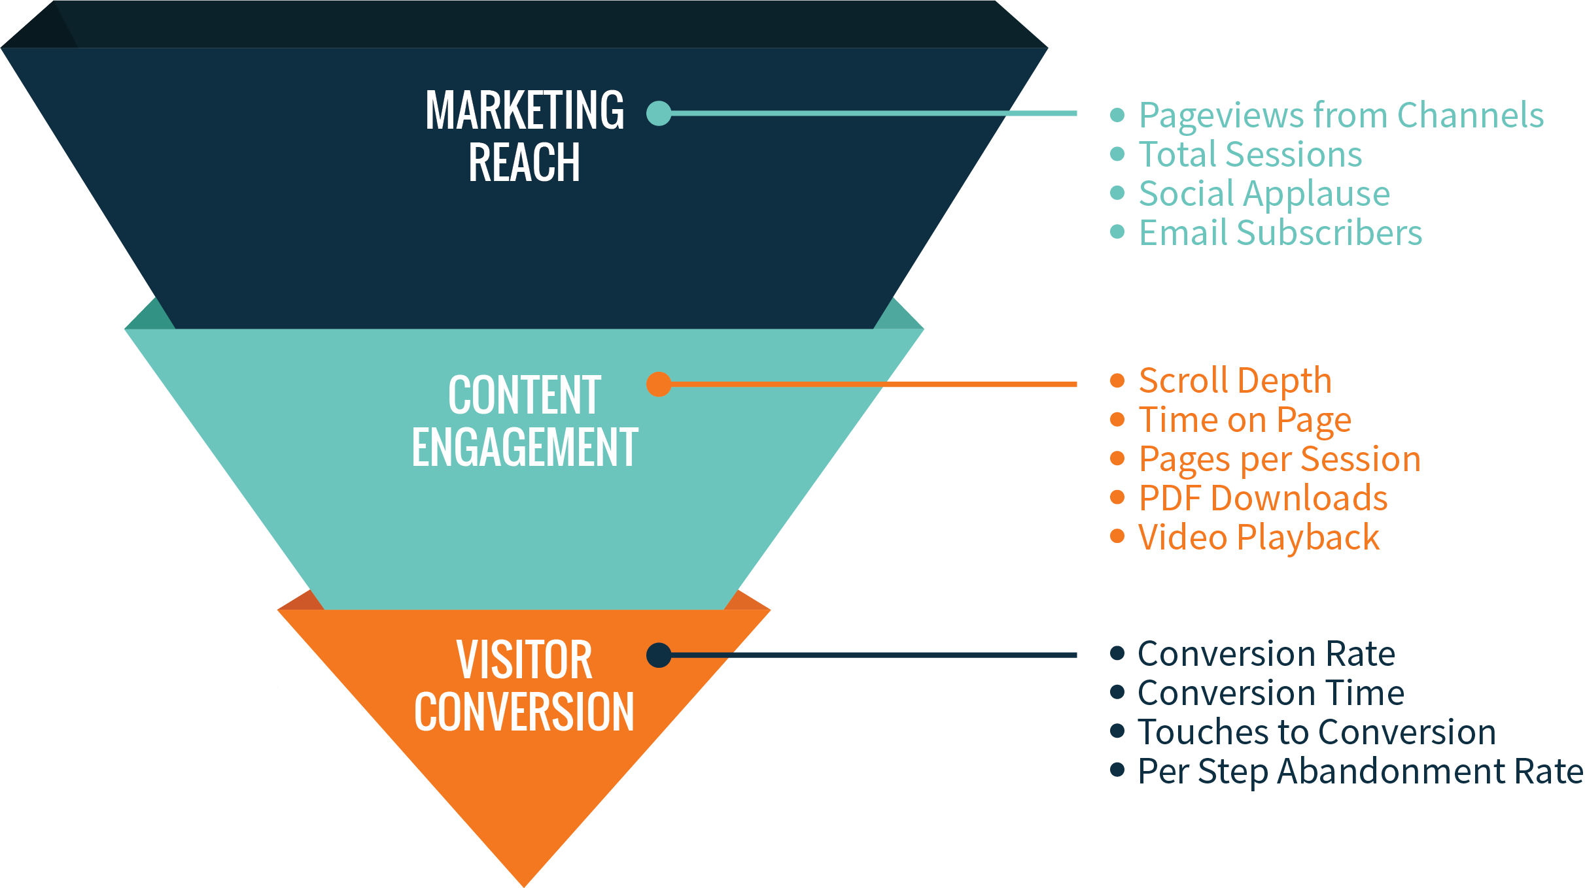
Measurement Lenses
Notes:
As you are creating KPIs, consider a few different lenses:
Marketing Reach
Content Engagement
Customer Conversion

Slide 17
Creating the Model
Notes:
THIS IS ALL GREAT, BUT HOW DO YOU ACTUALLY CREATE THIS MODEL?

Slide 18
Measuring What Matters
Functional Objective
Discuss long-term goals - get beyond the next funding cycle
Engagement Strategy
Understand your audiences; what are they trying to accomplish?
Key Performance Indicator (KPI)
Baseline: Research current value of the metric
Benchmark: Look to peers and comparators
Target: Incremental improvements you can monitor and track
Audience Segment
What groups of visitors are important? What visitor behavior is desirable?
Notes:
Sit down with your leadership and talk about what matters

Slide 19
There is no alternative to an honest conversation
Notes:
BE PREPARATED FOR THE HARD CONVERSATION

Slide 20
Reporting

Slide 21
Reporting
Create focused dashboards for different leadership needs
Quarterly reporting on content reach and engagement metrics
Report metrics in key audience segments, not in aggregate
Provide context and relate the metric to the business objective
Notes:
We know that most monthly metrics reports get skimmed once and then discarded. Those charts and graphs tell you about last month’s performance, traditional reports say nothing about what to do next or how to shift your engagement to match your evolving business goals.
We understand that different parts of the organization need different information, so we create custom reporting dashboards that are unique to specific leadership needs. This often includes reach-focused reports for marketing, engagement-focused dashboards for communications teams, revenue and conversion dashboards for sales, and rollup dashboards for the C-suite.
Rather than delivered in a monthly PDF, these dashboards can deliver real-time information and trends, allowing you to keep your finger on the pulse of your digital investment.

Slide 22
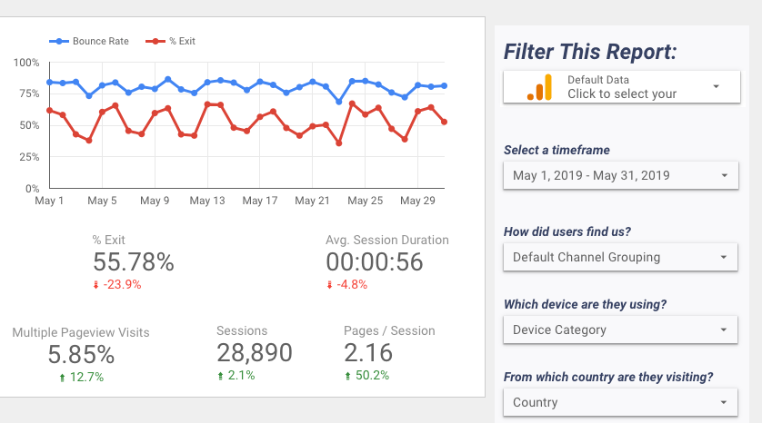
Notes:
Here is an example of part of a dashboard that Phase2 built for a client using Google Data Studio.
It combines:
Traditional reach metrics like Exit %, Session Duration, etc, so we don’t throw the baby out with the bath water
Specific metric for them - Multiple Pageview Visits for Content Engagement
Right column allows the user to segment the report by date, channel, device, and a few other segments

Slide 23
The Role of
Visitor Sentiment
Notes:
One of the criticisms of this approach is that it focuses on the micro - the individual metrics of specific tactics, at the expense of the bigger picture.
This is where visitor sentiment can serve as a counter-balance.
Visitor sentiment, gathered through Customer Satisfaction tools like ForeSee surveys, verbatims, or Net Promoter Scores (NPS) can show you the macro view of how well your digital properties are performing.
They provide a good escape valve to keep the metric from becoming the target.

Slide 24
Why is this important?
Notes:
Why is all of this important?
This approach helps us answer the question that we started with….

Slide 25
Is my content strategy working?
Notes:
IS MY CONTENT STRATEGY WORKING?!

Slide 26
CONTENT STRATEGY
ANALYTICS STRATEGY
Notes:
Those dashboards form the basis of a conversation - Given what we are seeing, what should we do?
In this way, the analytics model drives changes to the engagement strategy, which then leads to changes in the analytics model.
The value of this approach is that the data we gather explicitly aligns to your organizational goals.
Are your marketing efforts drawing people to you?
Is your investment in digital content creating engagement?
Are those efforts leading to sales conversions?
Beyond “insights”, we review the data in the context of your engagement strategy and provide concrete recommendations to continually align the strategy to evolving business goals. These recommendations may be a simple as creating more engaging articles headlines or as encompassing as streamlining a sales funnel to increase conversions.
Over time, we can track the progress of these KPIs. We can invest more resources in the strategies that are working, and for those that are not working, we can recommend alternative approaches.
The outcome of our approach is not “this is what happened”, but rather “this is what we should do.”

Slide 27
Shifting Your Strategy
Test hypotheses with A/B testing
Implement personalization strategy inside audience segments
Roll results into content strategy and editorial mission
Notes:
using A/B testing and related enhancements to move faltering KPIs in the right direction. In this way, the analytics model drives changes to the engagement strategy, which then leads to changes in the analytics model.

Slide 28
First, focus on the impact you want to have and build your strategy from there.

Slide 29
WHAT QUESTIONS DO YOU HAVE?

Slide 30
Jason Hamrick
Senior Strategist
Phase2
jhamrick@phase2technology.com
Notes:
Thank you for your time today, if you have follow up questions, I’ll be at the Phase2 booth

Slide 31
THANK YOU

