Slide 1
Drupal and Container Orchestration:
Using Kubernetes to Manage All the Things
Presented by
Shayan Sarkar | Booz Allen Hamilton
Will Patterson | Booz Allen Hamilton
Innovation center, Washington, D.C.
Drupal GovCon 2017

Slide 2
What has Docker Done for Us?
Continuous delivery
Deliver software more often and with less errors
No time spent on dev-to-ops handoffs
Improved Security
Containers help isolate each part of your system and provides better control of each component of your system
Run anything, anywhere
All languages, all databases, all operating systems
Any distribution, any cloud, any machine
Reproducibility
Reduces the times we say “it worked on my machine”

Slide 3
What Does Kubernetes do?
Kubernetes is an open-source system for automating deployment, scaling, and management of containerized applications.
Improves reliability
Continuously monitors and manages your containers
Will scale your application to handle changes in load
Better use of infrastructure resources
Helps reduce infrastructure requirements by gracefully scaling up and down your entire platform
Coordinates what containers run where and when across your system
How do all the different types of containers in a system talk to each other?
Easily coordinate deployments of your system
Which containers need to be deployed
Where should the containers be deployed

Slide 4
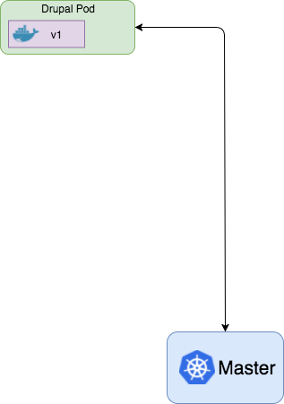
The Pod is the core Kubernetes Component
The Pod is the core component of Kubernetes
Collection of 1 or more containers
Each pod should focus on one container, however sidecar containers can be added to enhance features of the core container
spec: template: spec: containers: - name: drupal image: cr.io/repo/mydrupal:v1

Slide 5
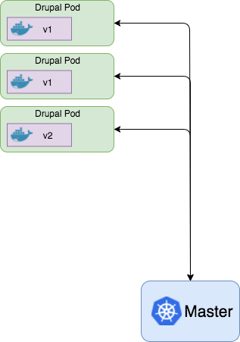
Pods can Handle Scaling and Deployments
Once Kubernetes understands what is in a pod, multiple management features are available:
System Performance
Scale up/down the number of pods based on CPU load or other criteria
System Monitoring
Probes to check the health of each pod
Any unhealthy ones get killed and new pod is put into service
Deployments
Deploy new versions of the container
Control traffic to the new pods to test the new version
Blue/Green deployments
Rolling deployments

Slide 6
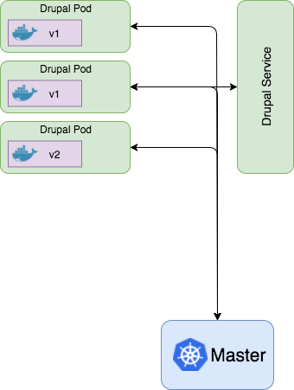
Kubernetes Services tie together the pods
Kubernetes Services are used to control communications with the pods
Load balance the requests
Don’t send traffic to the unhealthy ones
Only talk to the correct version
apiVersion: v1 kind: Service metadata: name: drupal spec: selector: app: drupal ports: - name: http-port port: 80 type: LoadBalancer

Slide 7
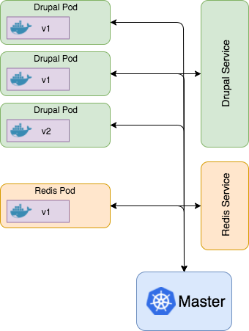
Services Structure allow multiple Components
With the Service architecture Kubernetes handles things that you often might have to worry about
Service discovery
Load balancing
Scaling
Service discovery allows each pod just needs to call the name of the service it wants to talk to
Services have multiple options
Session based load balancing
Single port based services
External Services
The Service architecture of Kubernetes can be scaled up to handle as many services as you would like for your system

Slide 8
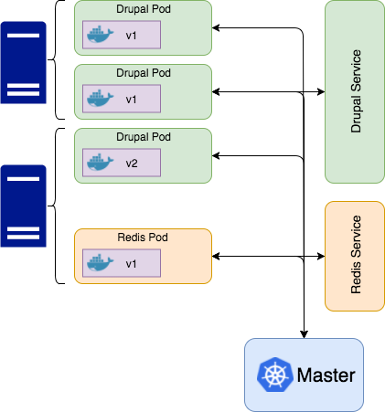
Where Is the Infrastructure?
You don’t have to worry about the infrastructure
The entire design of pods and services is described with YAML files
Nothing in deployments, pod management, service discovery, monitoring, etc required any knowledge about how many servers, IP addresses, load balancers, or anything else with the infrastructure
Behind the scenes, Kubernetes is aware of all of the servers available, load balancers, application gateways and will configure them automatically according to what is in the YAML files

Slide 9
Drupal Examples

Slide 10
Deployment
apiVersion: extensions/v1beta1 kind: Deployment metadata: name: drupal spec: template: spec: containers: - name: drupal image: cr.io/repo/mydrupal:v1 ports: containerPort: 80
Deployment—connects a Pod with replication control and rollout management
Synchronizes app configuration across instances
Production deploys are as simple as updating an image tag
No more bouncing apache on a dozen servers
Contains a Pod spec
Notes:
While the Pod is the atomic unit of the Kubernetes resource model, you’ll almost never deal with Pods directly. Instead we use deployments.
A Deployment is effectively a dynamic set of pods with replication control and rollout management.
The core of a Deployment is actually a Pod spec.
As you can see here we have defined a single container in our pod, specifying an image stored in private container registry.
Additionally we specified the credentials for accessing the container registry using a Kubernetes secret. This allows us to keep credentials out of source control but still keep them secure and available for our application.
Finally a Deployment allows us to specify how many copies of a Pod should be running at a time.
Having a fixed number of replicas is useful, but the real strength of an orchestration tool is in dynamic scailing.

Slide 11
Autoscaling
apiVersion: autoscaling/v1 kind: HorizontalPodAutoscaler spec: scaleTargetRef: apiVersion: extensions/v1beta1 kind: Deployment name: drupal minReplicas: 2 maxReplicas: 10 targetCPUUtilizationPercentage: 50
Realizes the promise of the cloud: scales your app in response to load, in real time
Kubernetes tracks resource utilization
Responds by adding or removing pods to the Replica Set
Kubernetes core supports CPU utilization
Other resources are available via add-ons
Pod autoscaling != node autoscaling
Node autoscaling for GCE and AWS as add-ons
Notes:
Autoscaling really is the ultimate promise of cloud hosting—elastic databases, elastic storage, and now, elasticity for you application
Kubernetes provides auto-scaling via a Horizontal Pod Auto-scaler.
Kubernetes tracks CPU utilization of the agent nodes and responds by scaling the replica set up or down.
In this example we have created a pod autoscaler for our Drupal deployment.
The auto scaler acts on any kubernetes resources matching the attributes in the target reference.
So here we’re targeting any deployment resource with the name “drupal”.
And instructing kubernetes to schedule an additional pod every time CPU utilization exceeds 50%, up to 10 copies.
Right now, kubernetes core only supports CPU utilization as a trigger, but other measures are available as add-ons.
But a word of caution. Pod autoscaling is not the same as scaling your VM set.
That functionality is available as add-ons for GCE and AWS.

Slide 12
Service
apiVersion: v1 kind: Service metadata: name: drupal spec: selector: app: drupal ports: - name: http-port port: 80 type: LoadBalancer
curl http://drupal/cron.php
Manages ports and internal IP’s with domain name resolution
Opens ports on agent nodes
Manages load balancing between pods
Provisions cloud provider load balancer
Exposes pods to Kubernetes service discovery
Notes:
At this point we have anywhere between 2 and 10 copies of our Drupal pod running on at most as many nodes.
We need a way to direct traffic to the correct nodes, and once there, to the correct container.
This is where a service comes in.
Just like the autoscaler, a service targets resources based on metadata. Here we target our drupal pods, specifying port 80
And finally, instruct kubernetes to provision an elastic load balancer from the cloud provider, configuring all the rules necessary to load balance across the set of nodes.
This gets us external access to our loadbalacned drupal cluster via a dynamically provisioned IP on the load balancer,
as well as including the service name in the Kubernetes cluster-internal DNS service.
In this case, “drupal” becomes a valid hostname for any pod in the cluster, allowing us to, say, trigger cron from another pod without knowing which nodes the drupal pods are running on.

Slide 13
External Service
kind: Service apiVersion: v1 metadata: name: mysql-service spec: type: ExternalName externalName: mysql.example.com ports: - port: 3306
Use RDS and provider services when possible
No need to hard code external services in your application
Adds an external resource to Kubernetes service discovery
Notes:
Another use for Kubernetes service discovery is providing DNS resolution for external services.
The most common use for a Drupal application would be accessing a Relational Database Service.
With this configuration, drupal can access the database with the hostname `mysql-service`.
First off, databases.
They’re crucial part of any Drupal site, and it’s tempting to go ahead and add MySQL to your cluster
But, when it comes to persisting data, nothing is simple
Kubernets provides the building blocks to run a stateful set of pods
But it comes down to individual cloud provider support if the data disk can be reliably identified by kubernetes and consistently attached.
In our experience, whenever possible, use the Relational Database Server provided by your cloud host

Slide 14
Deployment: Configuration Management
apiVersion: extensions/v1beta1 kind: Deployment spec: replicas: 2 template: spec: containers: - name: drupal image: cr.io/repo/mydrupal:v1 ports: containerPort: 80 env: - name: DB_HOSTNAME value: mysql-service - name: DB_PASSWORD valueFrom: secretKeyRef: name: mysql-service-secrets key: password imagePullSecrets: - name: registrykey
* $databases['default']['default'] = array( * 'driver' => 'sqlite', * 'database' => '/path/to/databasefilename', * ); * @endcode */ $databases['default']['default'] = array( 'driver' => 'mysql', 'database' => 'mydrupaldb', 'username' => getenv('DB_USERNAME'), 'password' => getenv('DB_PASSWORD'), 'host' => getenv('DB_HOSTNAME'), ); /** * Access control for update.php script. * * If you are updating your Drupal installation using * are not logged in using either an account with the * updates" permission or the site maintenance account * created during installation), you will need to modify

Slide 15
Deployment: Volumes
apiVersion: extensions/v1beta1 kind: Deployment spec: replicas: 2 template: spec: containers: - name: drupal image: cr.io/repo/mydrupal:v1 ports: containerPort: 80 volumeMounts: - name: my-drupal-volume mountPath: /drupal-7.56/sites/files volumes: - name: my-drupal-volume azureFile: secretName: azure-storage-secret shareName: <pre-existing-file-share> readOnly: false
Manages networked drives across containers and VM’s
volumeMounts sets the mount path and references a named volume
Volumes can be defined as
Pre-created named volumes
Dynamically provisioned Persistent Volume Claims

Slide 16
Nothing is easy
Notes:
So. I’m sure you saw this one coming.
Orchestration fills a big hole in managing containers in the cloud
But this is complicated functionality, wrangling disparate systems, all while being cloud host agnostic
We’ll go over a few gotchas when getting started with Kubernetes

Slide 17
Lessons Learned
Kubernetes is open source and fast moving. Cloud provider specific integrations might trail a couple versions.
Ingress Controllers
Managed Disks
While the Infrastructure is generally transparent, you still need to ensure that the cloud provider implemented Kubernetes support in a manner that meets your system needs
Internal vs External load balancers
Cluster Scaling
Leverage the strength of the open source community.
Notes:
Just as support for volumes differs between cloud providers,
The same is true for provisioning a network internal load balancer
and auto scaling a cluster
To make a long story short, Kubernetes releases a new version every 3 months with a slew of new functionality
Before jumping on the latest version, check that it works with your cloud provider
And if it doesn’t take a look at their git hub. They are moving just as quickly, and actively respond to questions and bugs
It really is an example of open source at it’s best, when you have Google, Amazon, and Microsoft all working on the same project.

Slide 18
Getting Started
Install local utilities: kubectl and minikube https://kubernetes.io/docs/tasks/tools/install-kubectl/
Checkout the Kubernetes docs https://kubernetes.io/docs/home/
Unified Logging with Fluentbit http://fluentbit.io/documentation/0.11/kubernetes/
Syslog, Docker, and Drupal https://github.com/BradJonesLLC/docker-drupal

Slide 19
Questions?
Join us at the BooZ Allen expo Booth

Slide 20
Additional Resources
Red Hat OpenShift : Enterprise implementation of Kubernetes
https://www.openshift.com/
Kops : Kubernetes cluster management utility
https://github.com/kubernetes/kops
Booz Allen’s Drupal.org Profile: https://www.drupal.org/booz-allen-hamilton
Join the Conversation…
…And Come Visit Our Booth!

Slide 21
For more Information…
Today’s Speakers – Please visit our booth for further Q&A:
Shayan Sarkar, Solution Architect, Sarkar_Shayan@bah.com
Will Patterson, Drupal Developer, Patterson_William@bah.com
Please contact Booz Allen’s Strategic Innovation Group for more information on our Drupal practice:
Arash Farazdaghi, Solution Architect, Farazdaghi_Arash@bah.com
Eric Robbins, Solution Architect, Robbins_Eric@bah.com
Craig Warsaw, Principal Solution Architect, Warsaw_Craig@bah.com
Join the Conversation…
…And Come Visit Our Booth!

