Slide 1
Let’s Migrate to Drupal 8
Presented by:
Ashma Shrestha
Karthik Baikati
Nurul Tamboli

Slide 2
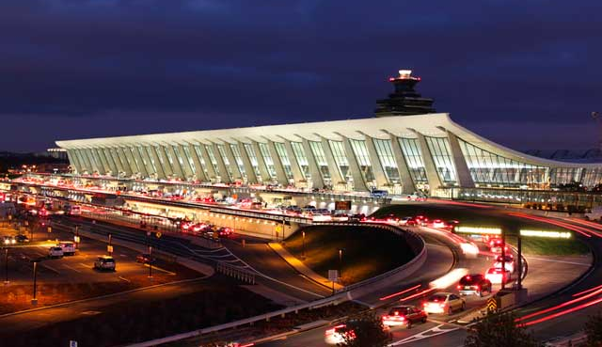
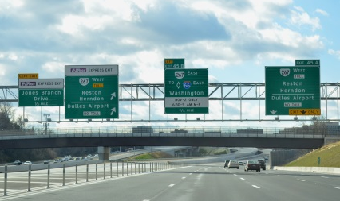
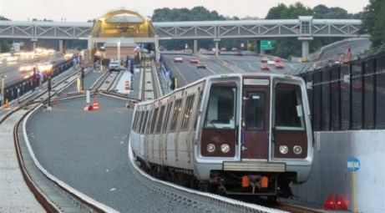
Who We Are
The Metropolitan Washington Airports Authority is an independent 2-airport system, charged with operating our airports, along with the Dulles Toll Road and construction of the Silver Line Metro.
Our mission is to develop, promote, and operate safely Reagan National and Dulles International airports, continually striving to improve our efficiency, customer orientation, and the level of air service offered at our airports.
We have 1200+ employees, and we serve over 45 million travelers, annually.
Ronald Reagan Washington National Airport (DCA)
Washington Dulles
International Airport (IAD)
Dulles Toll Road
Silver Line Metro

Slide 3
Our IT Journey
Our technology transformation at MWAA over the last few years:
From an outsourced IT function fostering a siloed culture between the two airports…
…to a strategically-aligned IT team focused on delivering efficient, flexible, future-proofed solutions
Centralized technology framework for operational and innovation excellence
Our approach: stabilize, consolidate, modernize, and innovate!

Slide 4
Our Recent IT Work
Began leveraging Drupal in 2014
Earned an MWAA Core Values Award in 2015 for FlyReagan.com and FlyDulles.com, a multi-site Acquia Drupal platform delivering information to 45 million passengers each year
Over the last few years, we developed multiple enterprise applications, including:
MWAA websites
Customer service kiosks
Multiple mobile apps
Airport digital display systems
Workday HR and Financials integration
GIS applications
veriScan biometric traveler verification system

Slide 6
Notable Achievements
SXSW 2019 Finalist
Digital Edge 50 winner
CIO100 Award winner
W3 Award Silver Award winner

Slide 7
What We Will Cover
Prepare for data migration
Overview of the Migrate API and migration plugins available
Overview of migration configuration to get started
Set up of a custom migration plugin
Demo migration process using drush as well as Migrate Drupal UI

Slide 8
What We Will Not Cover
Migrating multi-lingual websites
Migrating from versions early than Drupal 7
Migration from CVS or other datasource than Drupal 7 database

Slide 9
Where Do We Start?

Slide 10
Audit Your Website
Each organization has their own different set of challenges, but the initial step is always AUDIT:
Account for all the custom and contrib modules
Keep track of the migration path for each of the module
Generate a plan for unsupported modules
Generate a plan for custom module and data associated with it
Discuss/ Reach out to the community

Slide 11
Let’s Understand the Process
Every migration is defined as migration plugin Source - https://www.drupal.org/node/2127611
SOURCE
Drupal 8
Step 1:
Extract Data
using Source Plugin
Step 2:
Transform Data
using Process Plugin
Step 3:
Load Data
using Destination Plugin

Slide 12
What Tools Are Available
Yeahhh!! Migrate Module in Core
Core Modules
Migrate
Migrate Drupal
Migrate Drupal UI
Supporting Modules
Migrate tool - https://www.drupal.org/project/migrate_tools
Migrate Plus - https://www.drupal.org/project/migrate_plus
Migrate Upgrade - https://www.drupal.org/project/migrate_upgrade
Migrate Manifest - https://www.drupal.org/project/migrate_manifest

Slide 13
Let’s Start
Database setup and configuration
YAML Configuration File
Migration YAML File layout

Slide 14
Hurdles Faced
Nested Field Collection to Paragraphs
Image and file fields to Media
Workbench Moderation to Content Moderation
Link for Known Issues:
https://www.drupal.org/docs/8/upgrade/known-issues-when-upgrading-from-drupal-6-or-7-to-drupal-8

Slide 15
Our Solution
Nested Field Collection to Paragraphs ( Live Code Share)
Image and file fields to Media (Live Code Share)
Workbench Moderation to Content Moderation (Live Code Share)

Slide 16
Let’s Demo

Slide 17
Some Useful Drush Commands
migrate-status: lists migrations and their status.
migrate-import: performs import operations.
migrate-rollback: performs rollback operations.
migrate-stop: cleanly stops a running operation.
migrate-reset-status: sets a migration status to Idle if it's gotten stuck.
migrate-messages: lists any messages associated with a migration import.

Slide 18
Questions? Comments?

