Slide 1

Supporting Native Americans
Through Drupal

Slide 2
Who Are We?
Office of Information Management Technology,
Assistant Secretary – Indian Affairs
  Tony Morris (TMorris), IT Specialist
  Chris Allen (cjallen-bia), IT Specialist
  Mella Tapang , IT Specialist
  Chip Hossfeld, CollabraLink

Slide 3
Indian Affairs Background
Oldest agency of the United States Department of the Interior (Established in 1824).
Provides services to approximately 1.9 million American Indians and Alaska Natives.
Supports 573 federally recognized American Indian tribes and Alaska Native Villages in the United States.

Slide 4
Session Objective
What is this Session All About?
Discuss accomplishments during the Indian Affairs Internet Migration Project.
Discuss enhancements after launch of the new site in Drupal 7.
Adapting experience into Intranet Site development.

Slide 5
What Happened?
What happened?
In 2017, Indian Affairs set out to migrate its public website from Oracle WebLogic to Drupal 7.
CollabraLink was awarded the contract.
Team worked through 3 phases for 8 months.

Slide 6
Drupal Project
IndianAffairs.gov Drupal Project
Phase 1 - Research and Requirements (Discovery Phase)
Phase 2 - User Experience and Design
Phase 3 – Migration and Implementation

Slide 7
Phase 1
IndianAffairs.gov – Phase 1
Reviewed Content Inventory
Reviewed existing Content Management System (CMS)
        Reviewed Analytics
        Conducted Stakeholder Interviews
        Reviewed Feedback
        Persona-based Content Strategy

Slide 8
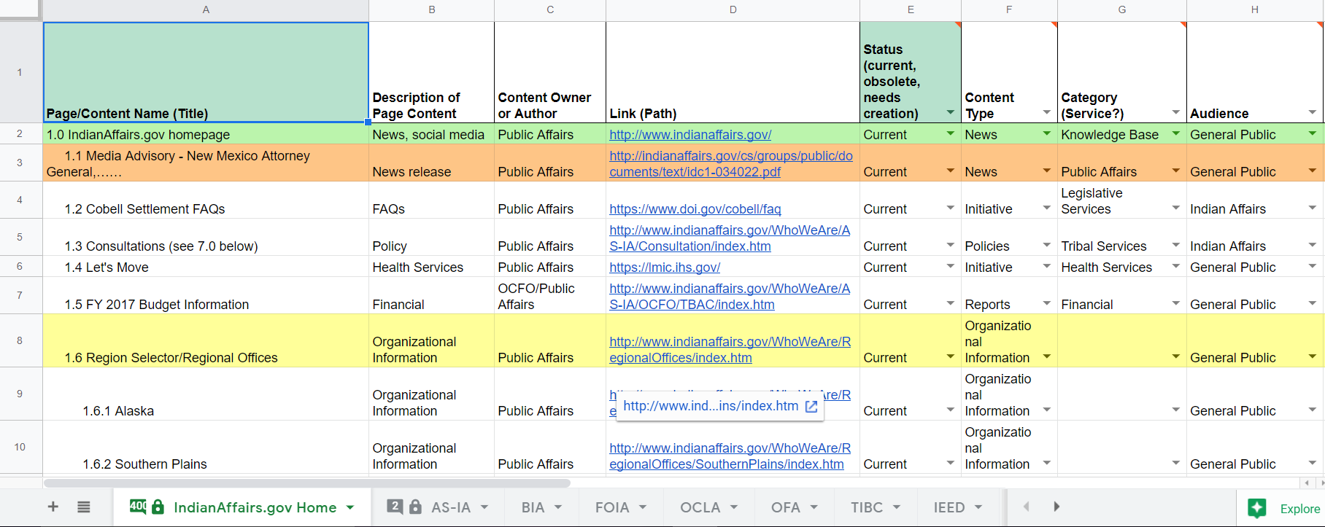
Content Inventory
Content Inventory

Slide 9
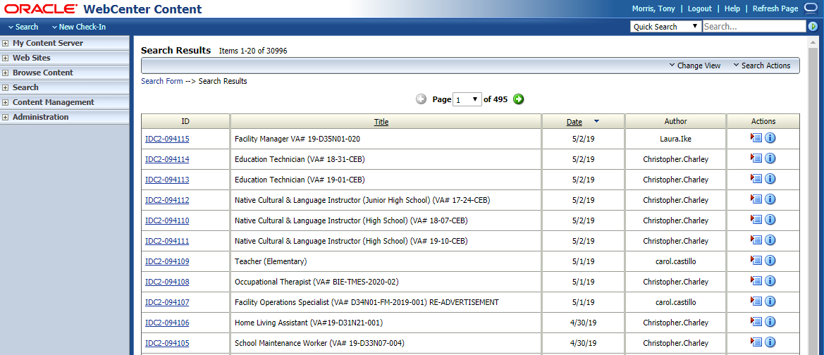
UCM
Oracle WebLogic (UCM)

Slide 10
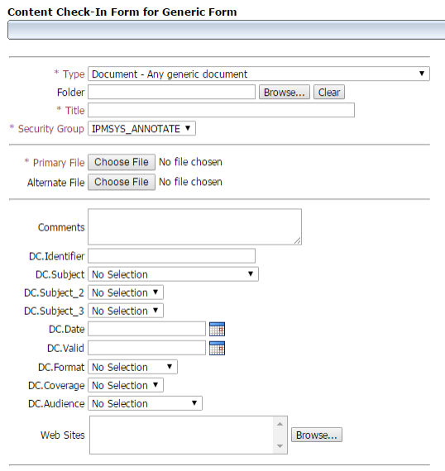
WebLogic
Oracle WebLogic ...continued
Security Groups:
WebTeam
ASIA
BIA
BIE
IEED
OCFO
OFA
RACA

Slide 11
Phase 2
IndianAffairs.gov – Phase 2
        Taxonomy Scheme
        Permissions Matrix
        Site Map, Design and Navigation - Public Affairs
        Migration Plan
Notes:
Taxonomy Scheme - based on federally recognized tribes and their related offices and states - Compared with Tribal Leader Directory Map for accuracy;
Permissions Matrix - User Roles and Groups

Slide 12
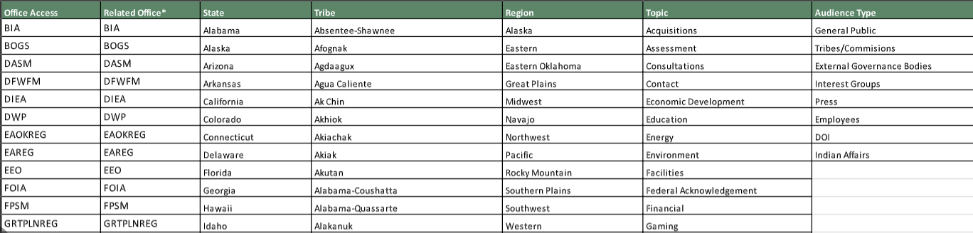
Taxonomy
Taxonomy Scheme

Slide 13
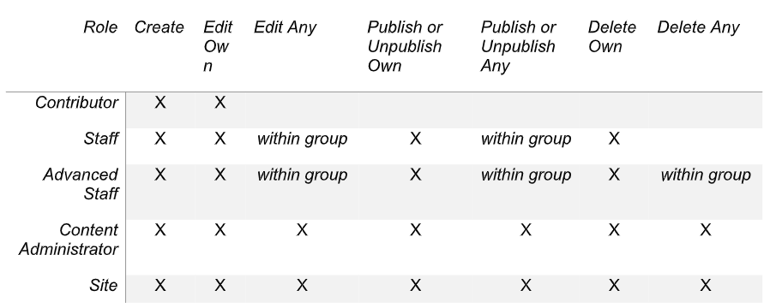
Roles
Permissions Matrix - Roles

Slide 14
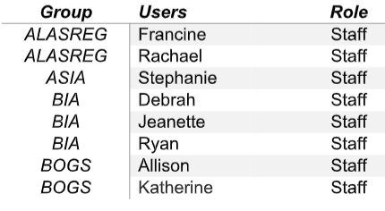
Groups
Permissions Matrix - Groups

Slide 15
Phase 3
IndianAffairs.gov – Phase 3
        Content Migration
        Implementation Plan
        Inherit modules from OpenPublic D7 distribution
        GitLab version control, Jenkins code deployment
        Content Types
        Blocks and Views
Notes:
Content migration - based off of content inventory

Slide 16
Content Migration
Content Migration
Clean up content from UCM
URL Mapping
  Paths
  Related documents
  Redirects
Asset Management

Slide 17
GitLab Jenkins
GitLab and Jenkins
Within DOI Platform utilized GitLab for code repository (DEV/PROD)
  Git workflow (merge request from developer branches, once merged new tags were created identifying latest build)
Jenkins for CI server (continuous delivery hub for our project)
  Jenkins build created off of GitLab tag

Slide 18




Content Types
Initial Content Types

Slide 19
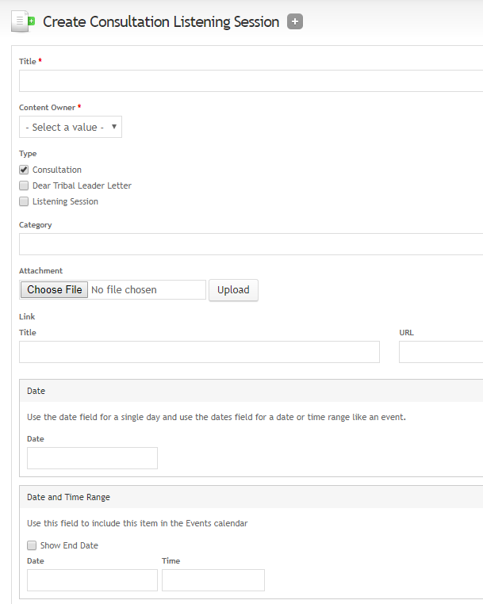
Consultations
Consultations
Listening sessions of public tribal meetings observed by Public Affairs office and Office of Regulatory Affairs and Collaborative Action (RACA).

Slide 20
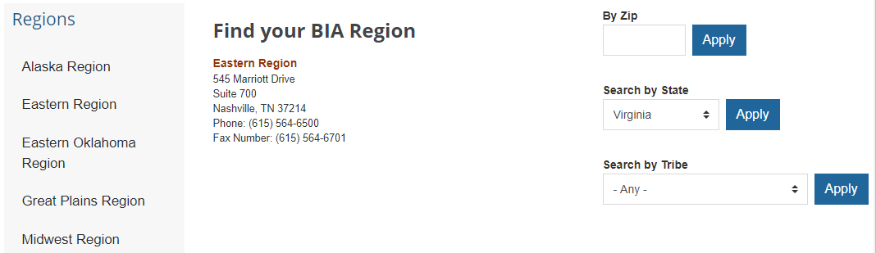
Office Search
Regional Office Search

Slide 21
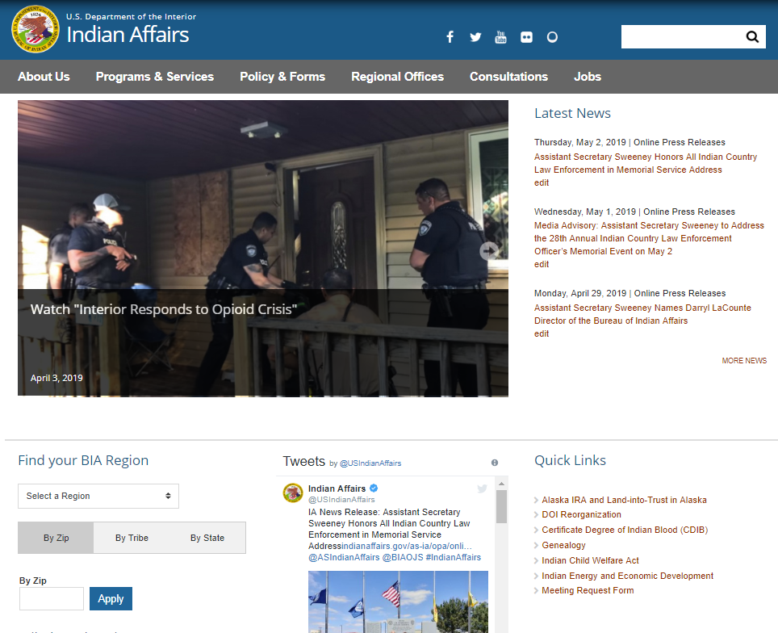
Launch
Site Launch
        IndianAffairs.gov
        aka
        BIA.gov
Notes:
Expand on launch

Slide 22
Enhancements
Enhancements
        Customized processes for user groups to add content through new content types
Federal Acknowledgement Petitions
Regulatory Affairs Handbooks, Memorandums and Online Forms
Indian Gaming Compacts
Wildland Fire Stories, Fire Information Bulletins
Online Press Releases
Tribal Leader Directory
Cleaned up modules (DOI Open Public Distribution)

Slide 23
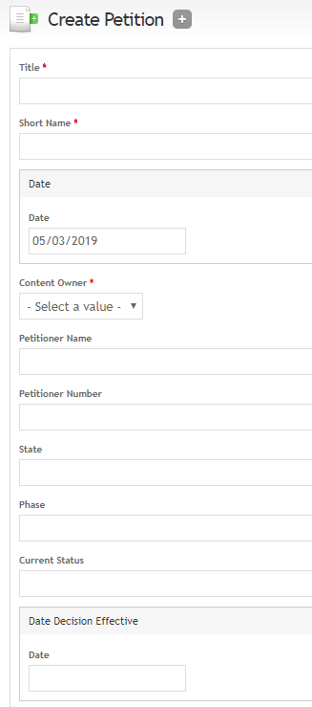
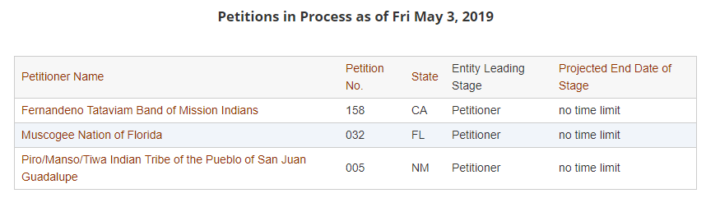
Petitions
Petitions

Slide 24
RACA
Regulatory Affairs and Collaborative Action
Office is responsible for a broad range of regulatory functions that involve collaboration with all Indian Affairs (IA) bureaus, offices, Tribal partners and other stakeholders.
  Required several content types that allowed latest version of attachments (pdfs)
  Developed these content types using attachment links (obtain latest version of attachment)
  Developed pages with Views conditionals based on certain page requirements

Slide 25
Gaming Compacts
Gaming Compacts
Gaming Compacts are policies declared necessary for any Class III gaming on reservations under the Indian Gaming Regulatory Act of 1988 (IGRA).
Designed to allow tribal and state governments to come to a "business" agreement.

Slide 26
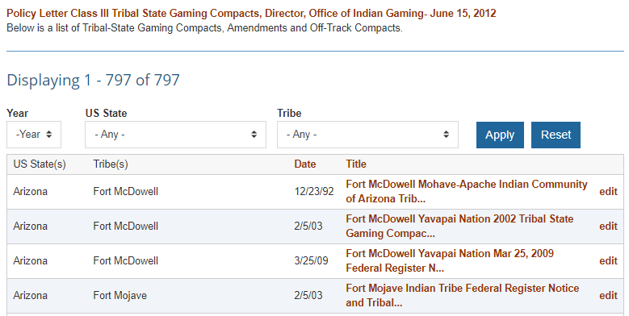
More Gaming Compacts
Gaming Compacts ...continued

Slide 27
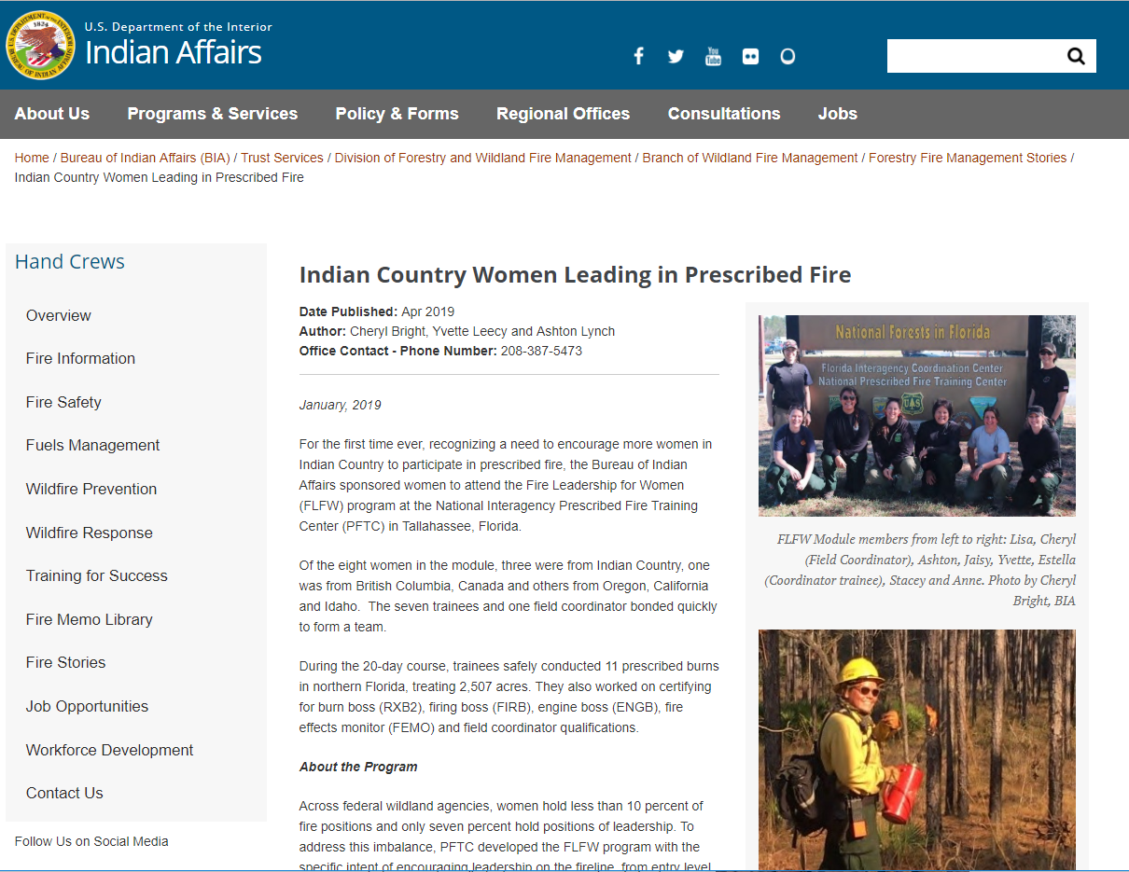
BWFM
Branch of Wildland Fire Management
Office utilized PDFs to generate periodic “Fire Stories”
Developed content type and custom template

Slide 28
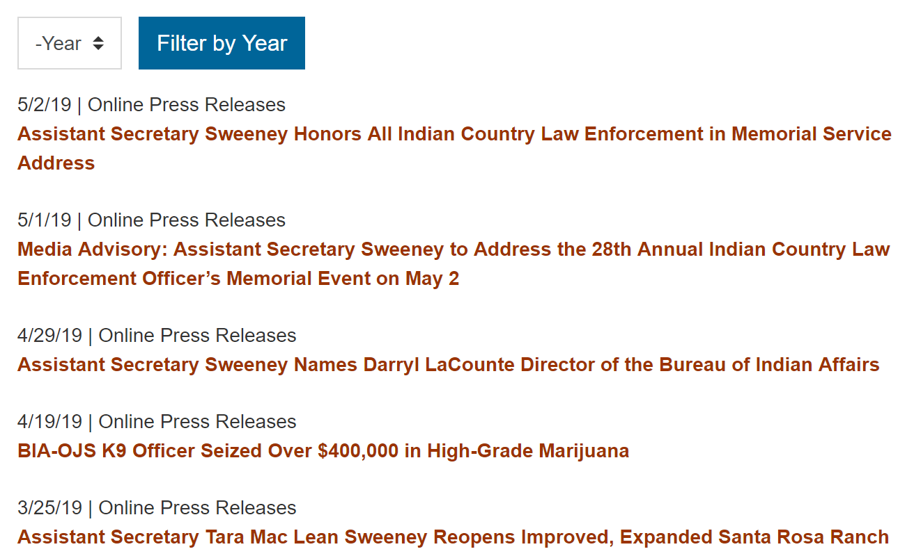
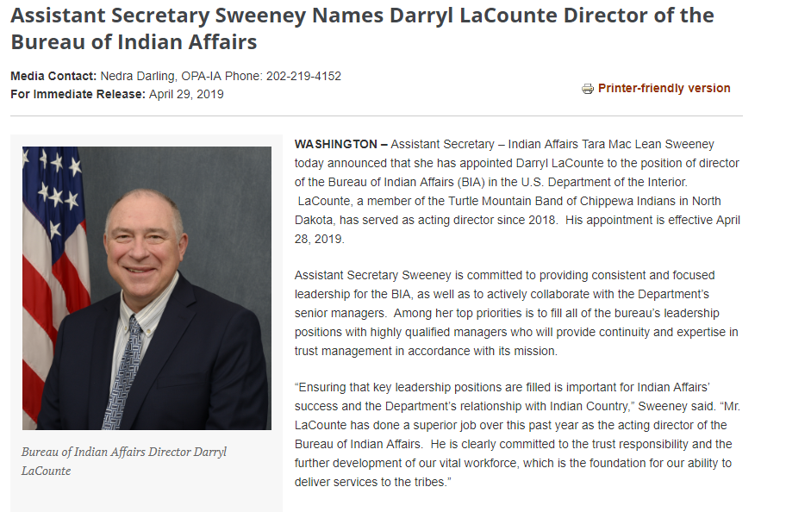
508 PRs
508 Compliant Press Releases

Slide 29
508 PRs 2
508 Compliant Press Releases
Online Press Releases - converted over 3,400 non-compliant PDFs to HTML pages over the course of five months.
PDFs
Content Type
Developed Google Sheet and assigned years to team.
Interns assisted with OCR conversion of non-compliant PDFs.
We learned that OCR process was all that was needed on original PDF (as opposed to saving compliant PDF).
Team assigned years to convert over into content type.
QA/QC was performed during and after conversion for spell checks, tables, styling, etc.

Slide 30
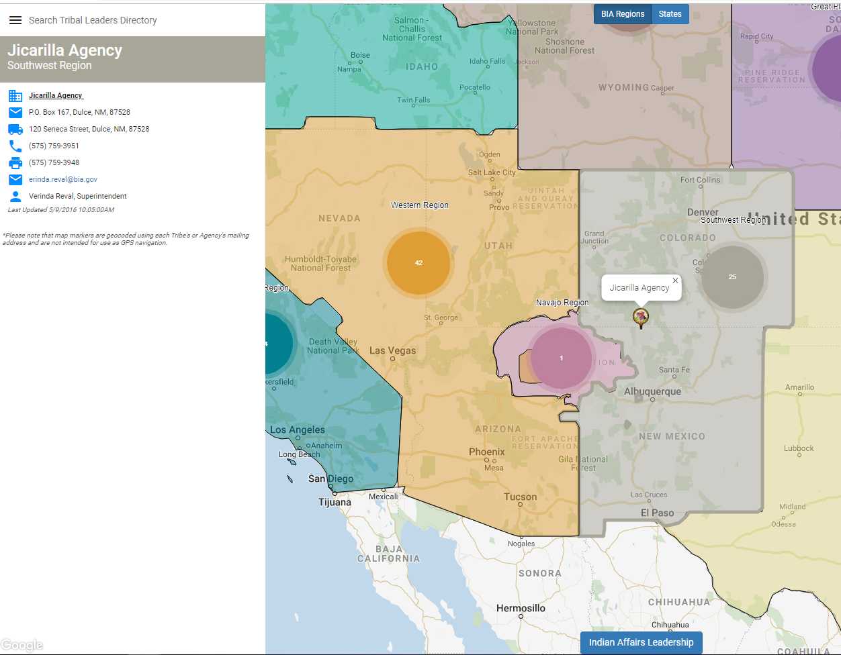
TLD
Tribal Leader Directory
Angular App that integrates with Drupal.
Team added new content type “Tribal Leader”.
Used Feeds Parser module to pull in data in CSV into “Tribal Leader” content type.
Now users with permissions can edit/update Tribal Leader dataset with Drupal content type.

Slide 31
Intranet
Intranet Project
BIA.gov replication
Permissions for users
Context data for offices, bureaus, regions
Taxonomy scheme
What we learned helped us use an Agile development approach.

Slide 32
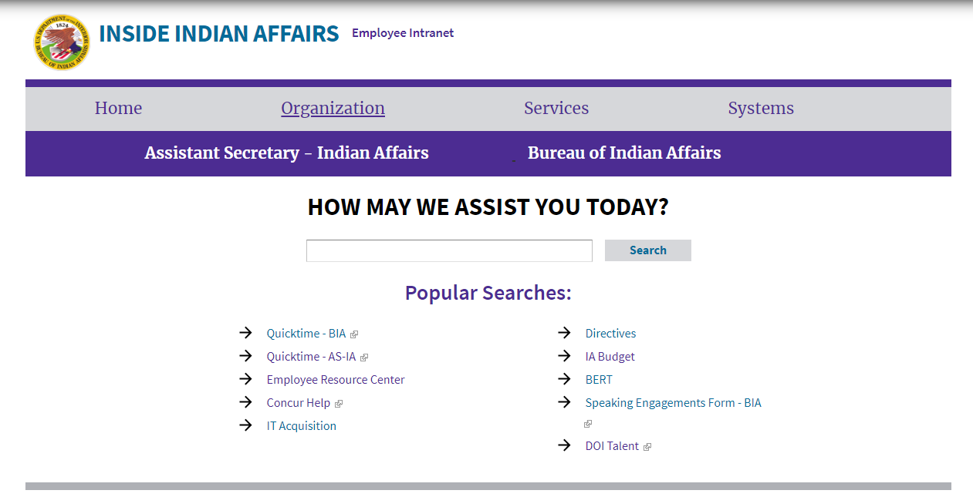
Intranet
Intranet Project

