Slide 1
A New Information Architecture for the NC State Board of Elections
[Early Draft. Website is currently being built and will go live in August]
Lois Nilsen
Content Strategist and Drupal Product Owner
Digital Solutions Section
NC Department of Information Technology

Slide 2
Existing Site
Updates to current CMS (DNN) difficult
Clunky integrations with online applications
Long blocks of text
Site visitors can’t find info
Complaints come in that SBE can’t address (candidate signs). Need to educate site visitors

Slide 3
NC Digital Commons Program
Run by Digital Solutions in the NC Dept of Information Technology
60 websites
Currently migrating to D8
Content Types for Government:
  Press Release
  Data Table
  Events
  Service Catalog

Slide 4
Office of Digital Solutions:
A Digital Agency within NC Government
Content Strategy Process:
Analyze old site: internal and site visitor surveys, analytics, site crawl
Writing for the Web Training
Personas and Top Tasks
Card Sorting: open then closed
Information Architecture
Migration Map

Slide 5
Our Process Strives to …
Create a shared understanding of goals
Provide the agency with governance best practices
Emphasize stakeholder buy-in throughout
Rely on the website owner to do much of the heavy lifting

Slide 6
Analysis: Bd of Elections Site Visitor Survey
Site visitors overwhelmingly requested “make information easier to find”
Top Tasks from site visitor survey:
  Search voter registration status
  Learn how to vote absentee by mail
  Find a sample ballot for an upcoming election
  Examine election results
  Find when and where to vote
  Download forms

Slide 7
Analysis: Bd of Elections Stakeholder Survey
“Website helps to provide transparency and improve confidence in our elections.”
“Voters are going to be looking for transparency, honesty and what is the NCSBE going to do to secure their vote and safety.”
“Foremost, voters in NC should be able to easily gather information on their voting status, including registration and sample ballots.”
“Ease of access to public data should be the first objective for the website.”

Slide 8
Analysis: Crawl of Existing Bd of Elections Site
Existing site map
  Is it organized?
  Is it logical?
  How much ROT?
  Agency IDs pages that will migrate
Title Tags and Meta Descriptions
Images and their Alt Text

Slide 9
Writing for the Web Training
Write for Site Visitors
Be as Brief as Possible
Chunk Information
Make Link Text Meaningful
About PDFs
Emphasis
When to use tables
When and how to use FAQs
Effective parent pages

Slide 10
Elections Personas and Top Tasks
Types of Site Visitors
Top Tasks for Voters
Voter
Candidate
Researcher
Treasurer of a Political Action Committee
Locations and schedules for early voting
Location of assigned Election Day voting precinct
Find voter registration status
Learn options to register to vote
Obtain a sample ballot
Learn voting options

Slide 11
Begin the New Site Map with Online Card Sort
[Video Demo of Optimal Workshop Card Sorting]

Slide 12
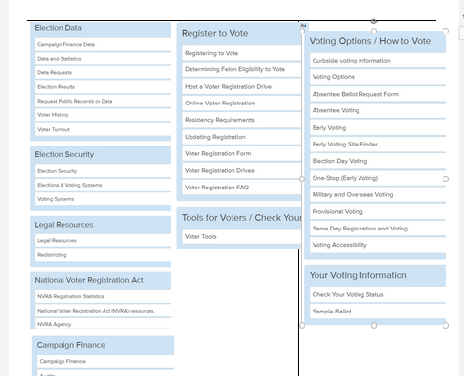
Card Sort Results in High Agreement

Slide 13
Card Sort Results—Little Agreement
[Video Demo of Optimal Workshop Closed Card Sort]

Slide 14
Difficult Discussion
Twelve topics, but only 7 fit on the menu
Merge and rename discussions with key stakeholders

Slide 15
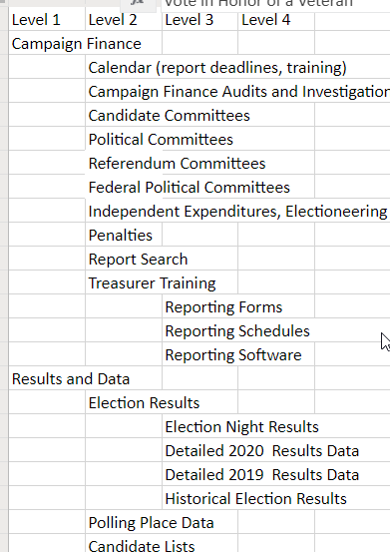
Result: High Level Site Map
Not yet exhaustive of all pages
Need to verify with site visitors

Slide 16
Tree Test
[Video Demo of Optimal Workshop Tree Test]

Slide 17
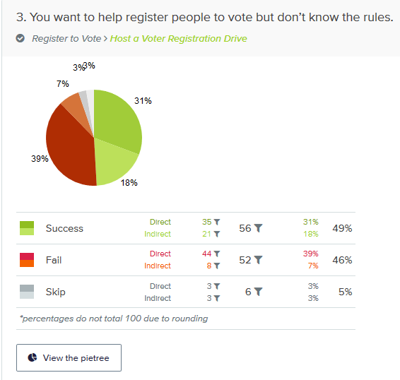
Tree Test Data

Slide 18
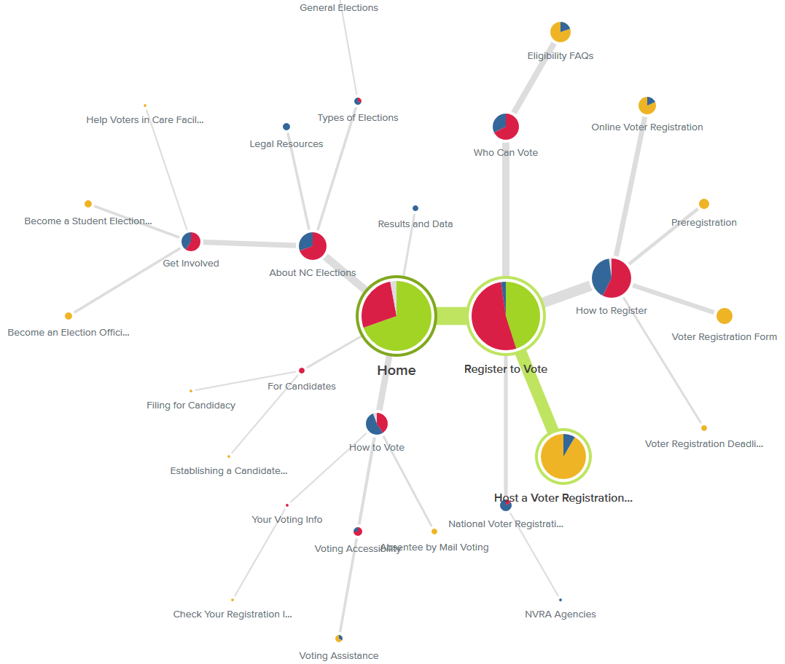
Deeper Dive into Tree Test Data
Remediate with:
  Cross-linking
  Changing menu labels
  Moving sections
Limitations of Tree Tests

Slide 19
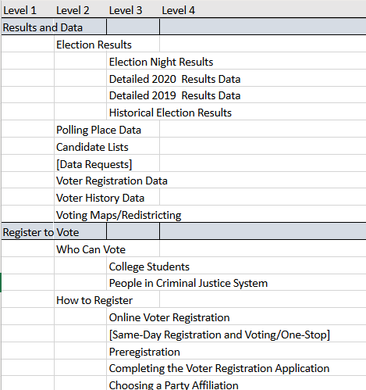
Site Map
Fill in all sections
Coach the agency – Don’t do it for them

Slide 20
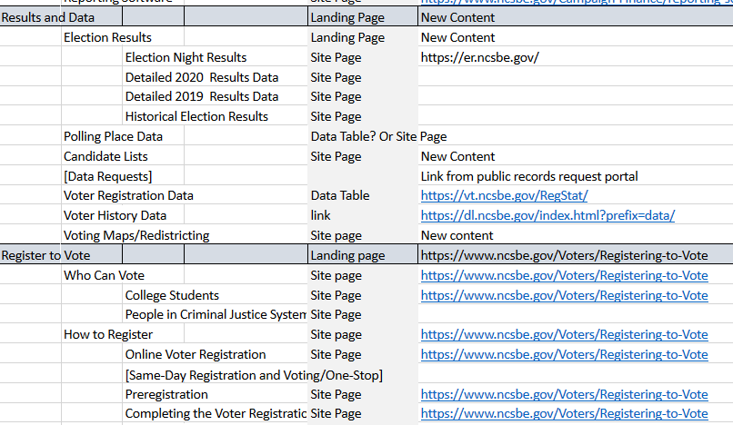
Turn the Site Map into a Migration Map
Add content types
Add pages that will feed content into new pages
Designate where new content is needed

Slide 21
Post Launch Site Visitor Survey

Slide 22
Lessons Learned

Slide 23
Thank You!

