Slide 1
“Was This Page Helpful?” Drupal said to Google
Presented by
Heather Skinner | Booz Allen Hamilton
Souleymane Coulibaly | Booz Allen Hamilton
Drupal govcon 2017

Slide 2
overview
Digital Strategy
Why integrate feedback with web metrics?
How to:
Create a feedback form
Use the dataLayer
Push data to Google Analytics
View the data insights using Google Analytics & Data Studio
Apply these concepts for other solutions

Slide 3
The Digital Strategy
PLAY 12
Use data to drive decisions
…Along with monitoring tools, a feedback mechanism should be in place for people to report issues directly…. https://playbook.cio.gov/

Slide 4
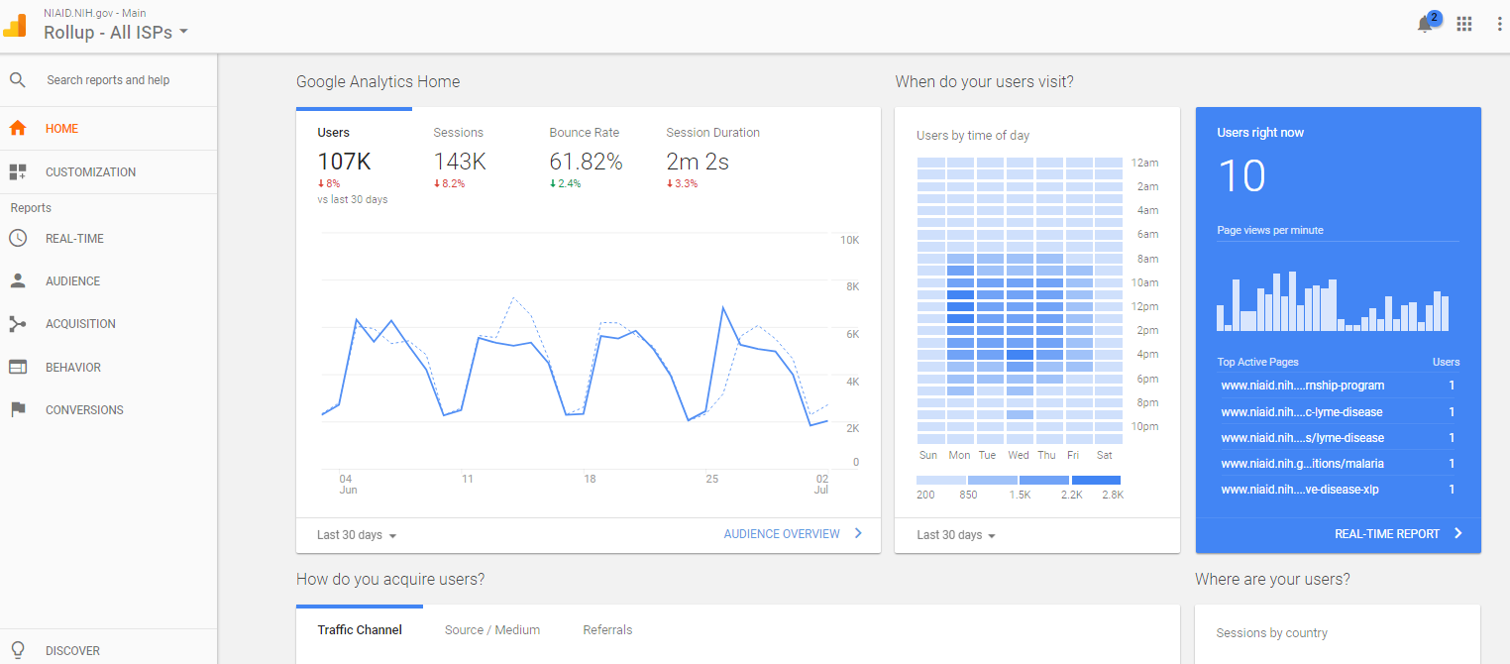
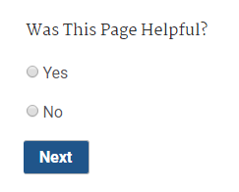
Getting feedback responses into Google Analytics

Slide 5
Why would we do that?

Slide 6
Information is too often siloed
Photo credit: dataflog.com

Slide 7
Every department, specialty, role, etc. has their own data set.
Feedback Responses
Google Analytics
Marketing
CMS data
Server data
Other
Photo credit: dataflog.com

Slide 8
Every department, specialty, role, etc. has their own data set.
“CTR increase by 50%”
“1 out of 5
users say…”
“200,000 followers!”
“Top Ten Pages”
“Last reviewed date: 2012”
“!$&%?”
Feedback Responses
Google Analytics
Marketing
CMS data
Server data
Other
Photo credit: dataflog.com

Slide 9
Take every bit of data with a grain of salt.

Slide 10
Learn from data with a broader perspective.

Slide 11
Quick answers don’t always tell the whole story.
Feedback Response Data
Page | Helpful | Not Helpful | Total Responses | % Helpful | % Not Helpful
Page One | 1 | 4 | 5 | 20% | 80%
Page Two | 1 | 4 | 5 | 20% | 80%
Page Three | 5 | 5 | 10 | 50% | 50%
Page Four | 7 | 3 | 10 | 70% | 30%
Google Analytics Data
Page | Pageviews
Page One | 100
Page Two | 20
Page Three | 100
Page Four | 42
waitbutwhy.com
Instant Gratification Monkey, waitbutwhy.com

Slide 12
Understand data with perspective.
Feedback Response Data
Page | Helpful | Not Helpful | Visitors | % Helpful | % Not Helpful
Page One | 1 | 4 | 100 | 1% | 4%
Page Two | 1 | 4 | 20 | 5% | 20%
Page Three | 5 | 5 | 100 | 5% | 5%
Page Four | 7 | 3 | 42 | 17% | 7%
Google Analytics Data
Page | Pageviews
Page One | 100
Page Two | 20
Page Three | 100
Page Four | 42

Slide 13
How tos…
Create a feedback form in Drupal
Utilize the dataLayer
Push data to Google Analytics using Google Tag Manager

Slide 14
Creating the Feedback Form
Similar Libraries Angular
React
Ember
Vue
Drupal 7 Module
Generates a block

Slide 15
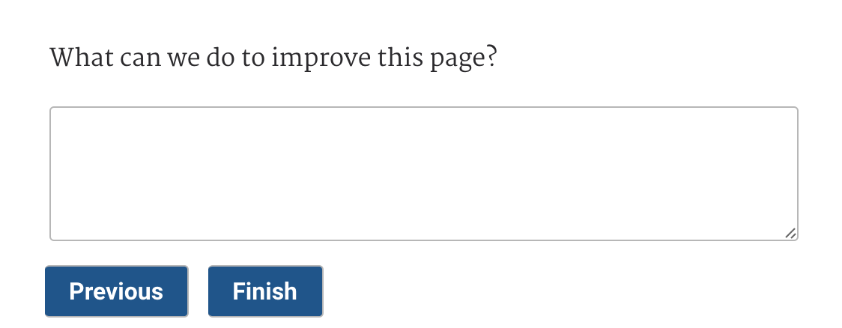
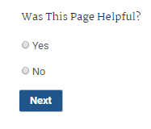
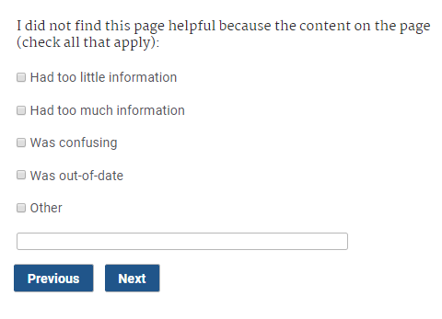
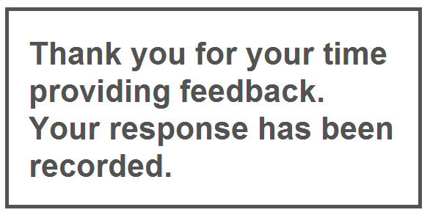
Creating the Feedback Form

Slide 16
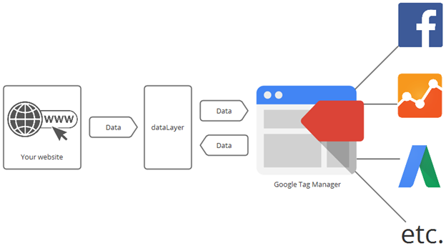
Getting feedback responses into Google Analytics

Slide 17
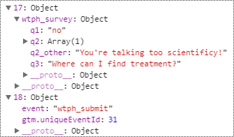
Utilizing the dataLayer

Slide 18
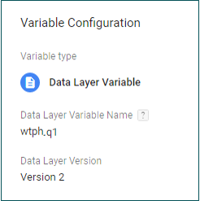
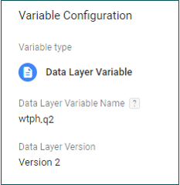
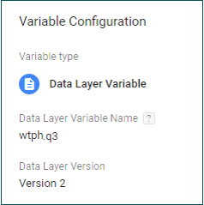
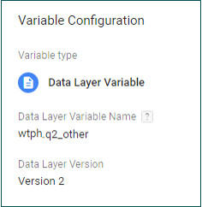
Creating Variables

Slide 19
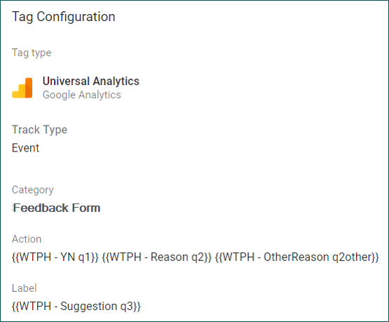
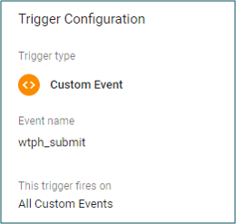
Creating the Trigger and the Tag

Slide 20
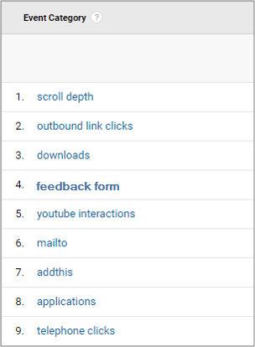
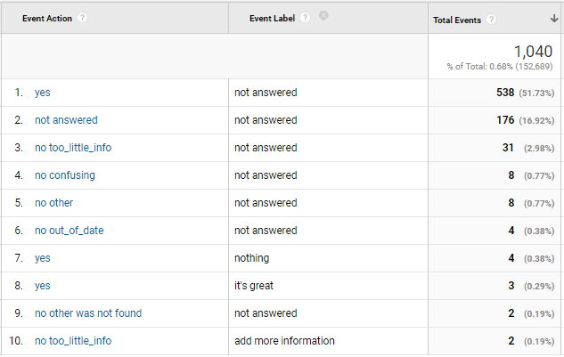
Google Analytics Events

Slide 21
View the data insights using Data Studio

Slide 22
Google Data Studio

Slide 23
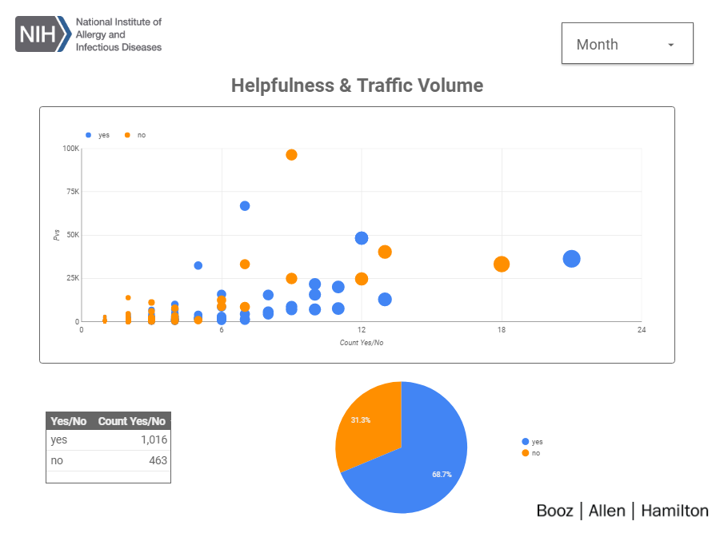
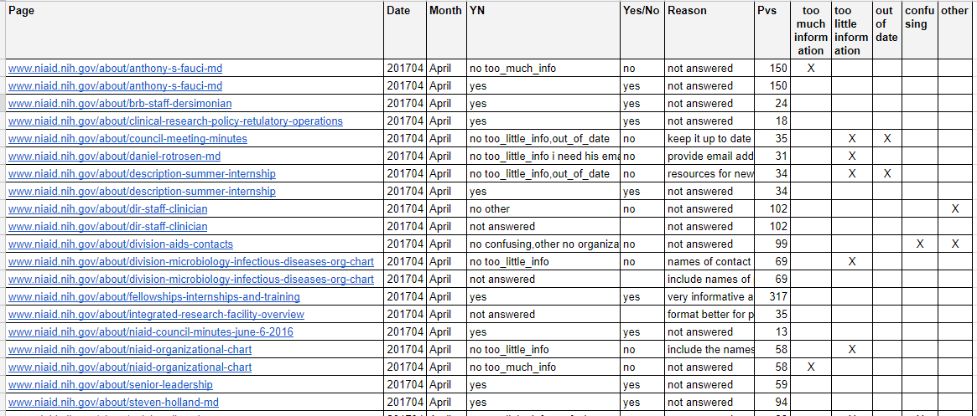
Integrate Data using Google Sheets

Slide 24
Other Uses to Consider
Use the dataLayer to capture Drupal elements
Author
Last update date
Taxonomy
Other meta data
Automate event tracking
Outbound links
Downloads
Video views

Slide 25
How to Convince Your Developers

Slide 26
Make These Promises
I will no longer interfere with your HTML DOM structure.
I will no longer ask you to add tags to the site, not for marketing, surveys, analytics, or anything else.
I will be happy and forever grateful.

Slide 27
Review
Developer buy-in
Insightful reporting
Was this page helpful?
Auto-event tracking
Drupal elements (author, last update date)
Google Analytics & Google Data Studio & Google Sheets
Utilizing the dataLayer & using Google Tag Manager
How to create the “Was This Page Helpful?” tool

Slide 29
Additional Resources
“Was This Page Helpful?” Tools
Drupal Module: https://www.drupal.org/sandbox/csouley20/2888212
Google Analytics Custom Report: https://analytics.google.com/analytics/web/template?uid=1beOaKfhSxuFm6FBYlDRcg
Websites mentioned in this presentation:​
National Institute of Allergy and Infectious Diseases (Public Website)​
https://waitbutwhy.com/2016/03/my-ted-talk.html - Tim Urban’s TED Talk
Booz Allen’s Drupal.org Profile:​
https://www.drupal.org/booz-allen-hamilton
Join the Conversation…
…And Come Visit Our Booth!

Slide 30
For more Information…
Today’s Speakers – Please visit our booth for further Q&A:
Heather Skinner, Lead Web Analyst, Skinner_Heather@bah.com
Souleymane Coulibaly, Lead Engineer, Coulibaly_Souleymane@bah.com
Contact NIAID’s New Media and Web Policy Branch to learn more about NIAID web projects:​
Tori Garten, Branch Chief, tori.garten@nih.gov​
Alice Litsinger, Supervisory Digital Information Specialist, litsingera@niaid.nih.gov
Please contact Booz Allen’s Strategic Innovation Group for more information on our Drupal practice:
Arash Farazdaghi, Solution Architect, Farazdaghi_Arash@bah.com
Eric Robbins, Solution Architect, Robbins_Eric@bah.com
Craig Warsaw, Principal Solution Architect, Warsaw_Craig@bah.com
Join the Conversation…
…And Come Visit Our Booth!

Slide 31
Thank you!

