Slide 1


Bringing USAJobs to www.Forest Service.fed.us
No code required, snap and fit Drupal pieces.
Notes:
Hi everybody! How are we doing today?
Good! … Here’s a hypothetical question,

Slide 2
?
Notes:
What would you do to find Forest Service jobs?
Search “Forest Service”?
Search “Government jobs”?
You will end up at Forest Service Jobs page.
What would you do if you wanted to find a Forest Service job?
Would you search for “Forest Service” or "Forest Service jobs" on Google?
Maybe you search Google for "how to find a government job" and go from there.
Whatever way you start, you are probably going to end up in one of two places, the Forest Service site, or the USAJobs site.

Slide 3
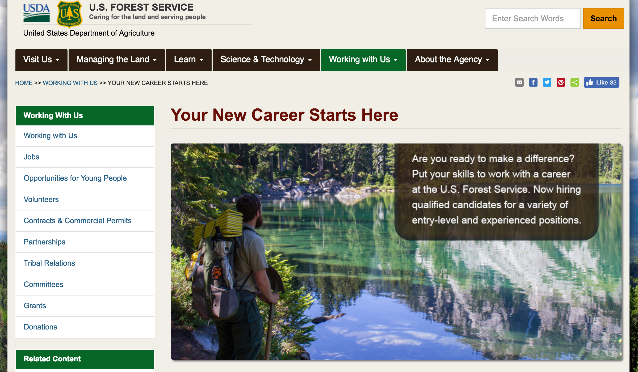
Option A
Notes:
Either way, a few months ago, if you had done what most people did to find a Forest Service job online, you would have ended up at a page on the Forest Service site called Jobs, which sounds awesome, except for it had exactly no jobs on it. It came up first on Google, but you couldn’t see any jobs there.

Slide 4
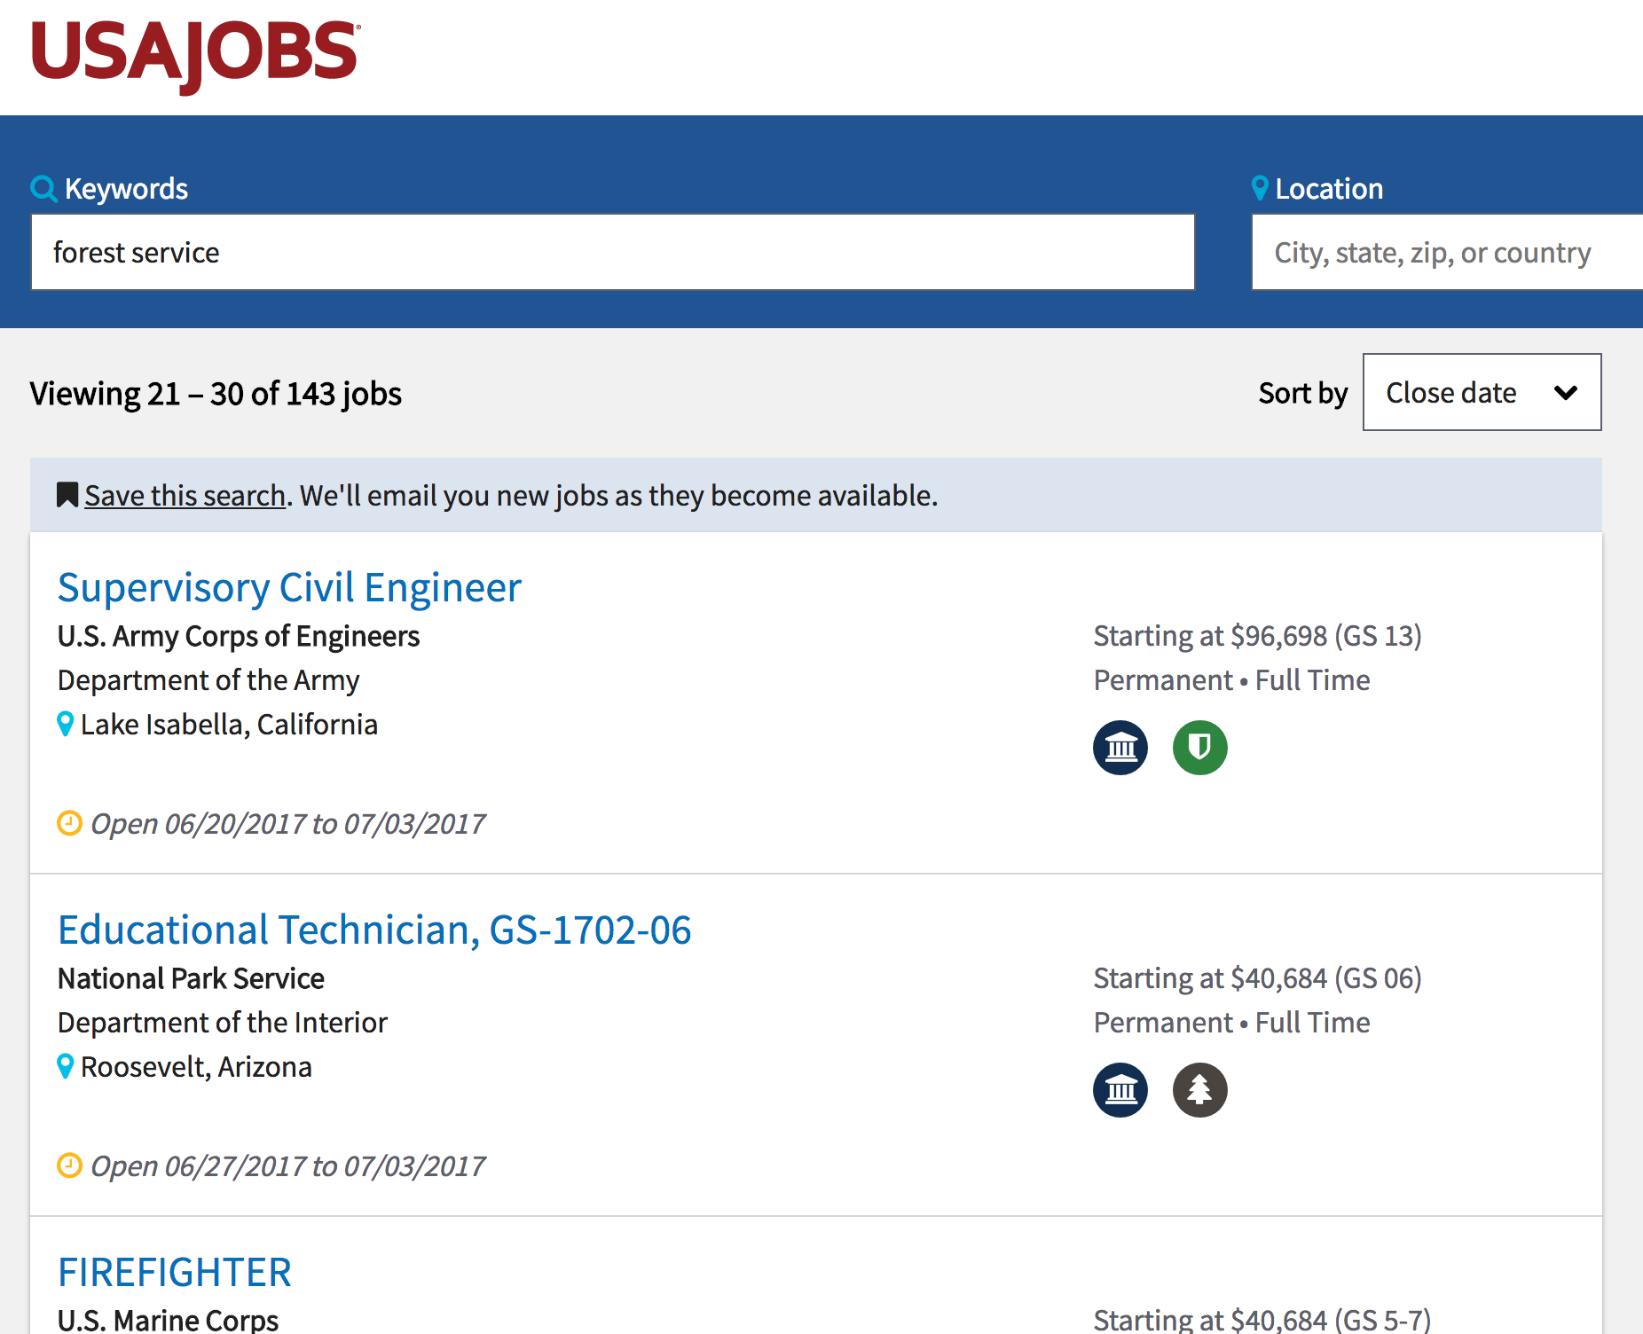
Option B
Notes:
Best way is USAJobs search “Forest Service”
But NOT agency specific
Just words “Forest” and “Service”
No agency filter
The best way to find a Forest Service specific job online would have been to find USAJobs, and search that site for Forest Service, which would have produced a wide variety of jobs that to a large degree were not even USDA Forest Service jobs. They were just jobs that had the words "forest" and "service" in them. The issue with this search site is that it has no filter for agency.

Slide 5

Ok, I’m lost!
Notes:
Not a good way
Need tailored for Forest Service
Need it where it is expected ON Forest Service Jobs page
This was obviously not a good way to put jobs in front of people who were looking for them. We needed a tailored solution that would find USDA Forest Service specific jobs and present them to people where they might expect to find them. We needed a list of jobs on the Forest Service site on that Jobs page that you would have found on your first Google search.

Slide 6
Patrick Teglia
Drupal Architect – USDA Forest Service CIO Drupal Enterprise Web Team
Notes:
I am Pat Teglia, and I am the Drupal architect for the USDA Forest Service CIO Drupal Enterprise Web Team and I am going to show you how my team built this solution without making any custom modules or having to deal with writing any custom code. I will give you the parts, and at the end you should be able to understand how they all work together.
I would like to take a moment to recognize the efforts of my team, particularly Maija Barnett for getting her fingers on the keyboard and popping out the first iteration of this feature for our site, and Harris Mahedavi for so many awesome insights and guidance, and to Raj Lal and all of you, for making it possible to get back and refactor this and make it generic for this presentation!
Also, please, no need to take notes, this presentation, and the link to the entire feature code on github, are attached to my session page.

Slide 7
So, why didn’t you use XYZ?
USAJobs module
USAJobs Integration module
Views JSON Query module
Advanced Authentication HTTP Fetcher
Notes:
Many ask why?
Many considered, none fit
1 – only showed preconfigured based on PUBLIC API
2 – same but only D8 too
3 – Issues with auth headers
4 – Took more setup and didn’t directly work with our type of authentication
We didn’t want to hack, and our needs were to specific for most of these
Many will ask why we didn't use any number of other possible solutions. I will say that we considered many, but none met our ultimate use case. For example:
USAJobs module, only showed a preconfigured block using only the public API which wouldn't allow agency specific selections
USAJobs Integration module, same as above basically, as well as being D8 only
Views JSON Query module, issues with authentication headers
We didn't want to hack current modules, and our needs were a bit too specific for current uses already, time to build our own!

Slide 8
Before you begin…
Get
your USAJobs API Token: https://developer.usajobs.gov/APIRequest/Index
Get
an API tool like Postman or ARC or similar
Have
a running Drupal 7 site
Notes:
We are going to need to do one or two things before we start snapping the pieces together.
1- First, get API Token from USAJobs
Very quick process, fill out form, get a token in email
2 – Need a tool to test AUTHENTICATED HEADERS
And view JSON results to test your API calls
3 – Lastly, need a Drupal site to put this on.

Slide 9
All the pieces
Probably have | Where the magic happens
ctools | feeds_ex (Feeds extensible parsers)
feeds | feeds_httpfetcher_append_headers
link | feeds_jsonpath_parser
list | feeds_tamper
options | job_scheduler
taxonomy | views_bootstrap
text | views_selective_filters
views | "jsonpath-0.8.1.php" library https://code.google.com/archive/p/jsonpath/downloads
Notes:
Modules you need
On left you probably already have
On the right are where the magic happens
JSONPath library comes from code.google.com
These are the modules you will probably need to install (which are included in the feature attached to this slideshow). The ones on the left are pretty common, but the ones on the right are where a lot of the magic happens. You will need them all to make this work.
The last one, the jsonpath library can be found currently at https://code.google.com/archive/p/jsonpath/downloads

Slide 10
Create a content type
Add some fields:
Required:
  Title, Position Title, Apply Link, Job Code Series & Grade, Position Offering Type, Application Close Date, Application Period, Locations, Location Subdivision Code, States, Low Grade, High Grade, Job Grade
Optional for Views Selective Filters:
  Internal Series for Filter, and Internal Title for Filter
Notes:
Need a content type first for fields to show up for mapping later
Some fields are seemingly dups, but this is for tamper
Last ones are for Views Selective Filters
You will need at least the following fields for the content type if you want to display the same data you saw in our view earlier. You can add more, if you want to display more data from USAJobs, but we need at least these.
Please note that there is seemingly some duplication in fields, however these are needed for us to tamper fields.
Also, the last two of these fields are actually extras to store information for our selective views filters, but honestly if you don’t mind not using selective filters you can disregard these.

Slide 11
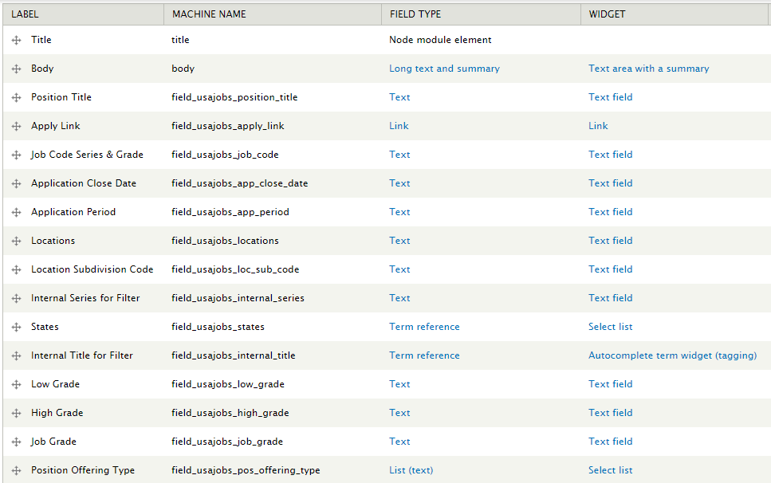
Should Be Something Like:
Notes:
When you are done, you should have something like this.

Slide 12
Setting up Feeds
Find JSON selectors with API tool
Setup JSONPath* parser to grab selected data
Setup the node mapping
Tamper the data before it is stored
* Refer to http://goessner.net/articles/JsonPath/ for a JSONPath reference
Notes:
First thing, if you don’t know feeds, do watch one of the many videos
Make sure set the content type you just created in the Node Processor settings
[Read the flow]
One other quirk, two parsers
BAD JSONPath Parser,
GOOD JSON JSONPath Parser is the one that works

Slide 13
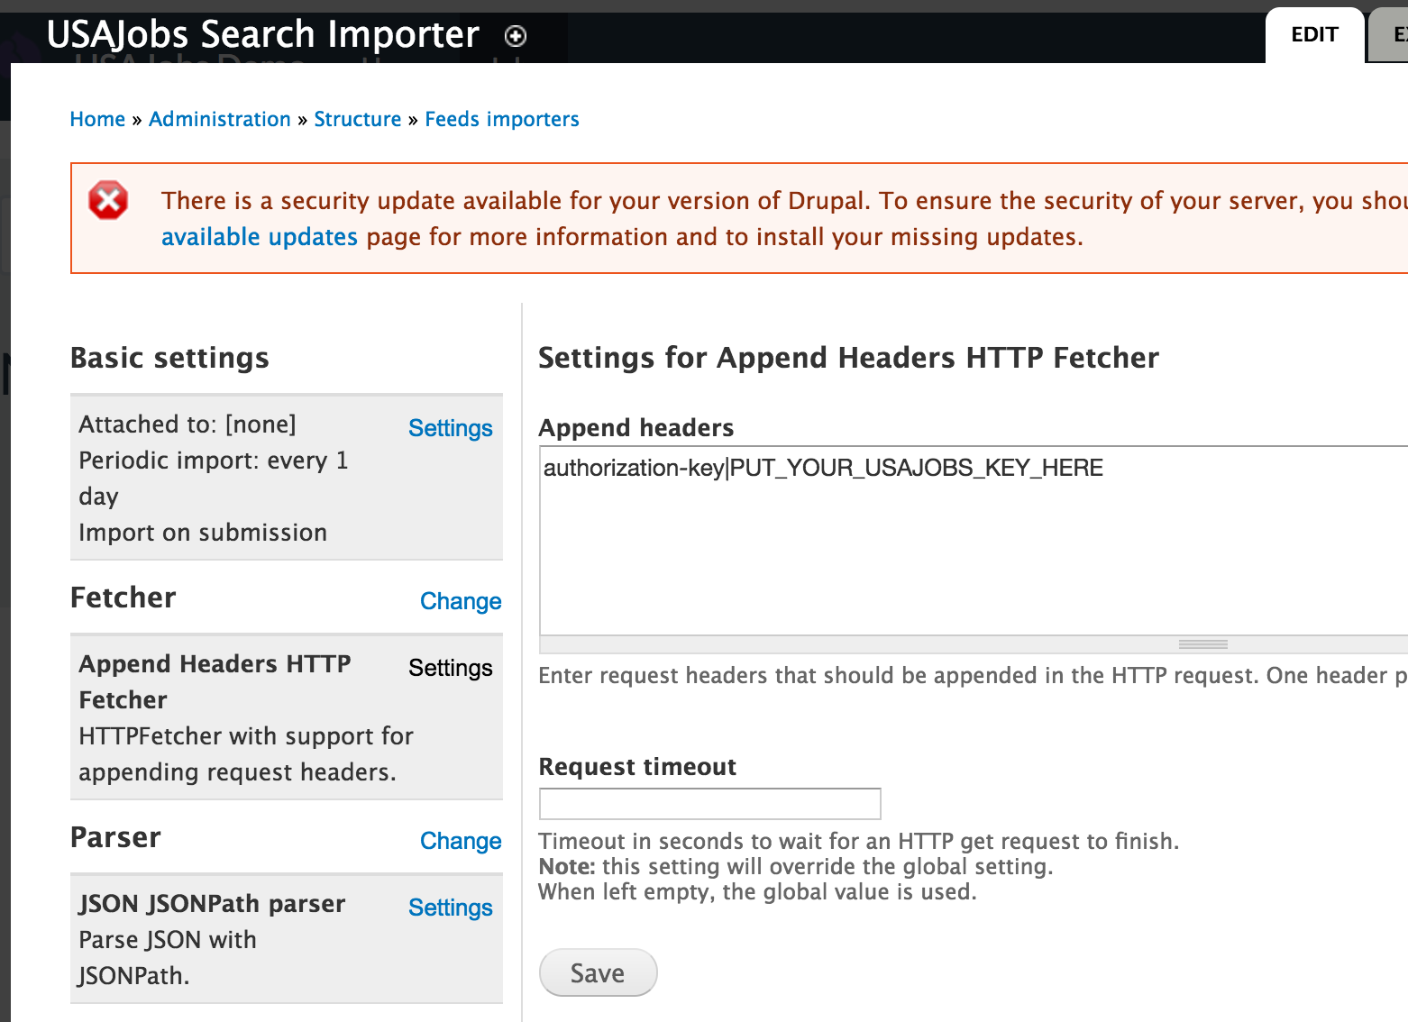
Add Your authorization-key
Notes:
Next major setup step is setting up you authorization-key
Do this in Append Headers HTTP Fetcher settings as shown above
Hit save!

Slide 14
JSONPath Parser
machine_name
“locations”
JSONPath expression
“MatchedObjectDescriptor.
PositionLocation[.CityName]”
Node Mapping
Target field machine_name
“field_usajobs_locations”
Content Type
Source machine_name
“locations”
Field name
“Locations”
Field machine_name
“field_usajobs_locations”
Notes:
Keep in mind that when setting up the parser, mapping and content types that the following items match up between them:
The JSONPath parser machine_name IS the same as the Node Mapping source machine name
The Node Mapping Target field machine_name IS the same as the Content type Field machine_name (it’s a drop-down so you can’t mess it up ☺ )

Slide 15
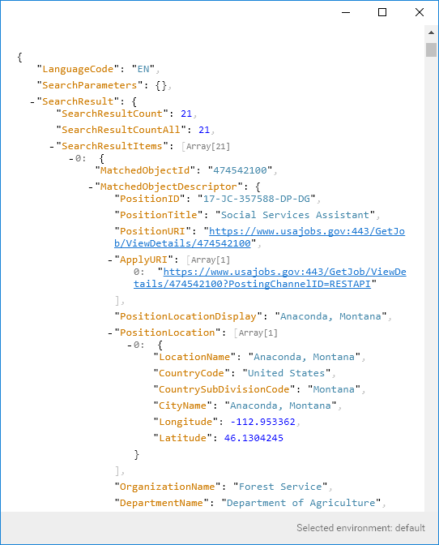
Find the Selectors:
“Context”
$.SearchResult.SearchResultItems.*
Notes:
SO, the first step is find selectors you need in your JSON tool to enter into the JSONPath JSONPath Parser
The parser requires “Context” so it can search into it’s array from there.
You will give it “$.SearchResult.SearchResultItems.*”
$ represents root element
JSONPath is like Xpath except it uses DOT notation rather than slashes
Asterisk is wildcard to say “Everything else we do goes here”

Slide 16
Find the Selectors:
Content Selector
MatchedObjectDescriptor.PositionTitle
Notes:
Next, find a content selector that you will use to populate a field
Dot notation
Always use MatchedObjectDescriptor
If you try to put MatchedObjectDescriptor in context, you get an error
Do this for all selectors

Slide 17
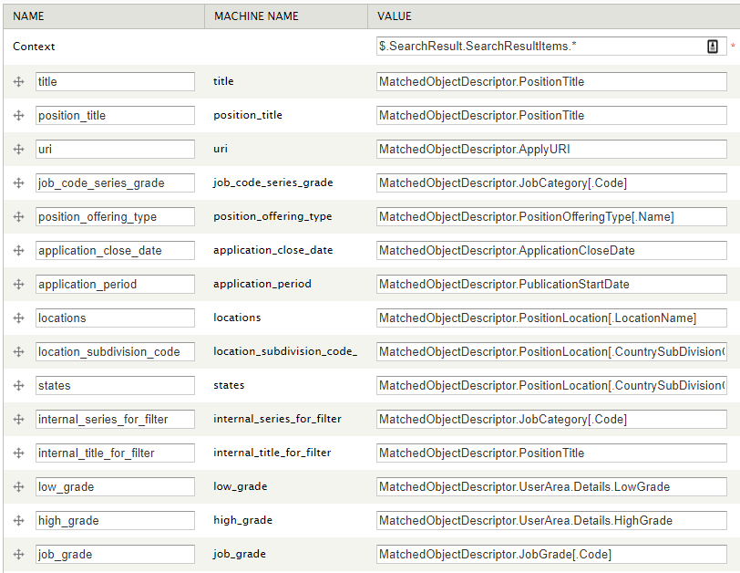
Use Brackets to Iterate Over Arrays, Dots for Objects
^{"PositionOfferingType": [{}
^{"Name": "Permanent",}
^{"Code": "15317"}],}
Notes:
In the end it should look something like this.
SOME TIPS:
Brackets allow you to dig into an array
Dots dig into objects

Slide 18
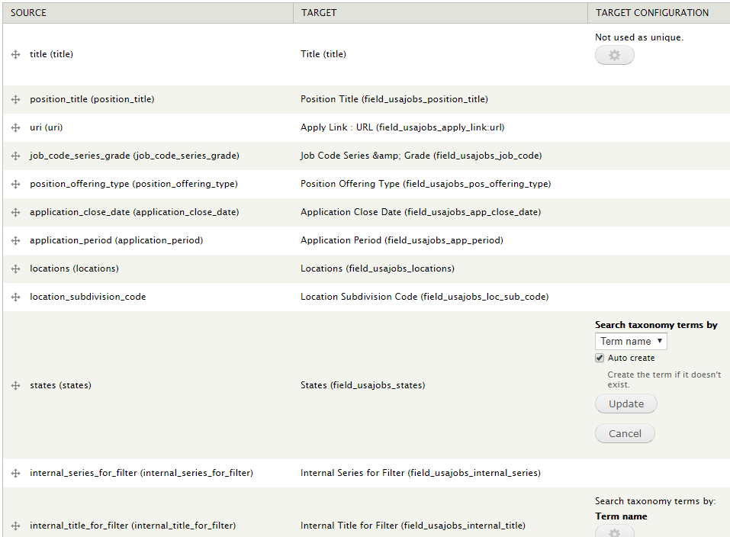
Node
Mapping
Notes:
Node mapping is pretty simple, luckily.
Line up the JSONPath name as Source with the content type field as Target.
Note for the taxonomy fields, you need to go back and edit to have them be “Auto create”

Slide 19
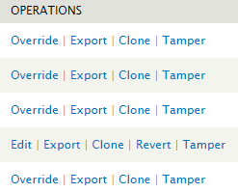
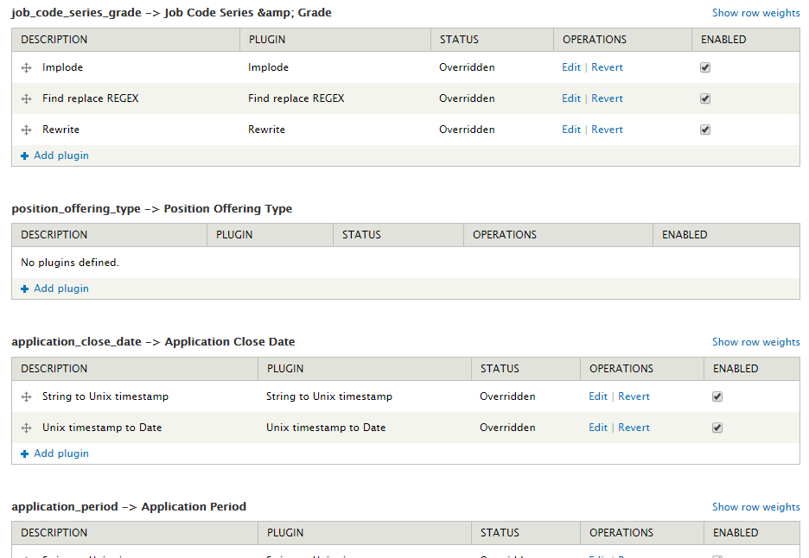
Tamper with that!
Feeds List – See “Tamper”
Tamper UI
Notes:
First thing, you won’t be able to use Tamper until you TURN ON Feeds Tamper UI
Then, go to the list of Feeds at admin -> structure -> feeds and click “Tamper”
Next you will be able to tamper with the content before it’s stored

Slide 20
Tamper with that!
Turn
Turn Unix timestamps into dates Drupal understands
Strtotime + timetodate “n/j/Y”
Rewrite
Rewrite using tokens to customize Code, Grade, and Series
“job_code_series_grade” to “[job_grade]-[job_code_series_grade]-[low_grade]/[high_grade]”
Replace
Change multiple locations into simply “Multiple”
Explode tamper on “,” + REGEX find “/^(.*?)\\|/” and Replace “Multiple”
Convert
Convert state names to abbreviations
Notes:
Tamper lets you change any data that is coming in a variety of ways.
On this project, we use it to convert the time string into the format of date we want
We use the rewrite tamper to combine Job Grade and Series so it displays those two things together like we like to see it
We switch an array of state names into the word “Multiple”
We switch individual state names into abbreviations

Slide 21
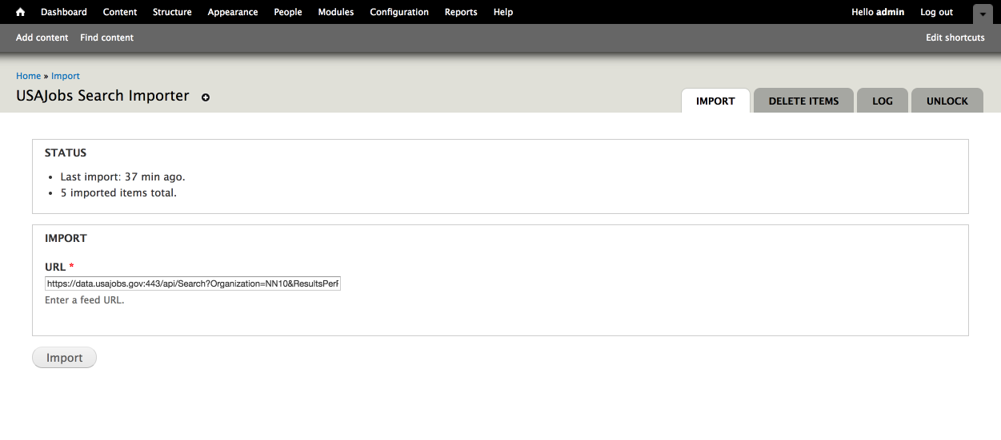
Run the Import
https://data.usajobs.gov:443/api/Search?Organization=NN10&ResultsPerPage=500
Notes:
You are DONE setting up the import!
Go to /import on your site, and enter the URL for the USAJobs API as shown above.
Replace the NN10 in that URL with your Agency code, and hit import.
After this, you will need to run drush search-index or run cron to get the search index to update.
Check “Content” too see you new nodes

Slide 22
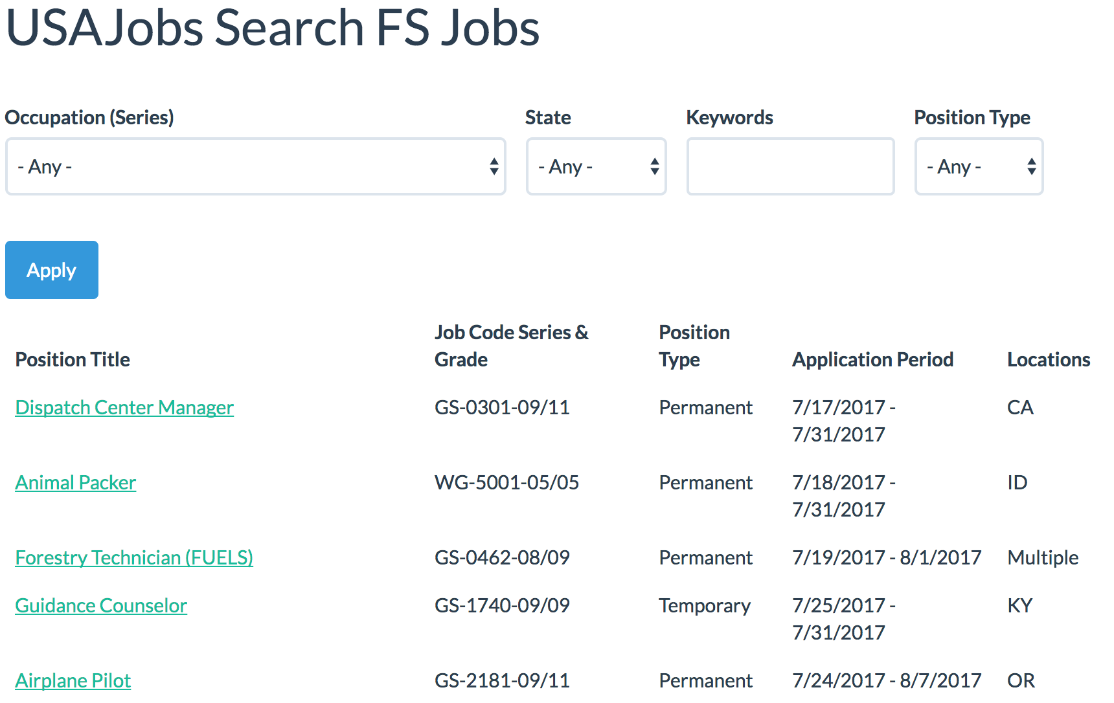
Now show us what you’ve got.
Notes:
Our view is not complicated
Only 5 columns in the table, and 4 filters.
Using views_selective_filters.
Remember how we had duplicate fields for filters – because different display than filter
full state names in filter
Occupation with series number in filter
In the list we are splitting the occupation out into position title, without series,
Series and grade combined.
Beyond that, we just displayed the contents that we had already tampered,
Linking the position title to the actual USAJobs application page for easy access.

Slide 23
That’s It! Questions?
On the session page:
This presentation! Inside of it I am providing a full zip of the entire feature.
A technical document with field mappings and such in .doc format.

