Slide 1


FUTURE-PROOF YOUR CONTENT:
BUILDING YOUR STRUCTURE
FROM THE BOTTOM UP
Presented by
Sara Kieffer-Hess | Booz Allen Hamilton
Glynnis McPhee | Booz Allen Hamilton
Christen Geiler | HHS ASPA DCD
Collaboration space, Alexandria, VA
DRUPAL GOVCON 2017

Slide 2

STRUCTURED CONTENT IS. . .
Content broken into parts and assigned metadata and taxonomy.
Flexible
Reusable
“Future-proof”

Slide 3
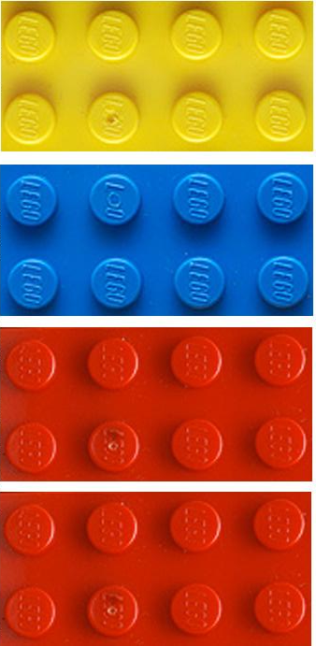
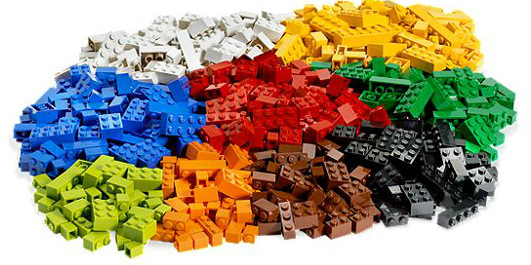
USING TAXONOMIES IN DRUPAL
Taxonomy is a method of classifying or grouping information (size, color, shape etc.)
Taxonomy enables content to be found by users.

Slide 4
STRUCTURED CONTENT = COPE
Create
Once
Publish
Everywhere

Slide 5
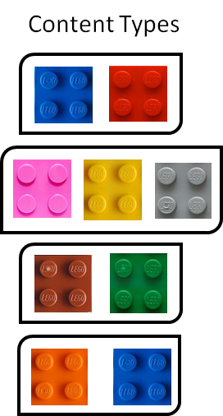




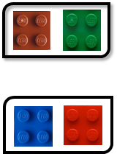
STRUCTURED CONTENT = COPE
Structured content
components
Visual
Display

Slide 6
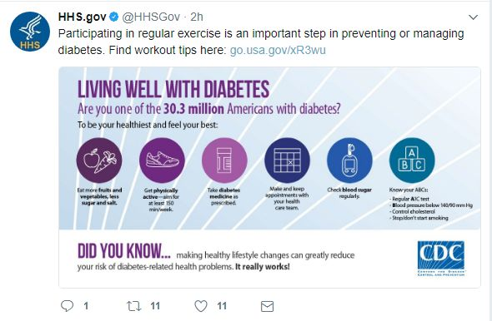
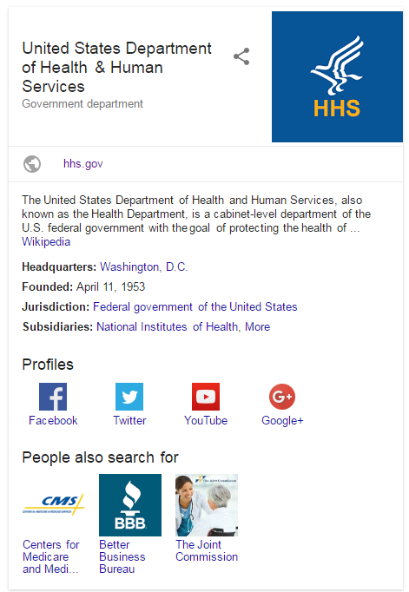

WHAT CAN STRUCTURED CONTENT DO FOR ME?
Social Media
Search Engines
Syndication

Slide 7
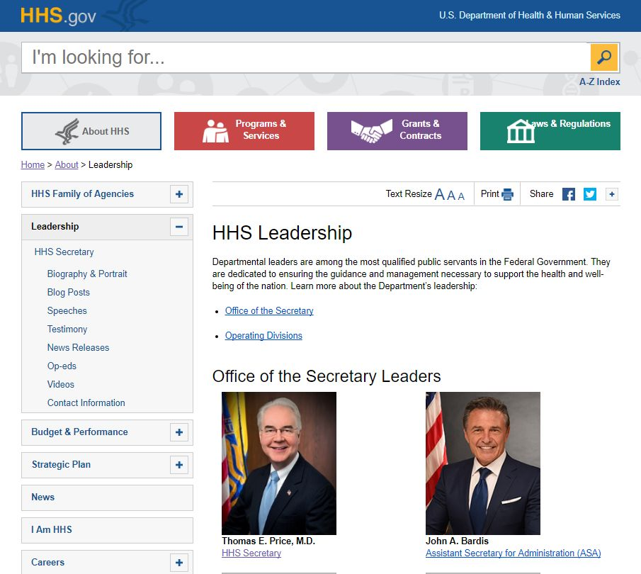
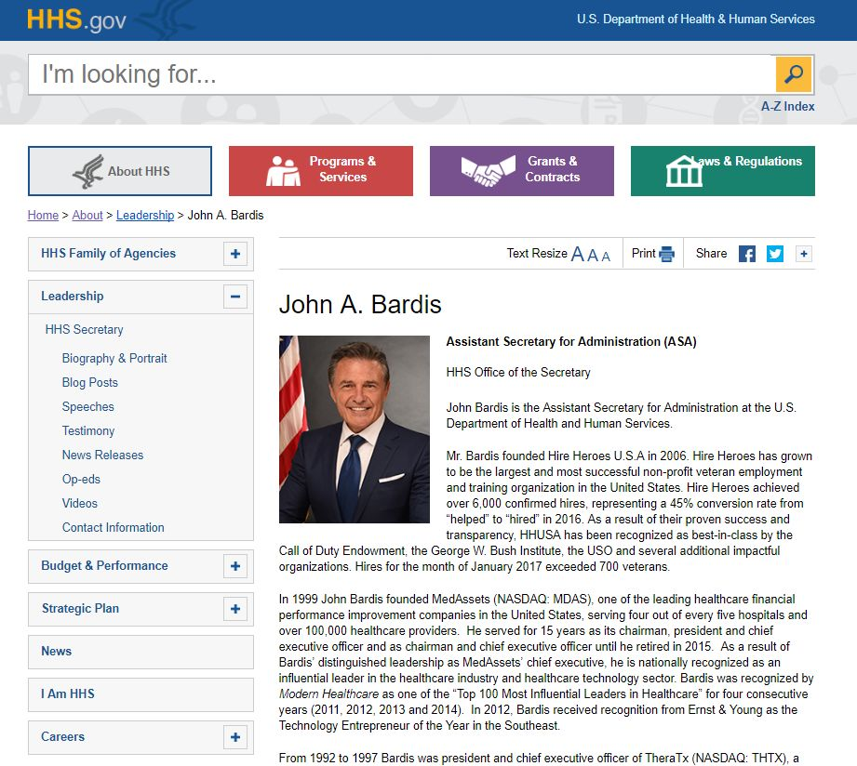
STRUCTURED CONTENT = FLEXIBLE

Slide 8
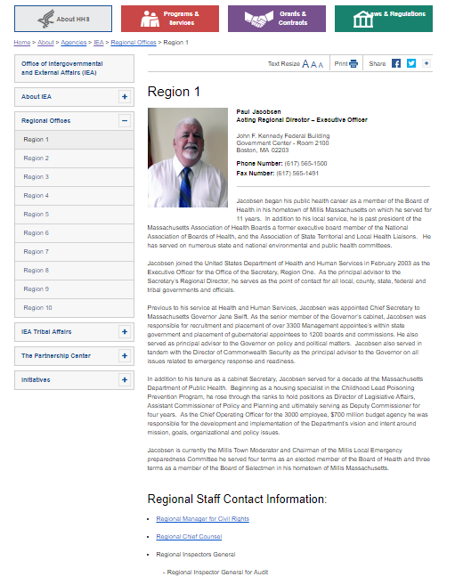
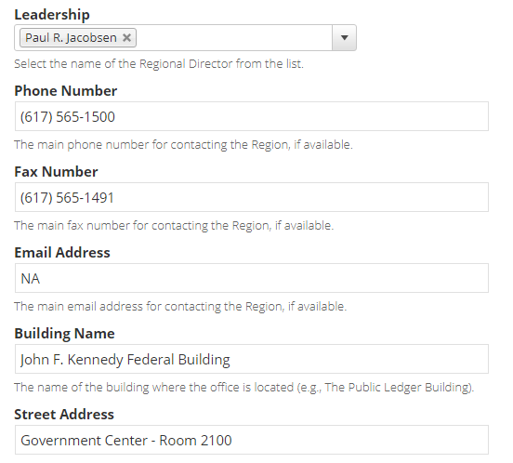
REUSABLE: LEADERSHIP BIO + REGION CONTENT TYPES

Slide 9
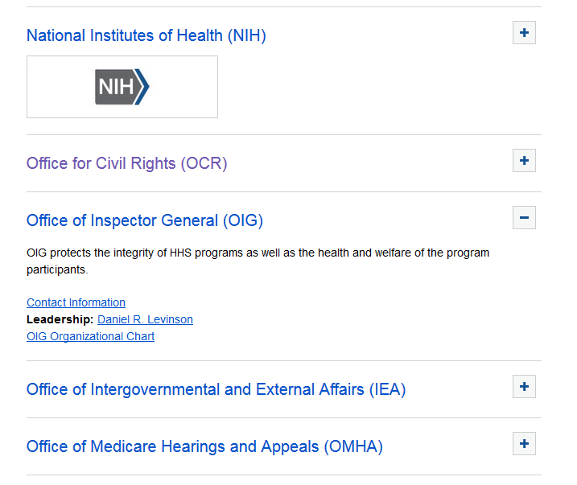
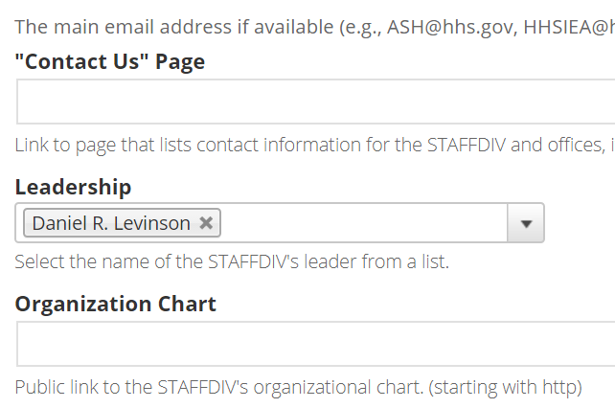
REUSABLE: LEADERSHIP BIO + STAFFDIV & OPDIV

Slide 10
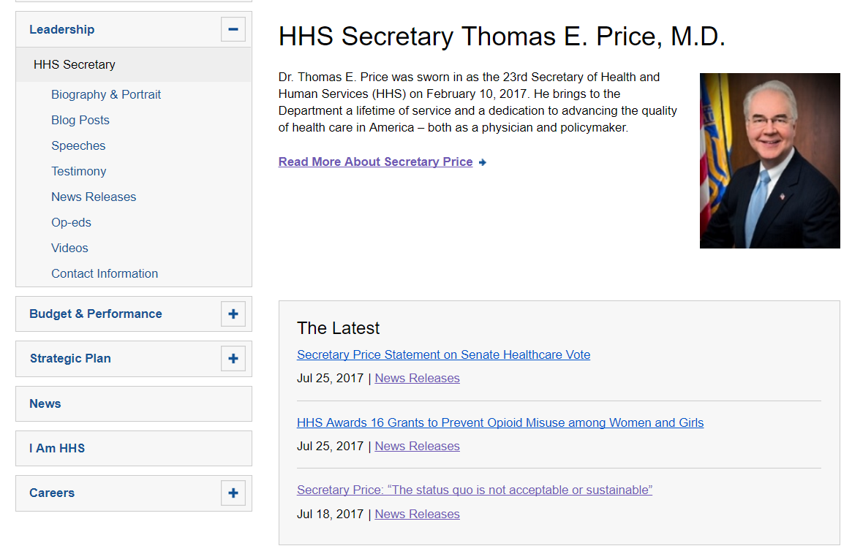
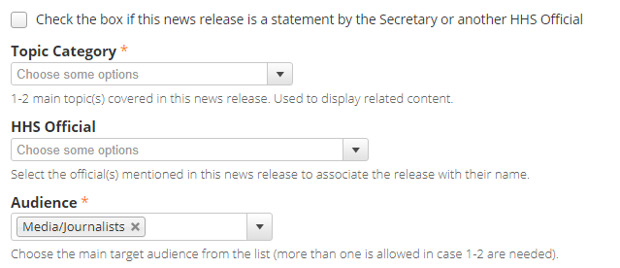
REUSABLE: LEADERSHIP BIO + NEWS RELEASE

Slide 11
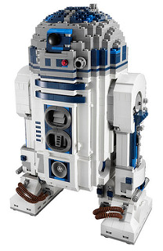

STRUCTURED CONTENT = FUTURE-PROOF
With the proper tagging and metadata, content is always ready for the next:
Content type
Website
Device
Search engine

Slide 12

HOW DO YOU ADD STRUCTURED CONTENT TO YOUR SITE?

Slide 13
CONTENT MODEL

Slide 14
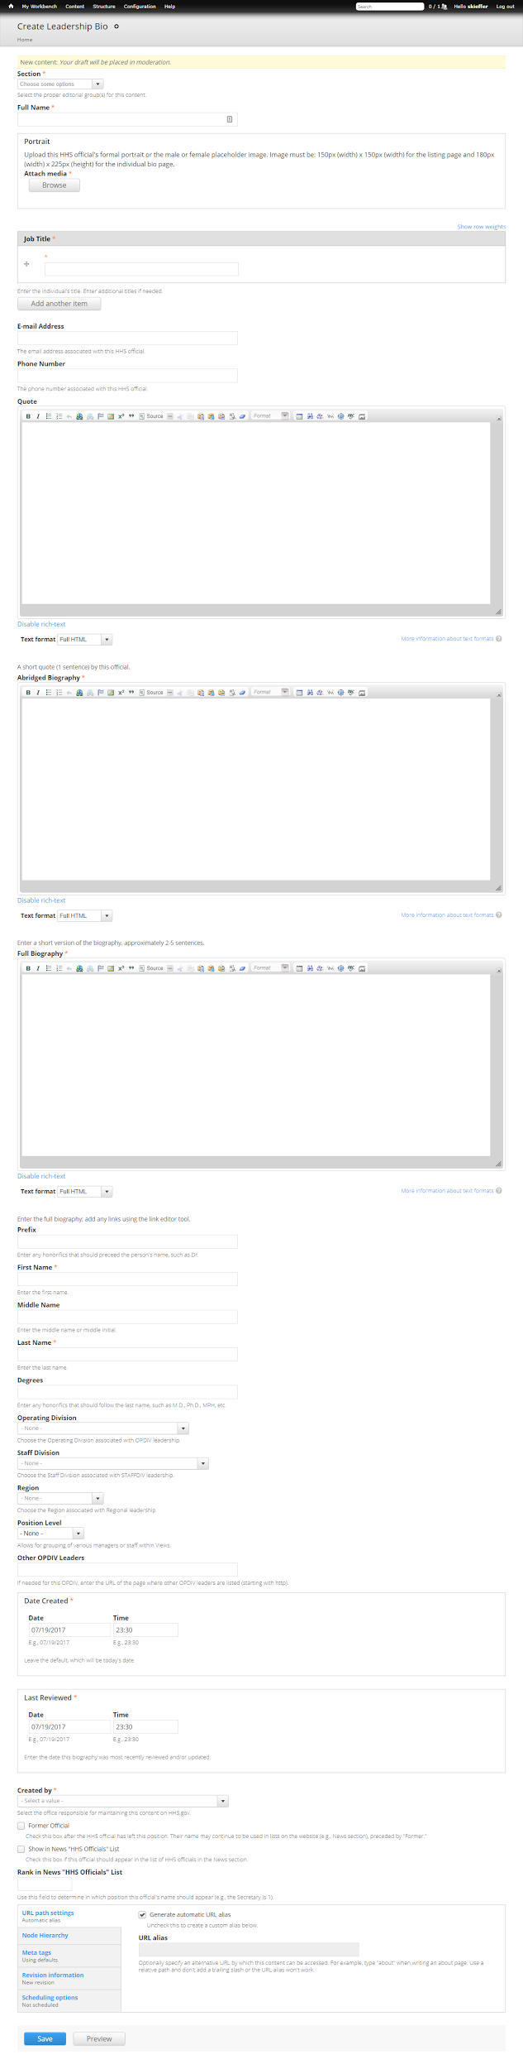
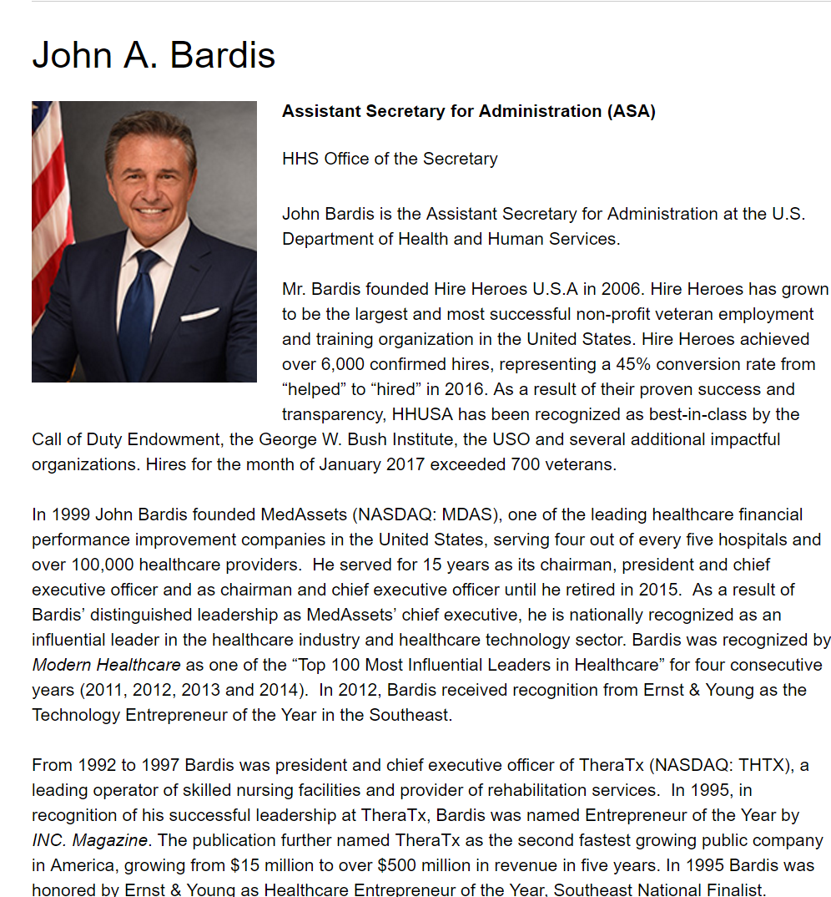
CONTENT TYPE: LEADERSHIP BIO
=

Slide 15
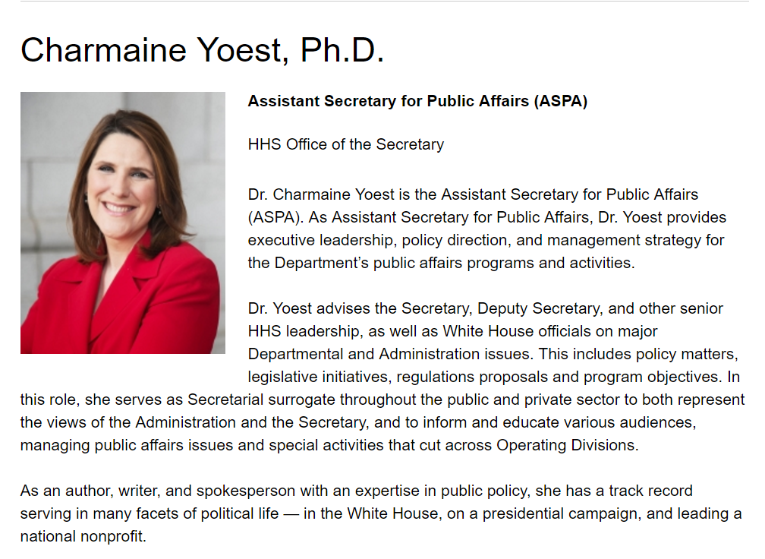

CONTENT TYPE = CONSISTENCY

Slide 16
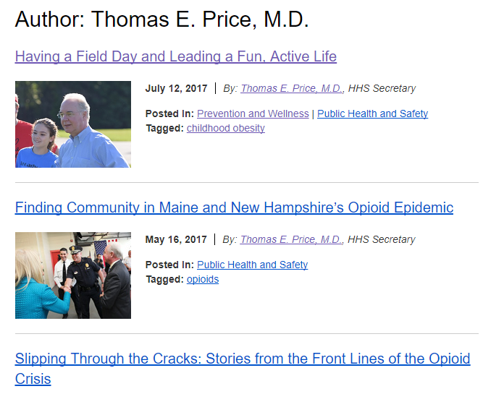
CONTENT TYPE + TAGGING = CONSISTENT AND REUSABLE

Slide 17
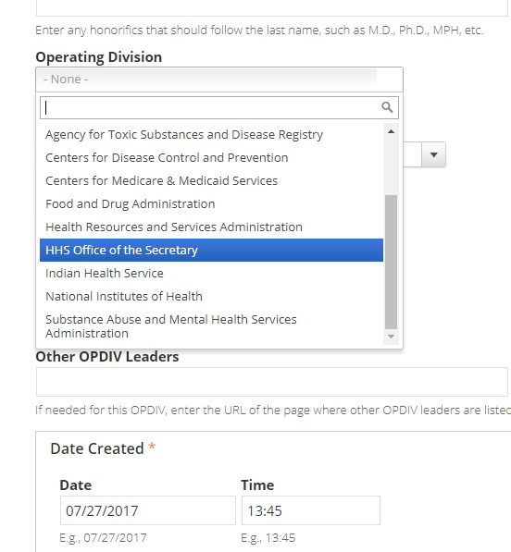
TAGGING + TAXONOMY AND USING VIEWS

Slide 18
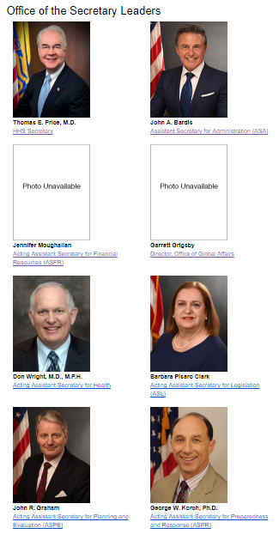
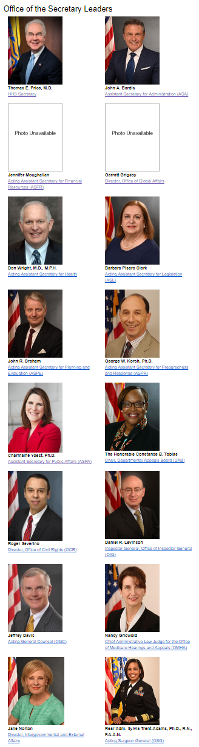
TAGGING + TAXONOMY

Slide 19
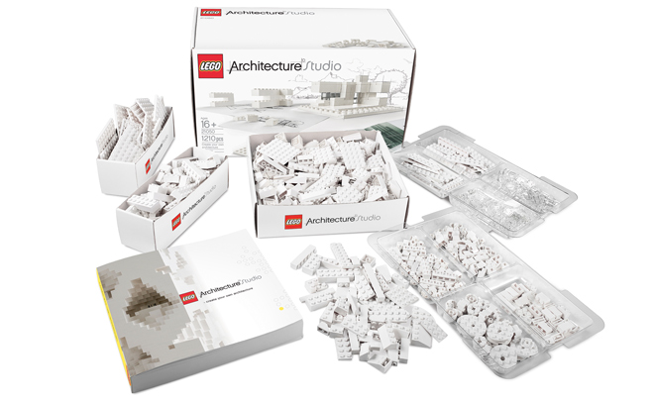
SPEAKING OF TAGS… WHAT ABOUT SCHEMA AND METADATA?
Schema is the instruction manual for metadata.

Slide 20

MICRODATA: W3 SCHOOLS STYLE
<title>HHS.gov</title>
<meta name="description" content="The U.S. Department of Health and Human Services (HHS) protects the health of all Americans and provides essential human services, especially for those least able to help themselves." />
<link rel="canonical" href="http://www.hhs.gov/" />
<link rel="shortlink" href="http://www.hhs.gov/" />
<link rel="publisher" href="https://plus.google.com/+HHS" />
<meta http-equiv="content-language" content="en" />

Slide 21

MICRODATA: DUBLIN CORE STYLE
<meta name="dcterms.title" content="HHS.gov" />
<meta name="dcterms.creator" content="U.S. Department of Health and Human Services" />
<meta name="dcterms.description" content="The U.S. Department of Health and Human Services (HHS) protects the health of all Americans and provides essential human services, especially for those least able to help themselves." />
<meta name="dcterms.publisher" content="HHS.gov" />
<meta name="dcterms.type" content="Text" />
<meta name="dcterms.identifier" content="http://www.hhs.gov/" />
<meta name="dcterms.format" content="text/html" />
<meta name="dcterms.language" content="en" />

Slide 22

MICRODATA: OPEN GRAPH STYLE
<meta property="og:type" content="website" />
<meta property="og:site_name" content="HHS.gov" />
<meta property="og:url" content="http://www.hhs.gov/" />
<meta property="og:title" content="HHS.gov" />
<meta property="og:description" content="The U.S. Department of Health and Human Services (HHS) protects the health of all Americans and provides essential human services, especially for those least able to help themselves." />

Slide 23

MICRODATA: TWITTER
<meta name="twitter:card" content="summary" />
<meta name="twitter:site:id" content="44783853" />
<meta name="twitter:site" content="@HHSgov" />
<meta name="twitter:url" content="https://www.hhs.gov/" />
<meta name="twitter:title" content="HHS.gov" />
<meta name="twitter:description" content="The U.S. Department of Health and Human Services (HHS) protects the health of all Americans and provides essential human services, especially for those least able to help themselves." />

Slide 24
HOW DO THEY DIFFER?
Drupal field | Schema | Dublin core | Open graph | twitter
Title | title | dcterms.title | og:description | meta name=”twitter:title”
Description | meta name=”description” | dcterms.description | og:description | meta name=” twitter:description”

Slide 25

THE FUTURE OF METADATA: JSON-LD
{
"@context": "https://schema.org",
"@type": "Person",
"disambiguatingDescription": "Assistant Secretary for Administration (ASA)",
"image": "https:\/\/www.hhs.gov\/sites\/default\/files\/john-bardis.jpg",
"name": "John A. Bardis",
"sameAs": "https://www.hhs.gov/about/leadership/john-a-bardis/index.html",
"url": "https:\/\/www.hhs.gov\/about\/leadership\/john-a-bardis\/index.html"
}

Slide 26

JSON-LD VS. HTML
<script type="application/ld+json">
{
"@context": "http://schema.org/",
"@type": "Article",
"name": "JSON-LD's Big Day at Google"
}
</script>
<!DOCTYPE html>
<html lang="en">
<head>
<title>JSON-LD's Big Day at Google</title>
</head>
<body>
<div itemscope itemtype="http://schema.org/Article">
<h1 itemprop="name">JSON-LD's Big Day at Google</h1>
</div>
</body>
</html>

Slide 27
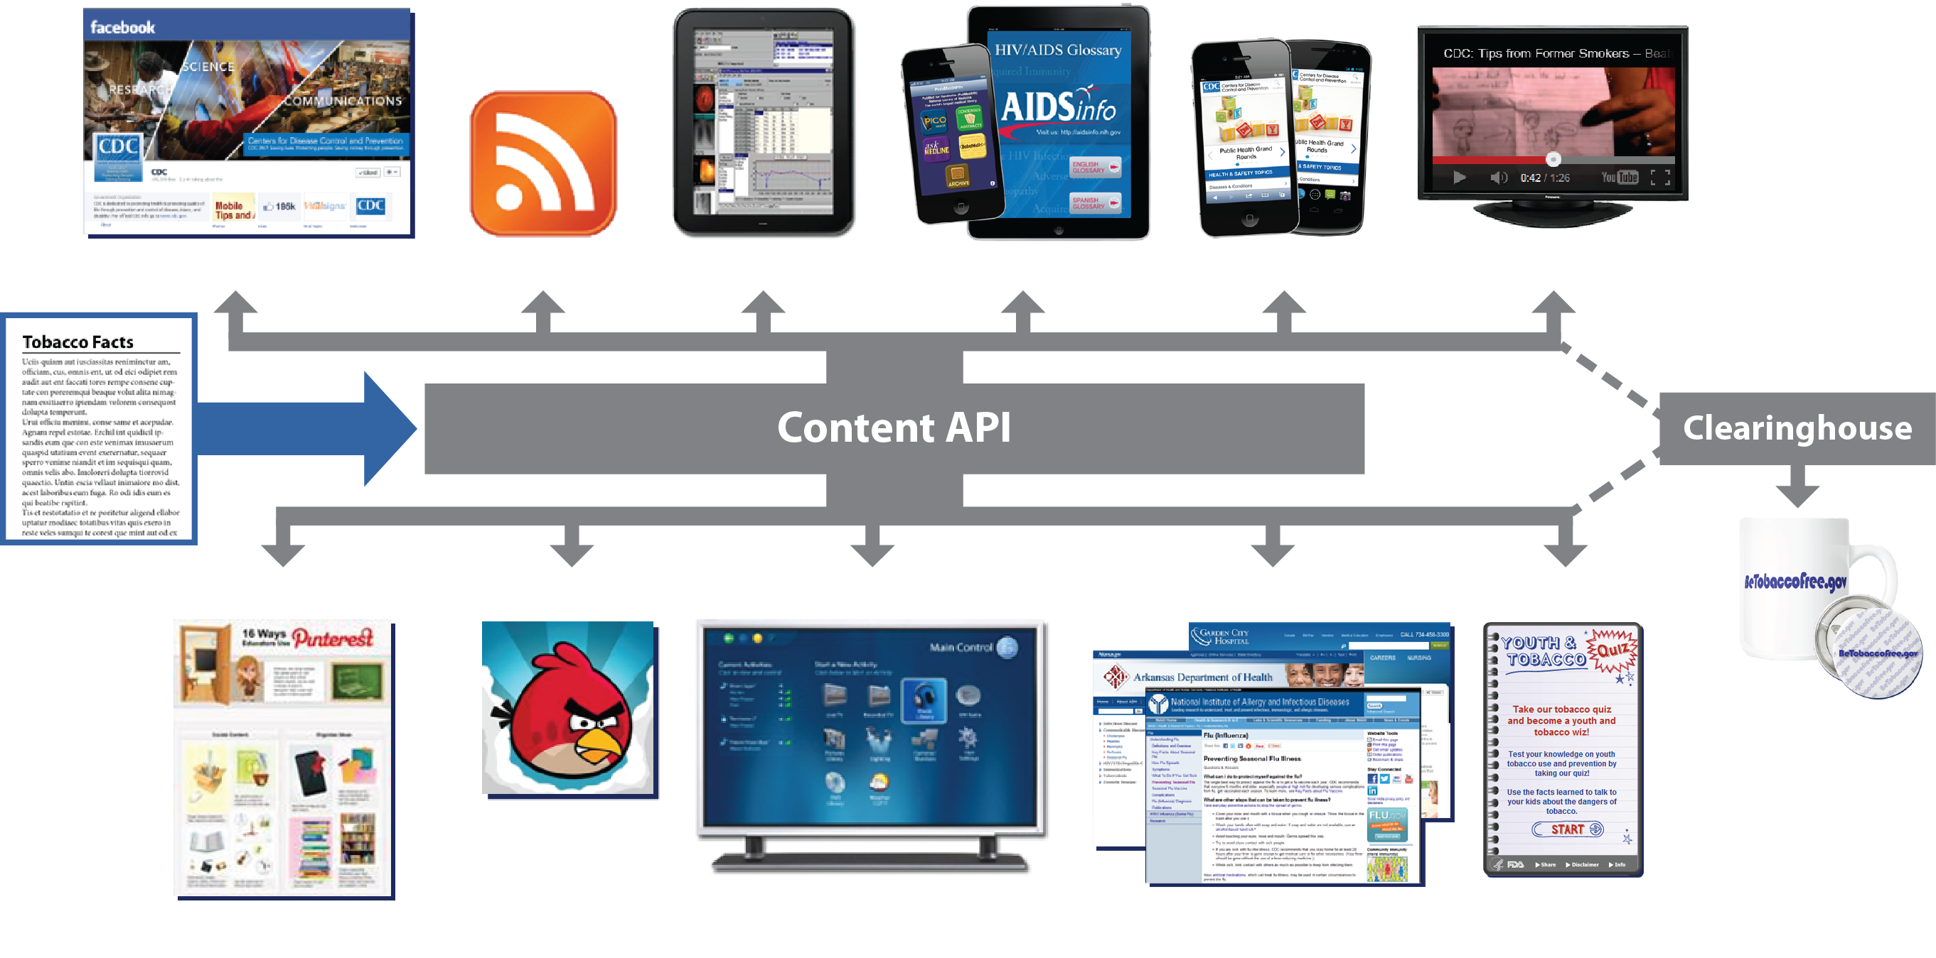
TAGGING > CONTENT SYNDICATION
If you can’t name it, you can’t find it. ~ Seth Earley

Slide 28
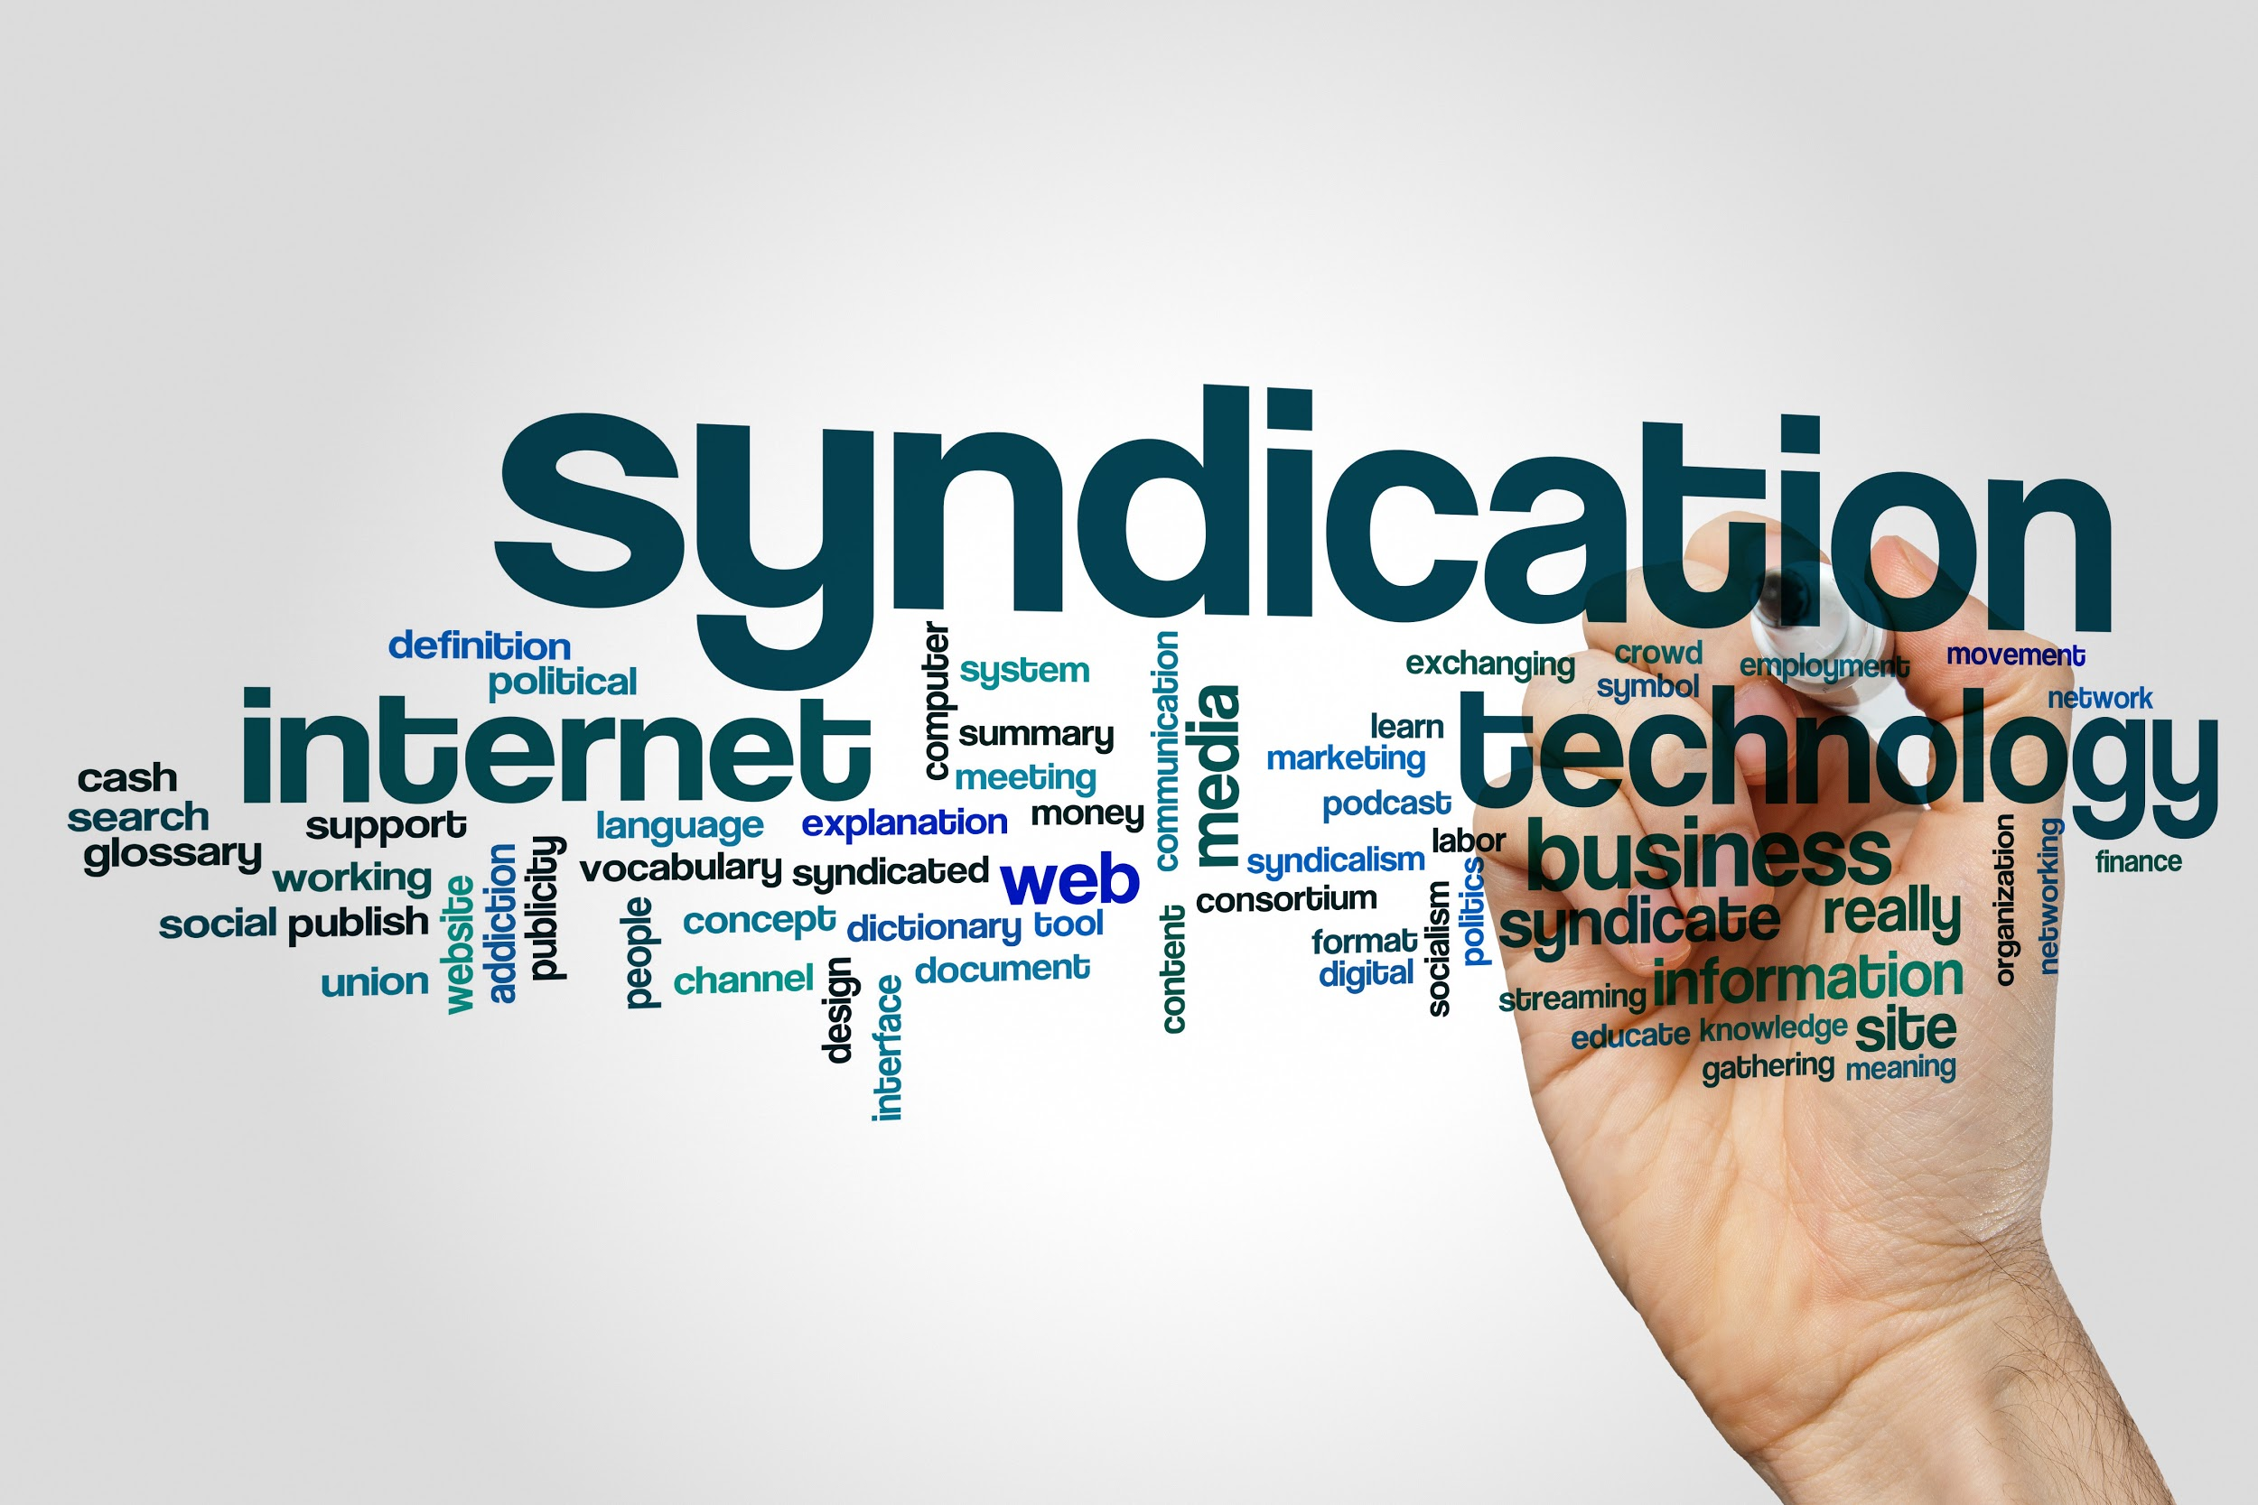
HHS SYNDICATION
Content Syndication allows consumers to place content from HHS web sites onto their own sites. The content can be in the form of web content, images, video, media players, or even a microsite.
HHS Syndication Storefront
https://digitalmedia.hhs.gov/

Slide 29

HHS SYNDICATION BENEFITS
The syndicated content is automatically updated in real time, requiring no effort from your staff to keep the pages up to date.
The service gives consumers more content to work with, while at the same time allowing their staff to focus efforts on local high priority areas.
Content Reuse: Leverage interagency content to reduce overhead and streamline content channels
Audience Retention: Retain and grow audiences based on content

Slide 30
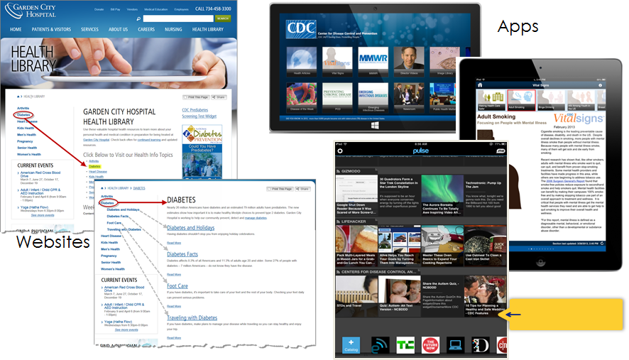
Content Goes Where Your Audiences Are

Slide 31
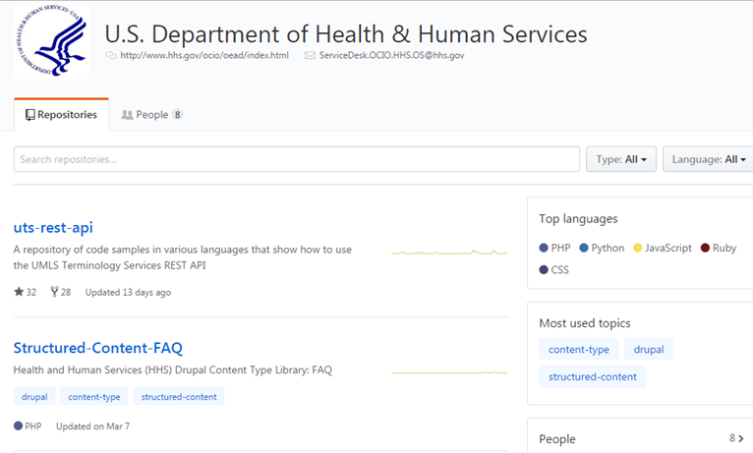
HHS GITHUB = CONTENT TYPES + DRUPAL FEATURES
HHS currently has over 30 models—and the list continues to grow as the site advances. In an effort to promote collaboration and help others utilize content models, HHS is sharing some of their content models via GitHub.

Slide 32

HHS GITHUB = CONTENT TYPES + DRUPAL FEATURES
Some of the models being offered include:
Article
FAQ
Announcements
News Release
Leadership Bio
Internal & External Blog Post

Slide 33
FAQ Content Model

Slide 34
Drupal Features
A feature is a collection of Drupal configurations that are intentionally grouped together to facilitate a particular use case. These configurations can be used for content type declarations, views, module settings, and roles and permissions, among other things.

Slide 35


SUMMARY
      UNSTRUCTURED CONTENT
        Everything is Awful!
Trapped in its current display
No identity
Has no future
      STRUCTURED CONTENT
        Everything is Awesome!
Reusable & Flexible
Future-proof
Search Engine friendly

Slide 36

QUESTIONS?

Slide 37


ADDITIONAL RESOURCES
HHS GitHub repository: https://github.com/HHS
HHS Syndication Storefront: https://syndication.hhs.gov/
HHS Offers Free Content Models and Drupal Features:
https://www.digitalgov.gov/2017/04/07/hhs-offers-free-content-models-and-drupal-features/
Information Architecture vs Content Strategy—and Why YOU Need Both: https://www.digitalgov.gov/2016/07/18/information-architecture-vs-content-strategy-and-why-you-need-both/
HHS Teams with Healthline.com to Serve Consumers: https://www.linkedin.com/pulse/hhs-teams-healthlinecom-serve-consumers-christen-geiler
JSON-LD's Big Day at Google: http://www.seoskeptic.com/json-ld-big-day-at-google/
Booz Allen’s Drupal.org Profile: https://www.drupal.org/booz-allen-hamilton
Join the Conversation…
…And Come Visit Our Booth!

Slide 38
FOR MORE INFORMATION…
Today’s Speakers – Please visit our booth for further Q&A:
Glynnis McPhee, Associate, Digital Strategist, McPhee_Glynnis@bah.com
Sara Kieffer-Hess, Lead Associate, Content Strategist, Kieffer-Hess_Sara@bah.com
Christen Geiler, Management and Program Analyst, HHS ASPA DCD, Christen.Geiler@hhs.gov
Please contact Booz Allen’s Strategic Innovation Group for more information on our Drupal practice:
Arash Farazdaghi, Solution Architect, Farazdaghi_Arash@bah.com
Eric Robbins, Solution Architect, Robbins_Eric@bah.com
Craig Warsaw, Principal Solution Architect, Warsaw_Craig@bah.com
Join the Conversation…
…And Come Visit Our Booth!

