Slide 1
Migration Migraine
Drupal GovCon
July 25, 2019

Slide 2
Introduction
Jeff Greenberg ( j. ayen green )
Senior Software Architect
Drupaler since D6 launch

Slide 3
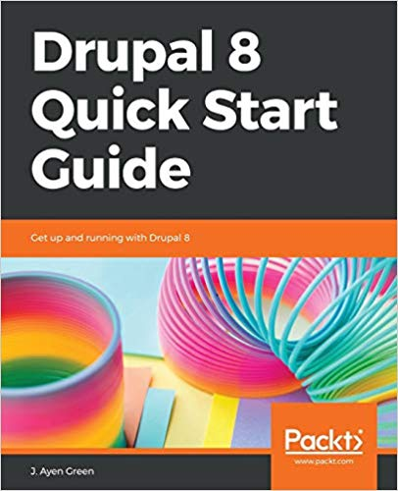
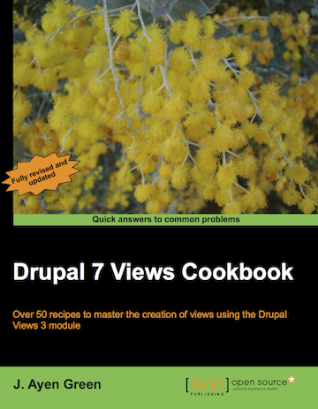
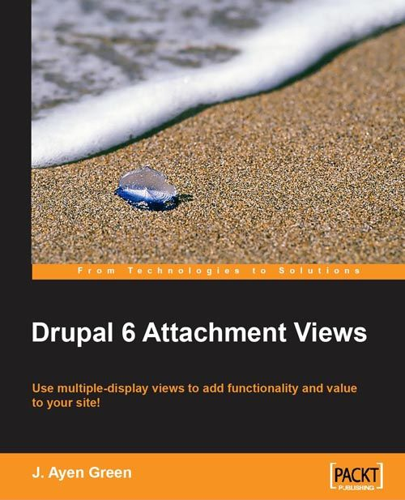
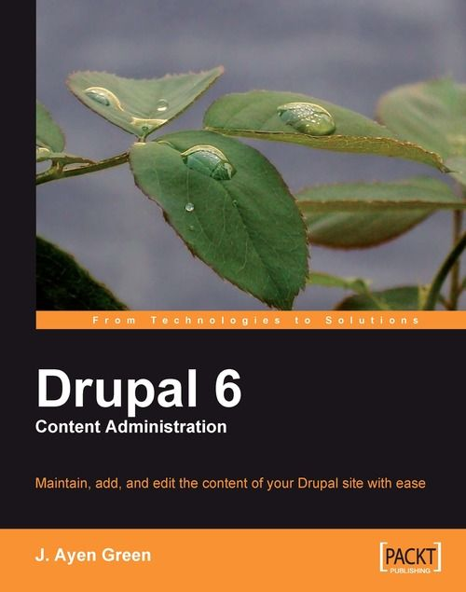
Introduction
Drupal writer (as J. Ayen Green)
Books Blog D.O Column
API Docs Team

Slide 4
mī grāSH(ə)n mī grān
n. The throbbing sensation behind each temple experienced when daring to attempt migrating content from a content management system.

Slide 5
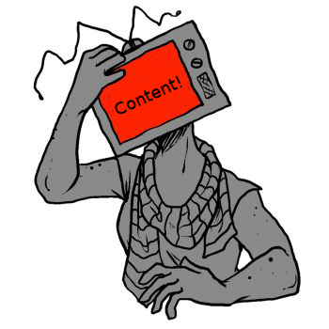
The leading cause of Migration Migraine…

Slide 6
Content – why?
Notes:
JOKE
END: most contributed functionality deals with the storage, retrieval and presentation of content

Slide 7
Content - how?
Modules that have been migrated but function differently or not at all
Modules that have gone from contrib to core with no migration path
Content types with field types or complexities that defy migration
Notes:
END: Content is the most difficult thing to migrate in a CMS. How easy would it be to migrate if there were no content

Slide 8
SLAM DUNK!
Migrating a D7 Article to a D8 Article

Slide 9
SLAM!
Migrating 35 Views
Notes:
Runner – hitting the wall – experience breeds analogy

Slide 10
3 headaches encountered
Recap of the intended migration
Description of the issue encountered
Considerations
Approach
Code (Bird’s-eye view)
Demo
Notes:
Balancing act case study/code/demo

Slide 11
1. Location Frustration
Intent – migrate a content type containing a location field
Issue – Location module has not yet been ported
Considerations
a single portable field structure, akin to the Location field type, for the entirety of the data
the migration should still be achievable in one pass

Slide 12
1. Location Frustration
Approach
Address module
Migration process plugin
Script
xxxx
xxxx
Location
xxxx
Plugin
Location
Address

Slide 13
2. Body Double
Intent – migrate content from D7 into the D8 Article content type
Issue – the D7 content type uses a text field distinct from the body field for the summary text. Both were to be merged into the D8 body.
Consideration
The handling of the body field in migrations is such that it expects and only allows a single source to be identified
‘d8_body/value’: d7_body
‘d8_body/summary’: d7_field
‘d8_body/value’: d7_body.value
‘d8_body/summary’: d7_field.value

Slide 14
Script
xxxx
xxxx
xxxx
2. Body Double
Approach
Override default migration
Hook_migrate_prepare_row()
body
body
summary

Slide 15
3. E Pluribus Unum
Intent – migrate video meta from D7
Issue –The D8 Media module video portion wasn’t available yet
Consideration
The meta should be kept in a single compound field
A marrying of a caption file and video

Slide 16
3. E Puribus Unum
Plugin
Field properties
Field storage
Approach
Create a field-type plugin
Populate the sub-fields in a migration script
Field Type
Field Widget
Add/Edit form
Field Formatter
Theming
Migration Script
‘my_destination/subfield_name’: xxx

Slide 17
At Bixal, we are inspired by the promise and potential of the world that surrounds us. We love getting the inside view on organizational challenges and coming up with bold, innovative ways to solve them.
Digital Communications (Strategic Communications, Content Strategy & Marketing)
Technology (Digital Transformation, Software Development, Maintenance & Operations)
Notes:
What is Migration Migraine?

Slide 18
Become a Bixaler!
Bixal currently has several Drupal Developer, IT and Data related roles available.
In the event that you’re interested in working with us:
Email talent@bixal.com
Visit our website www.bixal.com/careers

Slide 19
Thank You!
Jeff.Greenberg@bixal.com
@accidentalcoder
jeffrgreenberg
The code can be found at https://github.com/JAyenGreen/migration_migraine

