Slide 1
How to give feedback while keeping your head
Danielle Sheffler
Lead Technical Project Manager
Drupal govcon – July 26th, 2019

Slide 2
agenda
What is radical candor?
What it isn’t
characteristics of radical candor
Putting it into practice

Slide 3
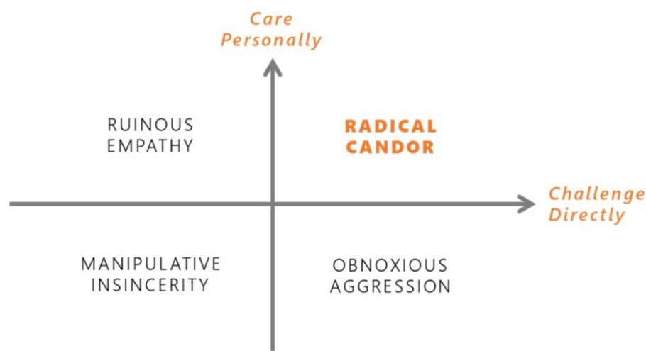
Radical candor
Notes:
Radical candor – putting care personally (not just business) and challenge directly together. Being kind, sincere, direct. Most people want to avoid conflict. Need to learn to not leave the door open/have anything open for interpretation. Benefits – more motivation, take more risks, care enough about person to help with strengths and weaknesses, can admit when you’re wrong and fix mistakes. Less likely to get angry because they know someone cares.

Slide 4
What it isn’t
Notes:
Not to be mean, direct, etc Don’t have to be in management to use techniques

Slide 5
Obnoxious aggression
Notes:
Looking down on people, frontstabbing, belittiling compliments

Slide 6
Manipulative insincerity
Notes:
Don’t care enough about people to challenge directly. Example is falsely apologizing.

Slide 7
Ruinous empathy
Notes:
Making the person feel better instead of asking for continued good work or giving criticism. Also harder to ask for criticism.

Slide 8
Putting the pieces together
Notes:
Example of business dinner May need to determine what radical candor means for your team/department/organization

Slide 9
Radical candor on projects
Listen
Clarify
Debate
Decide
Persuade
Execute
Learn
Rinse and repeat
Notes:
Listen – step up, step back, create a culture of how team will listen to one another
Clarify – be ok with not having a fully developed idea, use the right language for the right people
Debate – care about the ideas, not the egos. Also think about team culture. Don’t end the debate based on frustration.
Decide – manager doesn’t have to be the decision maker, should be people with the best info, increase morale
Persuade – think about team’s emotions, “show your work”
Execute – Team should execute on solution together
Learn – admit when you have an ugly baby

Slide 10
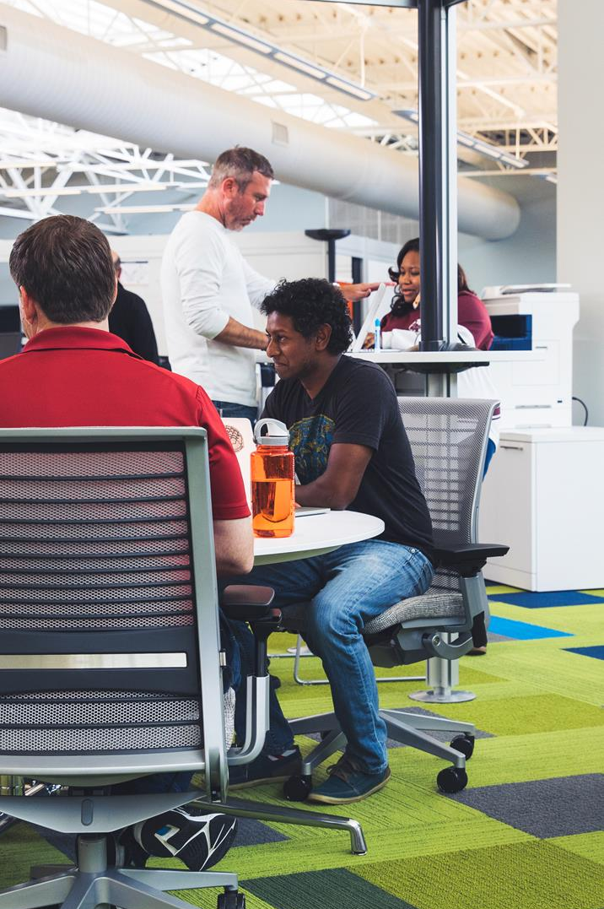
Putting it into practice

Slide 11
relationships
Practice self-care
Empower others on the team
Bond with your teammates
Determine your personal brand/values
Be open to differences

Slide 12
Praise and criticism
Ask for criticism
Repeat what you heard
Say thank you when receiving criticism
Giving criticism - immediately
Situation you saw
Behavior
Impact you observed
Praise in public, criticize in private
Avoid backstabbing
Notes:
Ask for criticism – is there anything I could do or stop doing that would make it easier to work with me?
Don’t get defensive

Slide 13
Gsd – get stuff done
1:1s
Step away from your desk
Direct report sets the agenda
Use the time to get feedback/criticism
Follow up questions
Daily scrum
Sprint Retrospectives
Status Meetings

Slide 14
Questions?
@DSheffler
Sheffler_Danielle@bah.com

